Slide 1

6:1-21

Slide 2
6:1-21
SPECIAL SABBATH EDITION
Jerusalem Dispatch
LOCAL JUDEA NEGEV SPORTS GALILEE WEATHER LIVING STYLE CLASSIFIEDS OBITUARTY PERSONALS
WETLANDS TRAMPLED IN LABOR STRIKE
Pursuing Environmentalists Killed
HATE CRIME KILLS BELOVED CHAMPION
Psychologist Questions Influence of Rocks on Youth
FIRE SENDS RELIGIOUS RIGHT EXTREMIST INTO FRENZY
400 Killed in Riot

Slide 3
6:1-21
SPECIAL SABBATH EDITION
Bethlehem Bee
LOCAL JUDEA NEGEV SPORTS GALILEE WEATHER LIVING STYLE CLASSIFIEDS OBITUARTY PERSONALS
HOTELS FULL, ANIMALS LEFT HOMELESS
Animal Rights Activists Enraged by Insensitive Couple
FUNDAMENTALIST PREACHER RAISES A STINK
Will Reading to be Delayed
PREACHER STEALS CHILD'S LUNCH
Disciples Mystified Over Behavior

Slide 4

6:1-21

Slide 5
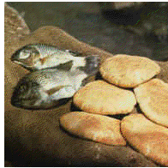
6:1-21
Matt. 14:13–21
Mark 6:31–44
Luke 9:11–17

Slide 6
6:1-21

Slide 7
6:1-21
Luke 9:13: "You give them something to eat"

Slide 8
6:1-21

Slide 9
6:1-21
Parable of the Talents (Matt. 25:14-30)

Slide 10
6:1-21

Slide 11
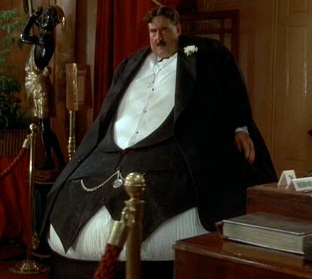
6:1-21
Filled ~ empiplēmi – glutted

Slide 12
6:1-21

Slide 13
6:1-21
Baskets ~ kophinos – like a knapsack

Slide 14
6:1-21

Slide 15
6:1-21
Mark 6:48 ~ Then He saw them straining at rowing, for the wind was against them. Now about the fourth watch of the night He came to them, walking on the sea, and would have passed them by.

Slide 16
6:1-21

Slide 17
6:1-21
Matt. 14:28-33

Slide 18
6:1-21

