Slide 1
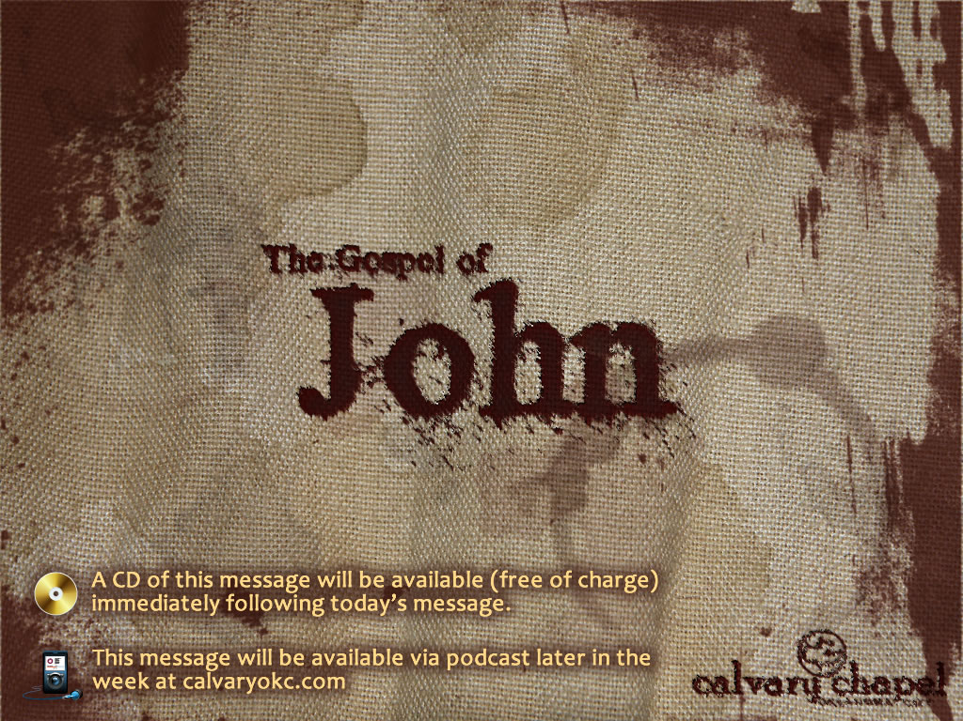
5:24-47

Slide 2
5:24-47
Eph. 2:1 ~ And you He made alive, who were dead in trespasses and sins,

Slide 3
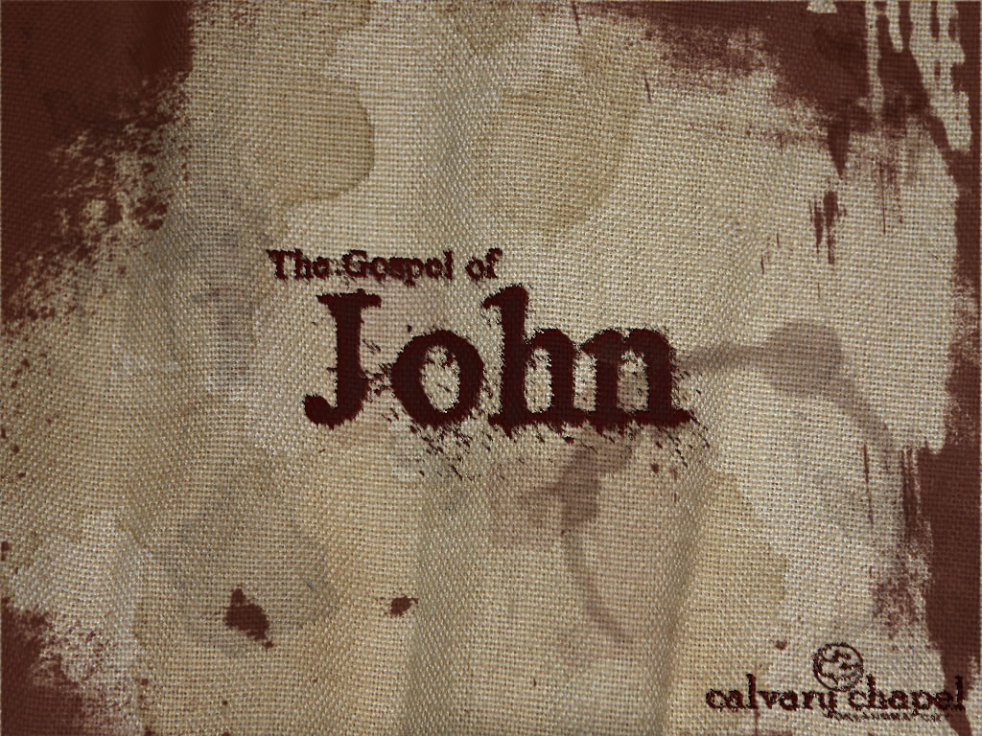
5:24-47

Slide 4
5:24-47
John 6:28-29 ~ ²⁸ Then they said to Him, "What shall we do, that we may work the works of God?"
²⁹ Jesus answered and said to them, "This is the work of God, that you believe in Him whom He sent."

Slide 5
5:24-47

Slide 6
5:24-47
1 Thess. 4:13-18 ~ ¹³ But I do not want you to be ignorant, brethren, concerning those who have fallen asleep, lest you sorrow as others who have no hope. ¹⁴ For if we believe that Jesus died and rose again, even so God will bring with Him those who sleep in Jesus.
¹⁵ For this we say to you by the word of the Lord, that we who are alive and remain until the coming of the Lord will by no means precede those who are asleep. ¹⁶ For the Lord Himself will descend from heaven with a shout, with the voice of an archangel, and with the trumpet of God. And the dead in Christ will rise first. ¹⁷ Then we who are alive and remain shall be caught up together with them in the clouds to meet the Lord in the air. And thus we shall always be with the Lord. ¹⁸ Therefore comfort one another with these words.

Slide 7
5:24-47

Slide 8
5:24-47
1 Cor. 15:51-56 ~ ⁵¹ Behold, I tell you a mystery: We shall not all sleep, but we shall all be changed— ⁵² in a moment, in the twinkling of an eye, at the last trumpet. For the trumpet will sound, and the dead will be raised incorruptible, and we shall be changed. ⁵³ For this corruptible must put on incorruption, and this mortal must put on immortality. ⁵⁴ So when this corruptible has put on incorruption, and this mortal has put on immortality, then shall be brought to pass the saying that is written: “Death is swallowed up in victory.”
⁵⁵ “O Death, where is your sting?
O Hades, where is your victory?”

Slide 9
5:24-47

Slide 10
5:24-47
Matt. 16:18 ~ And I also say to you that you are Peter, and on this rock I will build My church, and the gates of Hades shall not prevail against it.
Hell is not hadēs, Gehenna is

Slide 11
5:24-47

Slide 12
5:24-47
3 Judgments:
Bēma Judgment
1 Cor. 3:11-15 ~ ¹¹ For no other foundation can anyone lay than that which is laid, which is Jesus Christ. ¹² Now if anyone builds on this foundation with gold, silver, precious stones, wood, hay, straw, ¹³ each one’s work will become clear; for the Day will declare it, because it will be revealed by fire; and the fire will test each one’s work, of what sort it is. ¹⁴ If anyone’s work which he has built on it endures, he will receive a reward. ¹⁵ If anyone’s work is burned, he will suffer loss; but he himself will be saved, yet so as through fire.
2 Cor. 5:10 ~ For we must all appear before the judgment seat of Christ, that each one may receive the things done in the body, according to what he has done, whether good or bad.

Slide 13
5:24-47
3 Judgments:
Judgment of the Nation (sheep and goats)
Matt. 25:31-36 ~ ³¹ “When the Son of Man comes in His glory, and all the holy angels with Him, then He will sit on the throne of His glory. ³² All the nations will be gathered before Him, and He will separate them one from another, as a shepherd divides his sheep from the goats. ³³ And He will set the sheep on His right hand, but the goats on the left. ³⁴ Then the King will say to those on His right hand, ‘Come, you blessed of My Father, inherit the kingdom prepared for you from the foundation of the world: ³⁵ for I was hungry and you gave Me food; I was thirsty and you gave Me drink; I was a stranger and you took Me in; ³⁶ I was naked and you clothed Me; I was sick and you visited Me; I was in prison and you came to Me.’

Slide 14
5:24-47
3 Judgments:
Great White Throne Judgment
Rev. 20:11-15 ~ ¹¹ Then I saw a great white throne and Him who sat on it, from whose face the earth and the heaven fled away. And there was found no place for them. ¹² And I saw the dead, small and great, standing before God, and books were opened. And another book was opened, which is the Book of Life. And the dead were judged according to their works, by the things which were written in the books. ¹³ The sea gave up the dead who were in it, and Death and Hades delivered up the dead who were in them. And they were judged, each one according to his works. ¹⁴ Then Death and Hades were cast into the lake of fire. This is the second death. ¹⁵ And anyone not found written in the Book of Life was cast into the lake of fire.

Slide 15
5:24-47

Slide 16
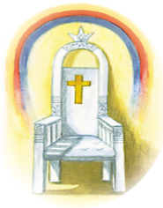

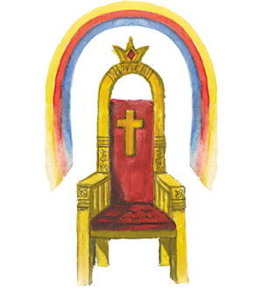


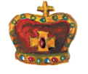
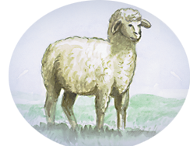
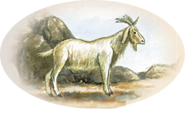

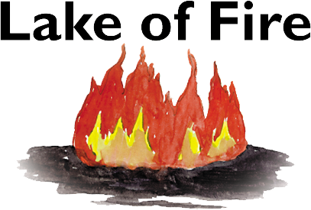
5:24-47
Great White Throne
Bema Judgment
Sheep/Goats Judgment
Rapture
7 yrs
1000 yrs

Slide 17
5:24-47

Slide 18
5:24-47
Jesus' three witnesses:
1st Witness: John the Baptist
2nd Witness: Jesus' miracles
3rd Witness: The Father
Through the Old Testament prophecies

Slide 19
5:24-47

