Slide 1
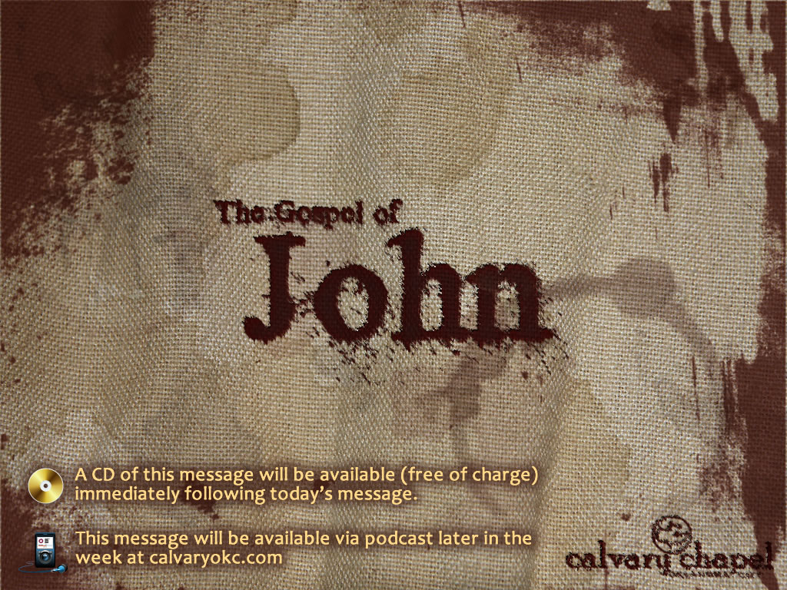
4:1-24

Slide 2
4:1-24
In chapter 3, He met a respected religious teacher at night
In chapter 4, rejected woman of the night at sundown

Slide 3
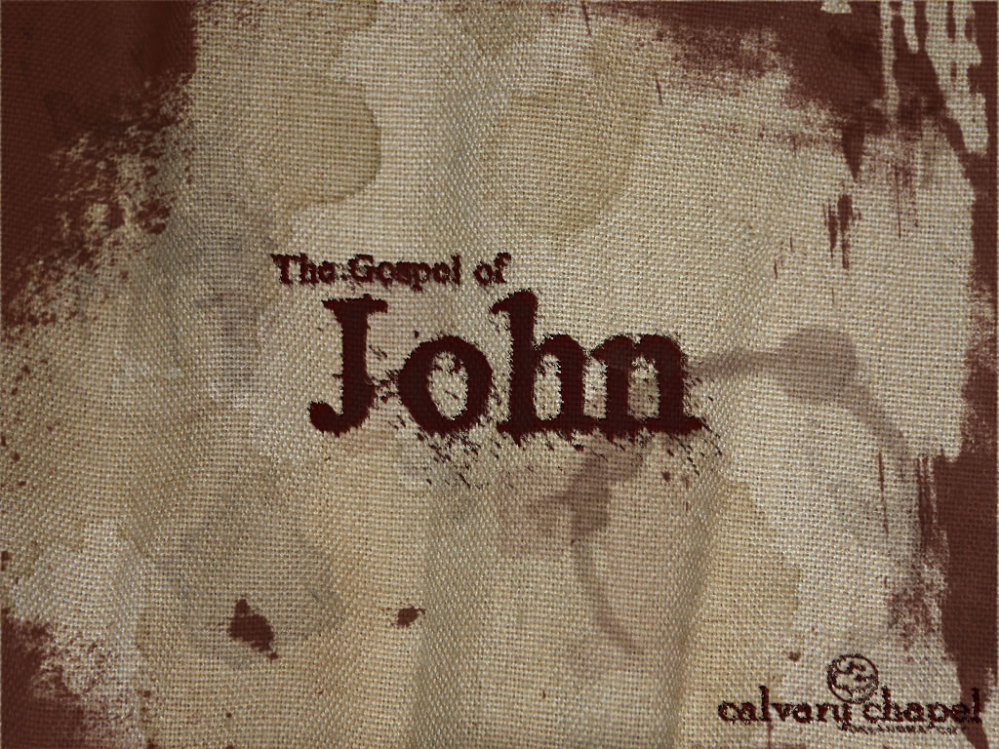
4:1-24

Slide 4
4:1-24
Needed ~ dei – KJV, must needs
4th of 10x in John

Slide 5
4:1-24

Slide 6
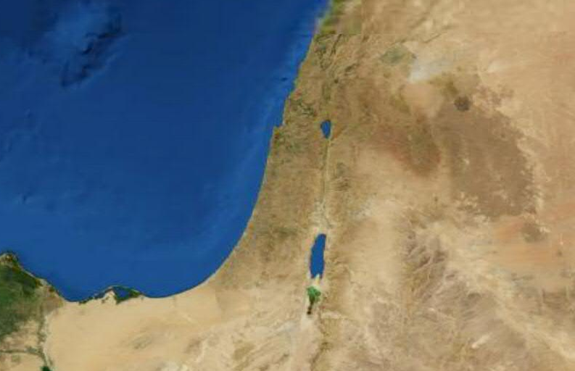
4:1-24
Sychar
Jerusalem
From a Hebrew word (shekar) for “an intoxicating drink”

Slide 7
4:1-24

Slide 8
4:1-24
Sixth hour:
Noon (Jewish time)
6:00 p.m. (Roman time)

Slide 9
4:1-24

Slide 10
4:1-24
Is. 55:1-9 ~ ¹ “Ho! Everyone who thirsts,
Come to the waters;
And you who have no money,
Come, buy and eat.
Yes, come, buy wine and milk
Without money and without price.
² Why do you spend money for what is not bread,
And your wages for what does not satisfy?
Listen carefully to Me, and eat what is good,
And let your soul delight itself in abundance.
³ Incline your ear, and come to Me.
Hear, and your soul shall live;
And I will make an everlasting covenant with you—
The sure mercies of David.
⁴ Indeed I have given him as a witness to the people,
A leader and commander for the people.
⁵ Surely you shall call a nation you do not know,
And nations who do not know you shall run to you,
Because of the Lord your God,
And the Holy One of Israel;
For He has glorified you.”
⁶ Seek the Lord while He may be found,
Call upon Him while He is near.
⁷ Let the wicked forsake his way,
And the unrighteous man his thoughts;
Let him return to the Lord,
And He will have mercy on him;
And to our God,
For He will abundantly pardon.
⁸ “For My thoughts are not your thoughts,
Nor are your ways My ways,” says the Lord.
⁹ “For as the heavens are higher than the earth,
So are My ways higher than your ways,
And My thoughts than your thoughts.

Slide 11
4:1-24

Slide 12
4:1-24
A Jew (v. 9)
Sir (. 11)
A prophet (v. 19)

Slide 13
4:1-24

Slide 14
4:1-24
“It is only when men begin to worship that they begin to grow” (Calvin Coolidge)
“More spiritual progress can be made in one short moment of speechless silence in the awesome presence of God than in years of mere study” (A. W. Tozer)
“Most middle-class Americans tend to worship their work, to work at their play, and to play at their worship” (Gordon Dahl)

Slide 15
4:1-24

