Slide 1
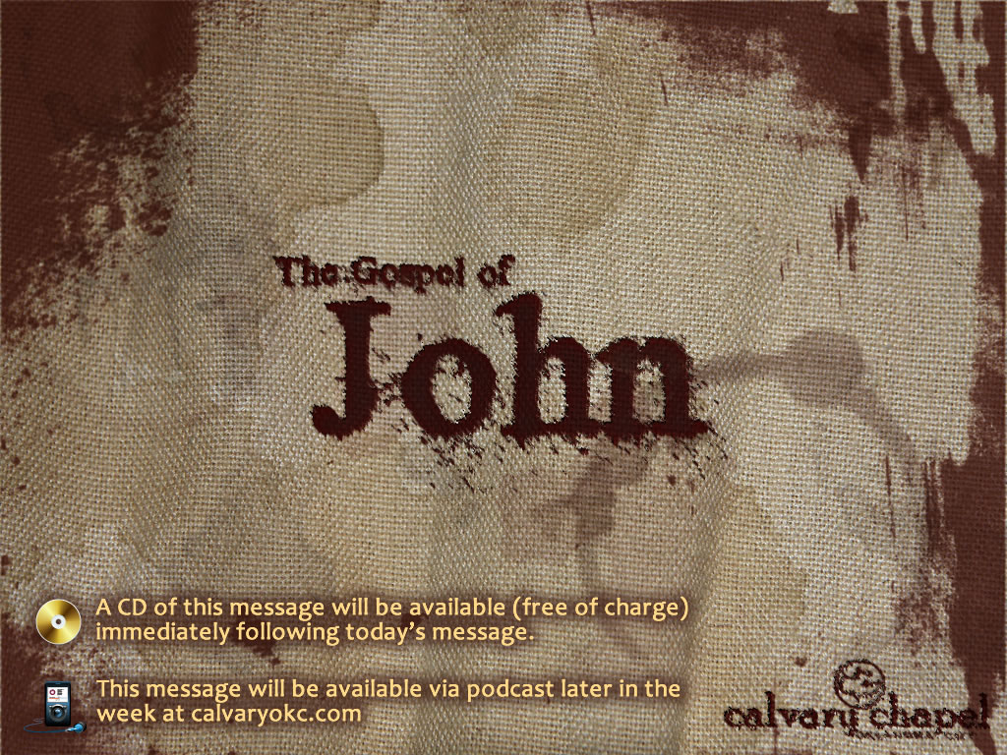
3:1-21

Slide 2
3:1-21
BORN ONCE – DIE TWICE
BORN TWICE – DIE ONCE

Slide 3
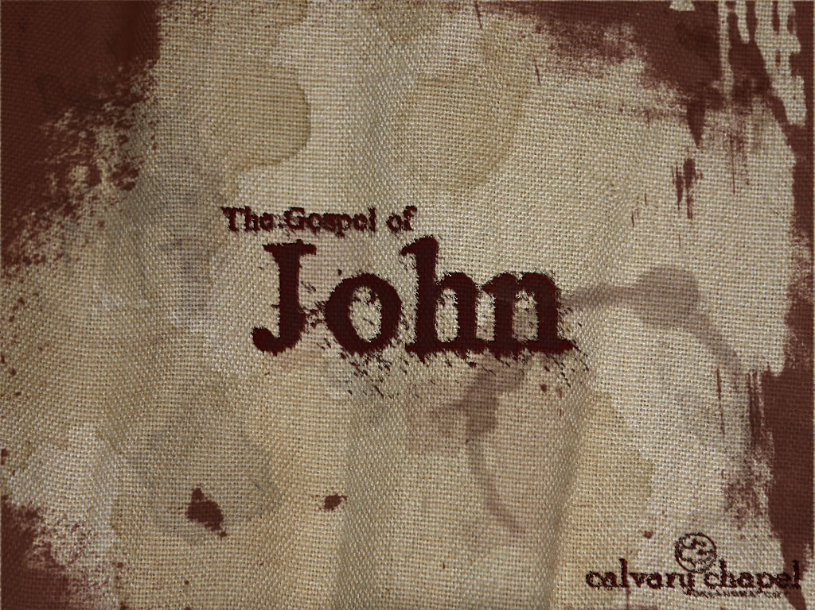
3:1-21

Slide 4
3:1-21
Things Not to Say During Childbirth:
"Gosh, you're lucky. I sure wish men could experience the miracle of childbirth."
"That was the kids on the phone. Did you have anything planned for dinner?"
"Do you think the baby will come before Monday Night Football starts?"
"You don't need an epidural. Just relax and enjoy the moment."
"I hope you're ready. The Glamour Shots photographer will be here in fifteen minutes."
"This whole experience kind of reminds me of an episode from I Love Lucy."
"If you think this hurts, I should tell you about the time I twisted my ankle playing basketball."
"Stop your swearing and just breathe."
"Remember what we learned in Lamaze class! HEE HEE HOO HOO. You're not using the right words."

Slide 5
3:1-21

Slide 6
3:1-21
Believed ~ pisteuō – trust in, rely on, cling to
Commit ~ pisteuō

Slide 7
3:1-21

Slide 8
3:1-21
But, de, not translated

Slide 9
3:1-21

Slide 10
3:1-21
Rabbi ~ from Hebrew rab – meaning great

Slide 11
3:1-21

Slide 12
3:1-21
He was
God who came to teach
not a teacher sent from God

Slide 13
3:1-21

Slide 14
3:1-21
Most assuredly ~ amēn, amēn – Hebraism inferring absolute truth
See ~ eidō – to perceive
Born again ~ anōthen – again or from above
Anagennaō – born again
1 Pet. 1:23 ~ having been born again, not of corruptible seed but incorruptible, through the word of God which lives and abides forever …

Slide 15
3:1-21

Slide 16
3:1-21
Rom. 8:7 ~ The carnal (sarx) mind is enmity against God

Slide 17
3:1-21

Slide 18
3:1-21
Is. 64:6 ~ But we are all like an unclean thing, And all our righteousnesses are like filthy rags; We all fade as a leaf, And our iniquities, like the wind, Have taken us away.

Slide 19
3:1-21

Slide 20
3:1-21
Must ~ dei – it is necessary

Slide 21
3:1-21

Slide 22
3:1-21
Ruach (Heb.), Pneuma (Gr.)
= wind, breath or spirit

Slide 23
3:1-21

Slide 24
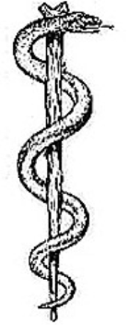
3:1-21
Rod of Aesclepius
Cross of Jesus

Slide 25
3:1-21

