Slide 1
2:11-25

Slide 2
2:11-25
Following are instructions on the best way to bathe your cat:
1. Thoroughly clean the toilet.
5. Flush the toilet 3 or 4 times. This provides a "power wash and rinse" which I have found to be quite effective.
2. Add the required amount of shampoo to the toilet water, and have both lids lifted.
6. Have someone open the door to the outside and ensure that there are no people between the toilet and the outside door.
3. Obtain the cat and soothe him while you carry him towards the bathroom.
7. Stand behind the toilet as far as you can, and quickly lift both lids.
4. In one smooth movement, put the cat in the toilet and close both lids (you may need to stand on the lid so that he cannot escape). CAUTION: Don't get any part of your body too close to the edge, as his paws will be reaching out to grab anything they can find. The cat will self-agitate and make ample suds. Never mind the noises that come from your toilet, the cat is actually enjoying this.
8. The now-clean cat will rocket out of the toilet and run outside where he will dry himself.
Sincerely,
The Dawg

Slide 3
2:11-25

Slide 4
2:11-25
3 mandatory feasts of Leviticus 23:
Passover
Pentecost
Tabernacles

Slide 5
2:11-25

Slide 6
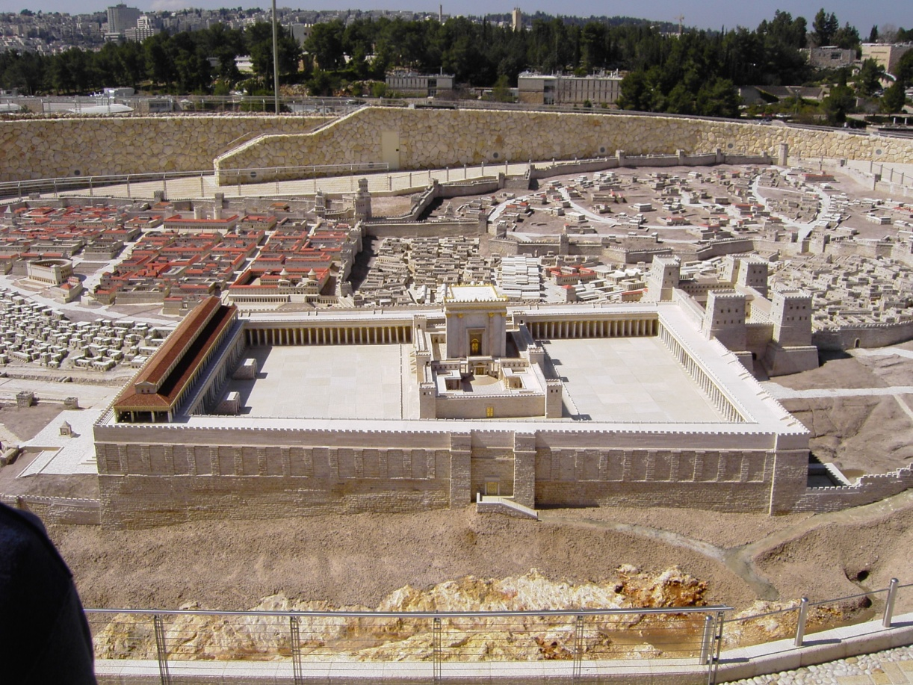
2:11-25
Court of the Gentiles

Slide 7
2:11-25

Slide 8
2:11-25
Eph. 4:26 ~ “Be angry, and do not sin”: do not let the sun go down on your wrath …

Slide 9
2:11-25

Slide 10
2:11-25
Heb. 12:6-8 ~ ⁶ For whom the Lord loves He chastens,
And scourges every son whom He receives."
⁷ If you endure chastening, God deals with you as with sons; for what son is there whom a father does not chasten? ⁸ But if you are without chastening, of which all have become partakers, then you are illegitimate and not sons.

Slide 11
2:11-25

Slide 12
2:11-25
1 Cor. 3:16 ~ Do you not know that you are the temple of God and that the Spirit of God dwells in you?.
1 Pet. 2:5a ~ you also, as living stones, are being built up a spiritual house

Slide 13
2:11-25

Slide 14
2:11-25
1 Cor. 6:19 ~ do you not know that your body is the temple of the Holy Spirit who is in you, whom you have from God, and you are not your own

Slide 15
2:11-25

Slide 16
2:11-25
Zeal ~ zēlos – from zeō (to bring to a boil)

Slide 17
2:11-25

Slide 18
2:11-25
vv. 14-15 ~ temple –
hieron
v. 19 ~ temple –
naos

Slide 19
2:11-25

Slide 20
2:11-25
For He is like a refiner’s fire
And like launderers’ soap.
³ He will sit as a refiner and a purifier of silver;
He will purify the sons of Levi,
And purge them as gold and silver,
That they may offer to the Lord
An offering in righteousness.
Malachi 3:1–3 ~ ¹ “Behold, I send My messenger,
And he will prepare the way before Me.
And the Lord, whom you seek,
Will suddenly come to His temple,
Even the Messenger of the covenant,
In whom you delight.
Behold, He is coming,”
Says the Lord of hosts.
² But who can endure the day of His coming?
And who can stand when He appears?

Slide 21
2:11-25

Slide 22
2:11-25
Sign ~ sēmeion – marker, token, sign post

Slide 23
2:11-25

