Slide 1
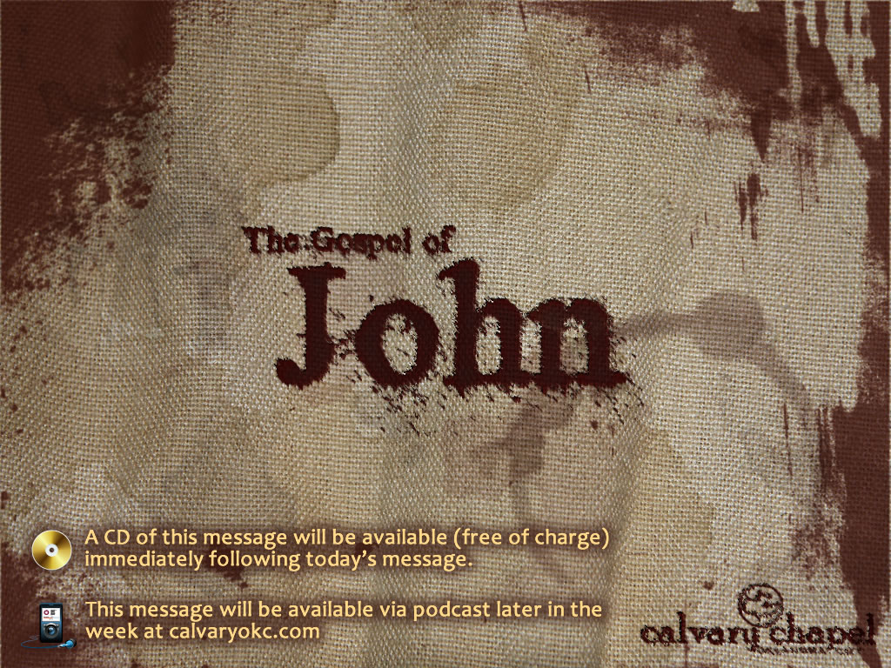
1:43-2:11

Slide 2
1:43-2:11
"By all means, marry. If you get a good wife, you will become very happy. If you get a bad one, you will become a philosopher." Socrates (470–399 BC)

Slide 3
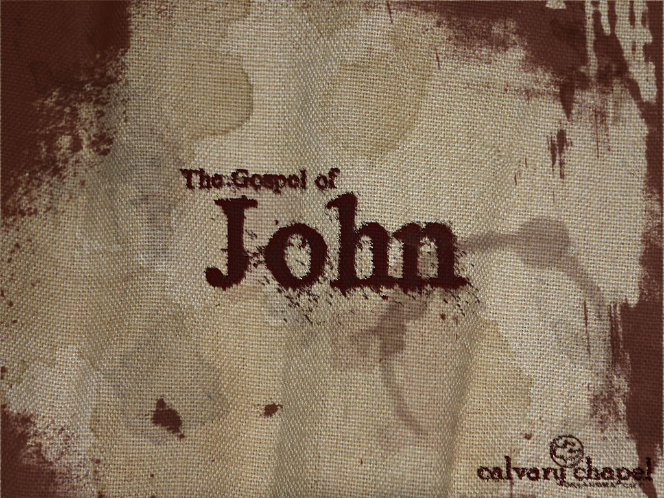
1:43-2:11

Slide 4
1:43-2:11
Woman ~ NIV, Dear woman

Slide 5
1:43-2:11

Slide 6
1:43-2:11
Twenty or thirty gallons ~ KJV, two or three firkins

Slide 7
1:43-2:11

Slide 8
1:43-2:11
Master ~ architriklinos – ruler of three couches

Slide 9
1:43-2:11

Slide 10
1:43-2:11
Prov. 20:1 ~ Wine is a mocker,
Strong drink is a brawler,
And whoever is led astray by it is not wise.

Slide 11
1:43-2:11

Slide 12
1:43-2:11
Prov. 23:31-35 ~ 31 Do not look on the wine when it is red,
When it sparkles in the cup,
When it swirls around smoothly;
32 At the last it bites like a serpent,
And stings like a viper.
33 Your eyes will see strange things,
And your heart will utter perverse things.
34 Yes, you will be like one who lies down in the midst of the sea,
Or like one who lies at the top of the mast, saying:
35 "They have struck me, but I was not hurt;
They have beaten me, but I did not feel it.
When shall I awake, that I may seek another drink?"

Slide 13
1:43-2:11

Slide 14
1:43-2:11
Nearly 1/3 of all teenagers in a study reported on by the CDC said they had 5+ drinks during one setting in the past 30 days
Percentage of violent college campus crime this is alcohol-related: 95
Source: CDC and NHTSA

Slide 15
1:43-2:11

Slide 16
1:43-2:11
Rom. 14:21 ~ It is good neither to eat meat nor drink wine nor do anything by which your brother stumbles or is offended or is made weak.

Slide 17
1:43-2:11

Slide 18
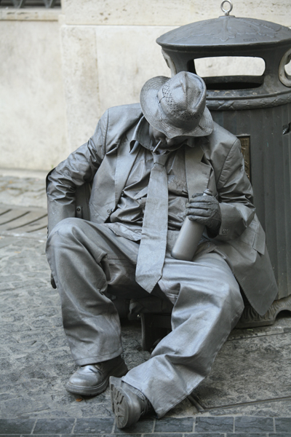
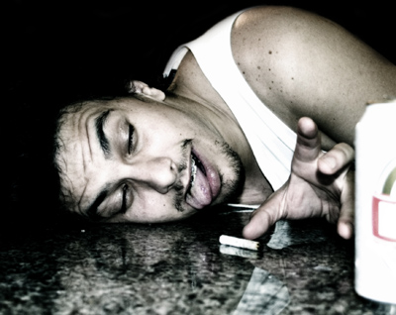
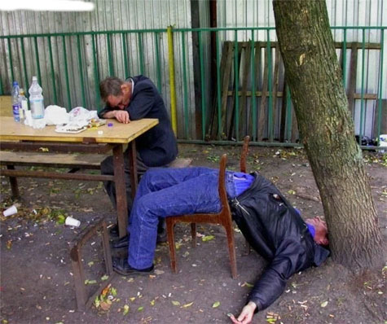
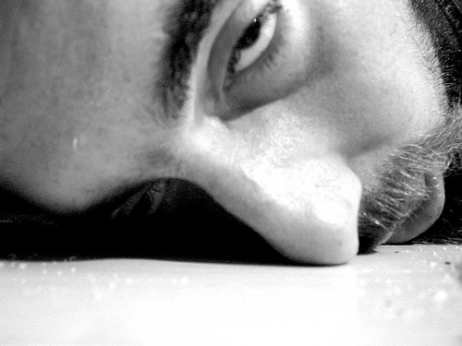
1:43-2:11
#3 cause of death among Americans (behind cancer and heart disease)
43,000+ alcohol related highway deaths
Almost 40% of all accidental deaths
“This Bud’s for you!”
Almost 30% of all suicides
Annual cost of nearly $200,000,000 per annum
Source: CDC and NHTSA

Slide 19
1:43-2:11

Slide 20
1:43-2:11
1. Water to wine
Hebrew Chiasm
1a. Followed by cleansing of Temple
An ancient literary technique in which concepts or ideas are placed in a special symmetric order or pattern in a chiastic structure to emphasize them.
I. e. ABC … CBA, etc.
2. Raising the nobleman's son
2a. Followed by commendation of faith
3. Lame man at Bethesda
3a. Followed by Sabbath debate
* Miracles #4 & 5 both culminated in the teaching that Jesus is sufficient to every need
4. Feeding the 5000 *
5. Walking on the water *
6. Healing of the man born blind
6a. Followed by Sabbath debate
7. Raising Lazarus
7a. Followed by admonition for lack of faith
8. 153 fish
8a. Followed by restoration of Peter

Slide 21
1:43-2:11

Slide 22
1:43-2:11
Neh. 8:10b ~ … for the joy of the LORD is your strength
Phil. 4:4 ~ Rejoice in the Lord always. Again I will say, rejoice!
Eph. 5:18 ~ And do not be drunk with wine, in which is dissipation; but be filled with the Spirit

Slide 23
1:43-2:11

