Slide 1
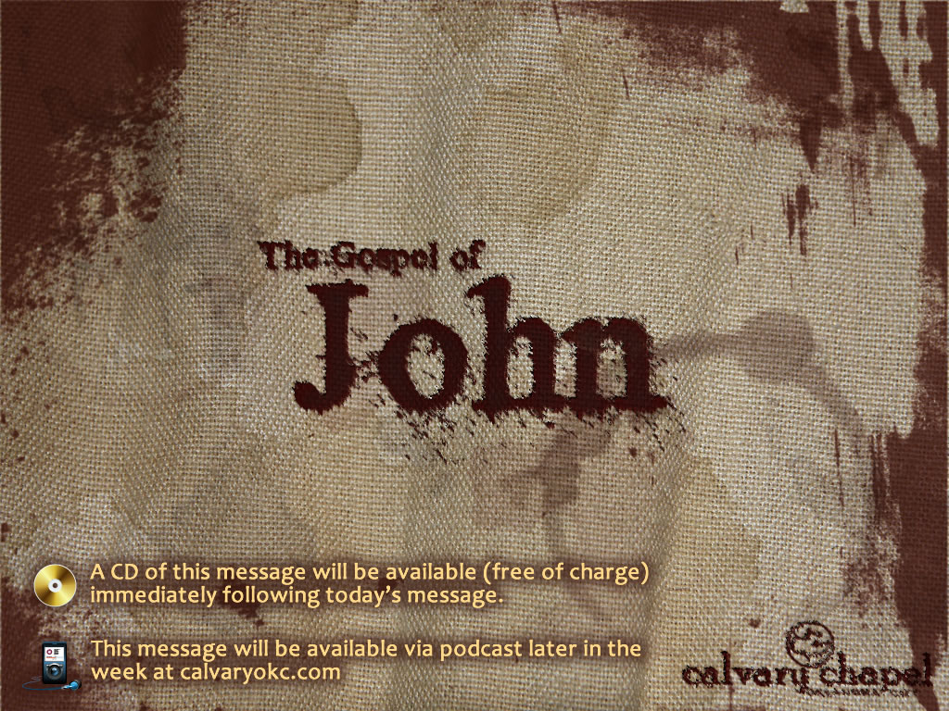
1:14-42

Slide 2
1:14-42
IMPORTANT NOTICE: If you are one of hundreds of parachuting enthusiasts who bought our Easy Sky Diving book, please make the following correction: on page 8, line 7, the words "state zip code" should have read "pull rip cord."
Apology: I originally wrote, "Woodrow Wilson's wife grazed sheep on front lawn of the White House." I'm sorry that typesetting inadvertently left out the word "sheep."
In one edition of today's Food Section, an inaccurate number of jalapeno peppers was given for Jeanette Crowley's South-western chicken salad recipe. The recipe should call for 2, not 21, jalapeno peppers.

Slide 3
1:14-42
The marriage of Miss Freda van Amburg and Willie Branton, which was announced in this paper a few weeks ago, was a mistake which we wish to correct.
It was incorrectly reported last Friday that today is T-shirt Appreciation Day. In fact, it is actually Teacher Appreciation Day.
Our newspaper carried the notice last week that Mr. Oscar Hoffnagle is a defective on the police farce. This was a typographical error. Mr. Hoffnagle is, of course, a detective on the police farce.

Slide 4
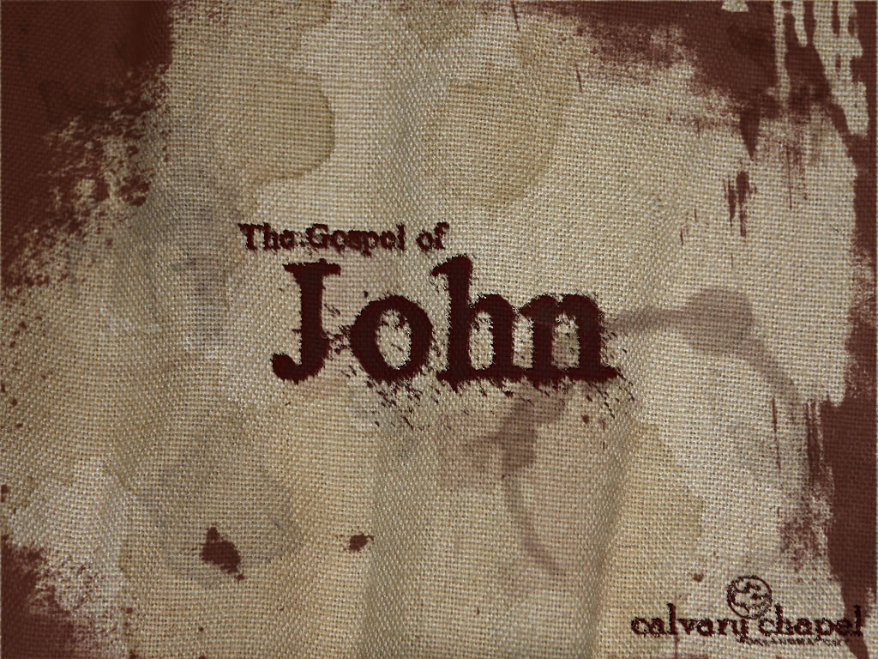
1:14-42

Slide 5
1:14-42
Word ~ logos (logo")
A collection

Slide 6
1:14-42

Slide 7
1:14-42
NIV ~ From the fullness of his grace we have all received one blessing after another.
NLT ~ From his abundance we have all received one gracious blessing after another.
Message ~ We all live off his generous bounty, gift after gift after gift.

Slide 8
1:14-42

Slide 9
1:14-42
Declared ~ exēgēomai, exegeted

Slide 10
1:14-42

Slide 11
1:14-42
Mark 14:36 ~ "Abba, Father," he said, "everything is possible for you. Take this cup from me. Yet not what I will, but what you will."
Rom. 8:15 ~ For you did not receive a spirit that makes you a slave again to fear, but you received the Spirit of sonship. And by him we cry, "Abba, Father."
Gal. 4:6 ~ Because you are sons, God sent the Spirit of his Son into our hearts, the Spirit who calls out, "Abba, Father."

Slide 12
1:14-42

Slide 13
1:14-42
D. L. Moody ~ "A man can counterfeit love, he can counterfeit faith, he can counterfeit hope and all the other graces, but it is very difficult to counterfeit humility."

Slide 14
1:14-42

Slide 15
1:14-42
Mal. 4:5-6 ~ ⁵ Behold, I will send you Elijah the prophet
Before the coming of the great and dreadful day of the LORD.
^{6a} And he will turn
The hearts of the fathers to the children,
And the hearts of the children to their fathers,
Matt. 11:14 ~ if you are willing to receive it, he is Elijah who is to come.

Slide 16
1:14-42

Slide 17
1:14-42
Deut. 18:15 ~ The Lord your God will raise up for you a Prophet like me from your midst, from your brethren. Him you shall hear.

Slide 18
1:14-42

Slide 19
1:14-42
Isaiah 40:3 ~ The voice of one crying in the wilderness:
"Prepare the way of the Lord;
Make straight in the desert
A highway for our God."

Slide 20
1:14-42

Slide 21
1:14-42
Hebrew reckoning
(Synoptic Gospels)
Roman reckoning
(Gospel of John)
1st hour = 6 a.m.
1st hour = 1 a.m.
3rd hour = 9 a.m.
3rd hour = 3 a.m.
10th hour = 4 p.m.
10th hour = 10 a.m.

Slide 22
1:14-42

Slide 23
1:14-42
C. H. Spurgeon ~ "Grace does not run in the blood, and regeneration is not of blood nor of birth, yet it doth very frequently—I was about to say almost always—happen that God, by means of one of a household draws the rest to Himself. He calls an individual, and then uses him to be a sort of spiritual decoy to bring the rest of the family into the gospel net."

Slide 24
1:14-42

