Slide 1
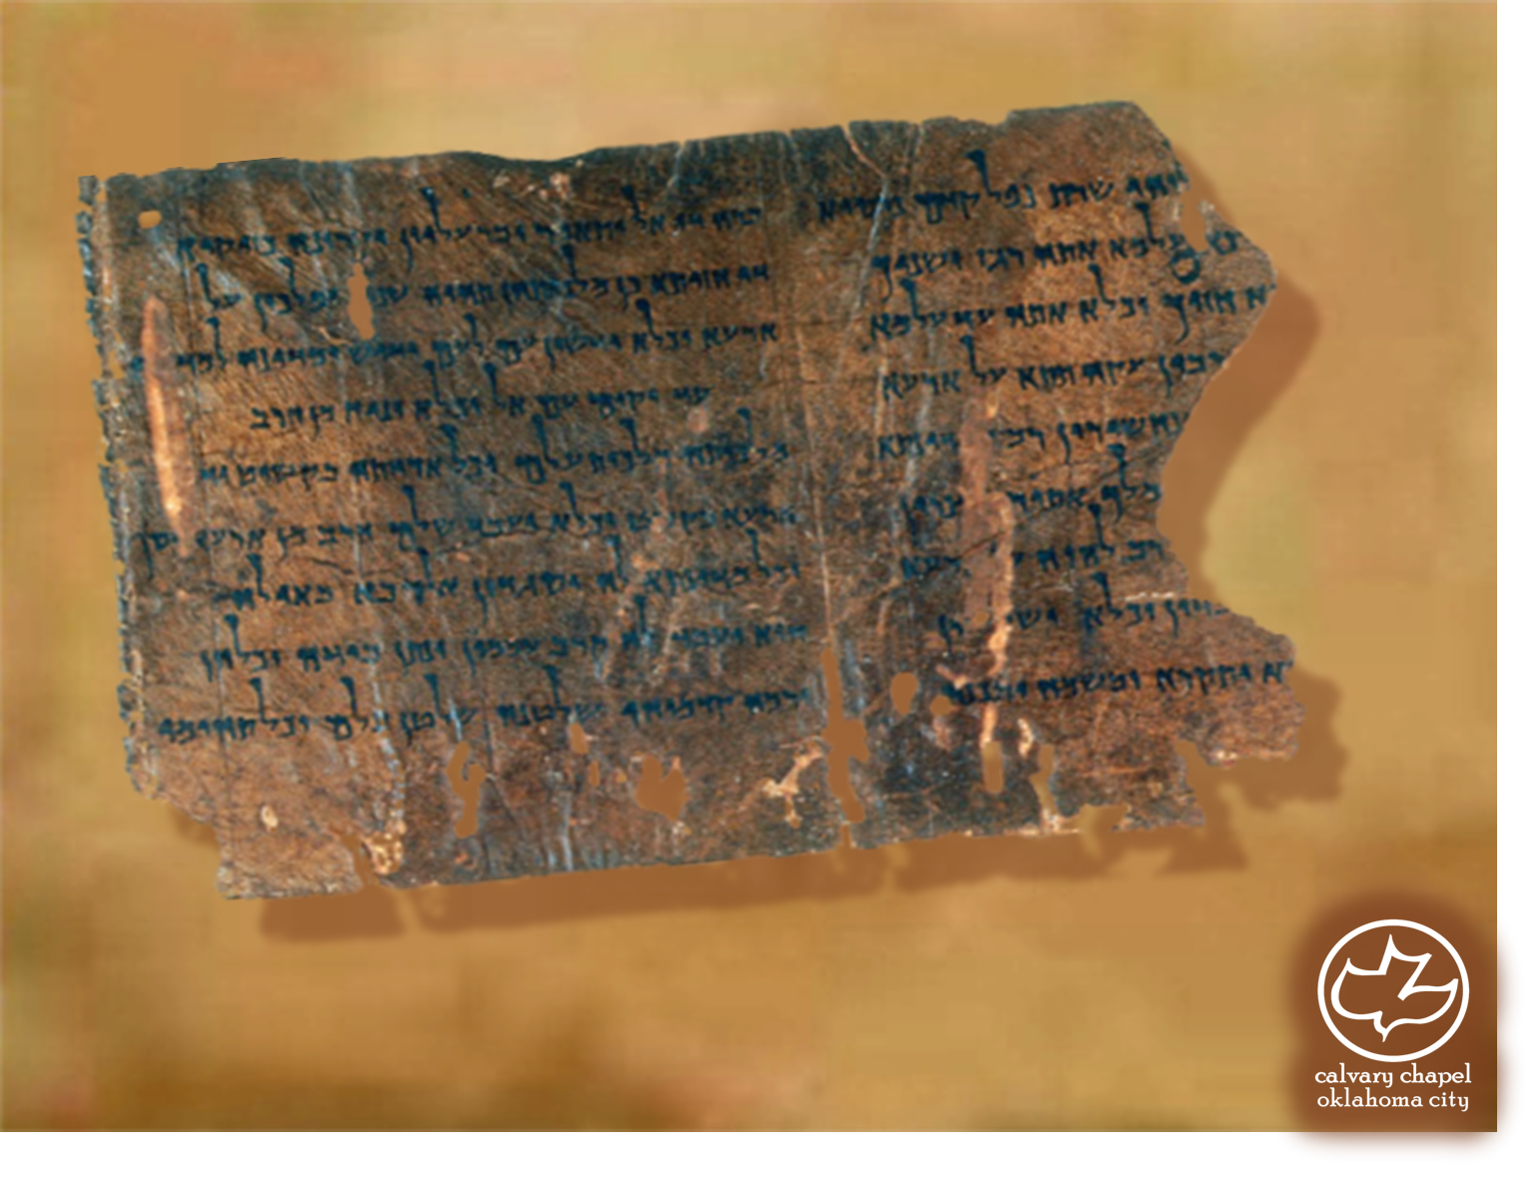

Minor Prophets … Major Message:
Joel 2:12-3:21
A CD of this message will be available (free of charge) immediately following today's message
This message will be available via podcast later this week at calvaryokc.com

Slide 2
Joel 2:12-3:21
David Guzik ~ “Sincere repentance is marked by action and emotion. Not every act of repentance will include fasting and weeping, but if action and emotion are absent, it isn’t real repentance.”

Slide 3
Joel 2:12-3:21
Rom. 2:3-4 ~ ³ And do you think this, O man, you who judge those practicing such things, and doing the same, that you will escape the judgment of God? ⁴ Or do you despise the riches of His goodness, forbearance, and longsuffering, not knowing that the goodness of God leads you to repentance?

Slide 4
Joel 2:12-3:21
C. H. Spurgeon ~ “Lost years can never be restored literally. Time once past is gone forever. Let no man make any mistake about this, or trifle with the present moment under any notion that the flying hour will ever wing its way back to him. As well recall the north wind, or fill again the emptied rain cloud, or
put back into their quiver the
arrows of the lord of day. As well bid the river which has hastened onward to the sea, bring back its rolling floods, as imagine that the years that have once gone can ever be restored to us. It will strike you at once that the locusts did not eat the years: the locusts ate the fruits of the years’ labour, the harvests of the fields;
so that the meaning of the
restoration of the years must be the restoration of those fruits and of those harvests which the locusts consumed. You cannot have back your time; but there is a strange and wonderful way in which God can give back to you the wasted blessings, the unripened fruits of years over which you mourned. The fruits of wasted years may yet be yours.”

Slide 5
Joel 2:12-3:21
Matt. 23:37-39 ~ ³⁷ O Jerusalem, Jerusalem, the one who kills the prophets and stones those who are sent to her! How often I wanted to gather your children together, as a hen gathers her chicks under her wings, but you were not willing! ³⁸ See! Your house is left to you desolate; ³⁹ for I say to you, you shall see Me no more till you say, ‘Blessed is He who comes in the name of the LORD!’"

Slide 6
Joel 2:12-3:21
Joel 2:28-32 form a separate chapter in the Tanakh

Slide 7
Joel 2:12-3:21
Acts 2:16 ~ But this is that which was spoken by the prophet Joel …

Slide 8
Joel 2:12-3:21
Joel 2 | Acts 2
Sons/Daughters prophesy
Sound of rushing wind
Old men dream
Cloven tongues of fire
Young men see visions
Spoke with other tongues
Spirit poured out
Spirit poured out
Sun turned to darkness
Interpretation of tongues?
Moon turned to blood

Slide 9
Joel 2:12-3:21
Jer. 31:33-34 ~ ³³ But this is the covenant that I will make with the house of Israel after those days, says the LORD: I will put My law in their minds, and write it on their hearts; and I will be their God, and they shall be My people. ³⁴ No more shall every man teach his neighbor, and every man his brother, saying, ‘Know the LORD,’ for they all
shall know Me, from the least of them to the greatest of them, says the LORD. For I will forgive their iniquity, and their sin I will remember no more.

Slide 10
Joel 2:12-3:21
Zech. 14:9 ~ And the LORD shall be King over all the earth. In that day it shall be — "The LORD is one," And His name one.

Slide 11
Joel 2:12-3:21
Valley of Jehoshaphat ~ Yahweh has judged

Slide 12
Joel 2:12-3:21

Slide 13
Joel 2:12-3:21
Is. 2:4 ~ He shall judge between the nations, And rebuke many people; They shall beat their swords into plowshares, And their spears into pruning hooks; Nation shall not lift up sword against nation, Neither shall they learn war anymore.

Slide 14
Joel 2:12-3:21
Zech 14:8 ~ And in that day it shall be
That living waters shall flow from Jerusalem,
Half of them toward the eastern sea
And half of them toward the western sea;
In both summer and winter it shall occur.

Slide 15
Joel 2:12-3:21
nasb ~ And I will avenge their blood which I have not avenged, For the Lord dwells in Zion.

Slide 16
Joel 2:12-3:21
Adam Clarke ~ “This prophet, who has many things similar to Ezekiel, ends his prophecy in nearly the same way: Ezekiel says of the glory of the Church, Yehovah shammah, THE LORD IS THERE (Eze. 48:35). Joel says, Yehovah shochen betsiyon, THE LORD DWELLETH IN ZION. Both point out the continued indwelling of Christ among his people.”

