Slide 1
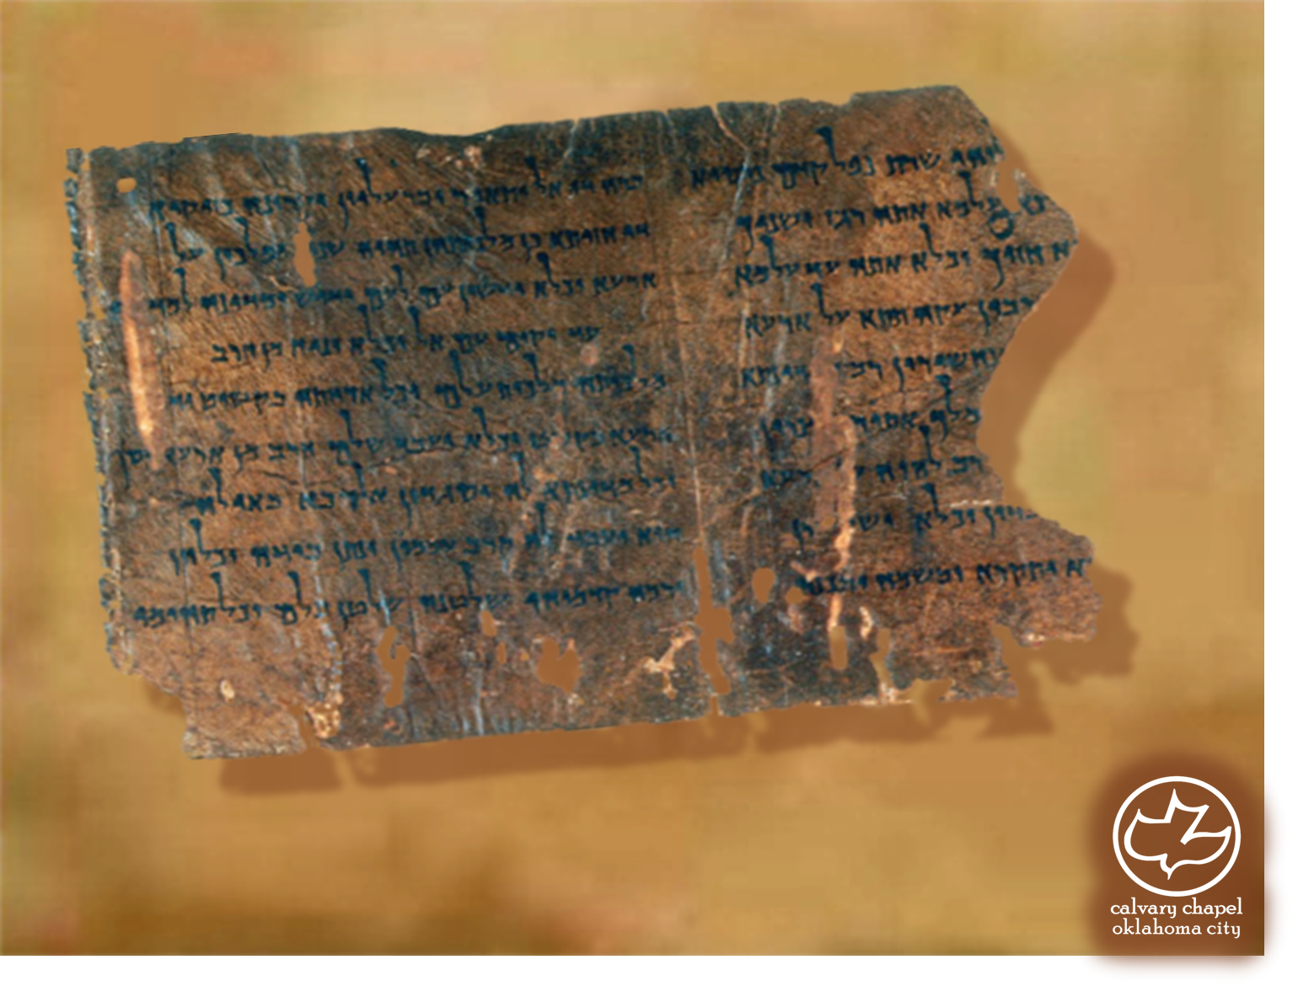

Minor Prophets … Major Message:
Joel 1:1-2:11
A CD of this message will be available (free of charge) immediately following today's message
This message will be available via podcast later this week at calvaryokc.com

Slide 2
Joel 1:1-2:11
Joash
800BC
750BC
700BC
650BC
600BC
550BC
Joel
Joel
The first of the writing prophets – late 9th century BC

Slide 3
Joel 1:1-2:11
Theme: the Day of the Lord ~ 24x, 6 prophets, 5x by Joel
Jeff Miller ~ “The Day of the Lord as understood by the Hebrews and expressed in the prophets is a multifaceted concept. Five aspects of the Day of the Lord nearness, judgment, terror, call to repentance, and restoration may be readily drawn from a study of the texts in which the phrase occurs.”

Slide 4
Joel 1:1-2:11
Joel ~ Jehovah is God
Pethuel ~ vision of God

Slide 5
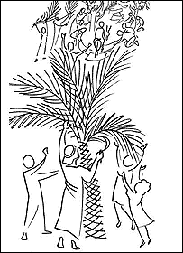
Joel 1:1-2:11
GNB ~ Swarm after swarm of locusts settled on the crops; what one swarm left, the next swarm devoured.

Slide 6
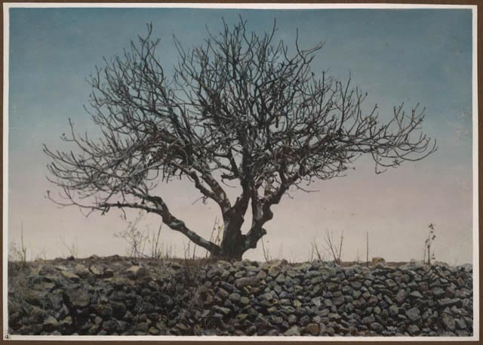
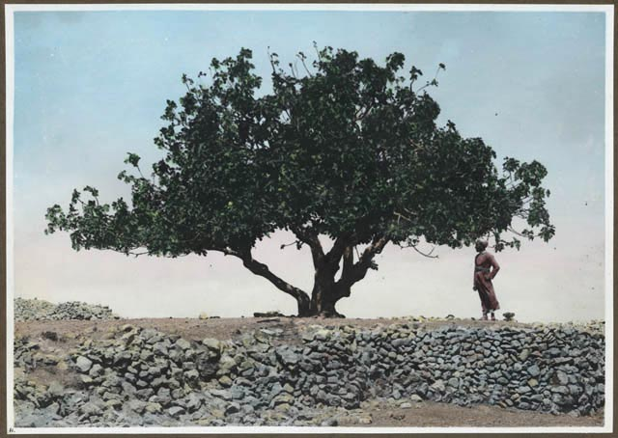
Joel 1:1-2:11

Slide 7
Joel 1:1-2:11
John Whiting ~ “Whenever touched, or especially when finding themselves caught within one’s clothes, they exuded from their mouth a dark fluid, an irritant to the skin and soiling the garments in a most disgusting manner. Imagine the feeling (we speak from experience) with a dozen or two such
creatures over an inch long,
with saw-like legs and rough bodies, making a race-course of your back!”
"A loud noise was heard before the locusts were seen, produced by the flapping of myriads of locust wings and resembling the distant rumbling of waves. The sun was suddenly darkened. Showers of their excrements fell thick and fast, resembling those of mice.”

Slide 8
Joel 1:1-2:11
1 Kings 8:37–38 ~ ³⁷ When there is famine in the land, pestilence or blight or mildew, locusts or grasshoppers; when their enemy besieges them in the land of their cities; whatever plague or whatever sickness there is; ³⁸ whatever prayer, whatever supplication is made by anyone, or by all Your people Israel, when each one knows the plague of his own heart, and spreads out his hands toward this temple …

Slide 9
Joel 1:1-2:11
Destruction ~ shōd – 48 of 57x in Old Testament found in prophets
Almighty ~ shadday – from same root

Slide 10
Joel 1:1-2:11
David Guzik ~ “When we are right with God, we want the day of the LORD. We long for Him to show His strength because we know that we abide in Him. When we are not right with God, we dread the day of the LORD, because when God shows Himself strong, His strength may work against us.”

Slide 11
Joel 1:1-2:11
Rev. 9:1-12 – 5th trumpet (The Bottomless Pit)

