Slide 1
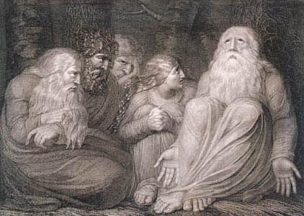


The book of
Job 1.1-1.7
A study of suffering and spiritual warfare
A CD of this message (free of charge) will be available immediately following the service .
It will also be available for podcast later this week at calvaryokc.com.

Slide 2
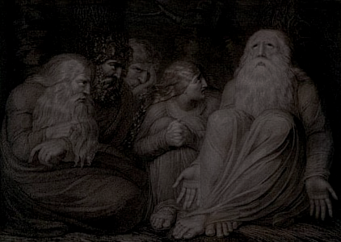
Job 1.1-1.7
Warren Wiersbe ~ “God didn’t question Job’s integrity or sincerity; He only questioned Job’s ability to explain the ways of God in the world. Job had spoken the truth about God, but his speeches had lacked humility. Job thought he knew about God, but he didn’t realize how much he didn’t know about God. Knowledge of our own ignorance is the first step toward true wisdom.”

Slide 3
Job 1.1-1.7

Slide 4
Job 1.1-1.7
Chapters 38-41 ~ God asks Job approximately 77 questions

Slide 5
Job 1.1-1.7

Slide 6
Job 1.1-1.7
Sons of God ~ bene` elohim

Slide 7
Job 1.1-1.7

Slide 8
Job 1.1-1.7
Rev. 8.7a ~ The first angel sounded: And hail and fire followed, mingled with blood, and they were thrown to the earth.
Rev. 16.21a ~ And great hail from heaven fell upon men, each hailstone about the weight of a talent.

Slide 9
Job 1.1-1.7

Slide 10
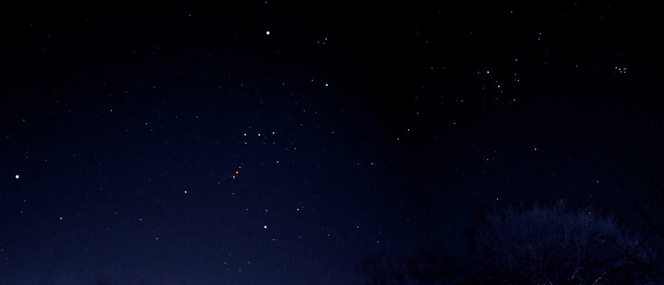
Job 1.1-1.7
Orion
Pleiades
belt

Slide 11
Job 1.1-1.7
KJV ~ Canst thou bind the sweet influences of Pleiades,
Pleiades has its own gravitation
The belt of Orion is going in different directions

Slide 12
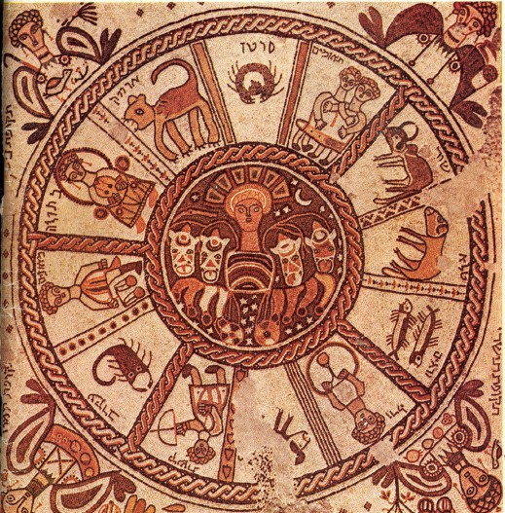
Job 1.1-1.7
Mazzaroth ~ Hebrew Zodiac

Slide 13
Job 1.1-1.7

Slide 14
Job 1.1-1.7
NIV ~ Who let the wild donkey go free? Who untied his ropes
NLT ~ Who makes the wild donkey wild?

Slide 15
Job 1.1-1.7

Slide 16
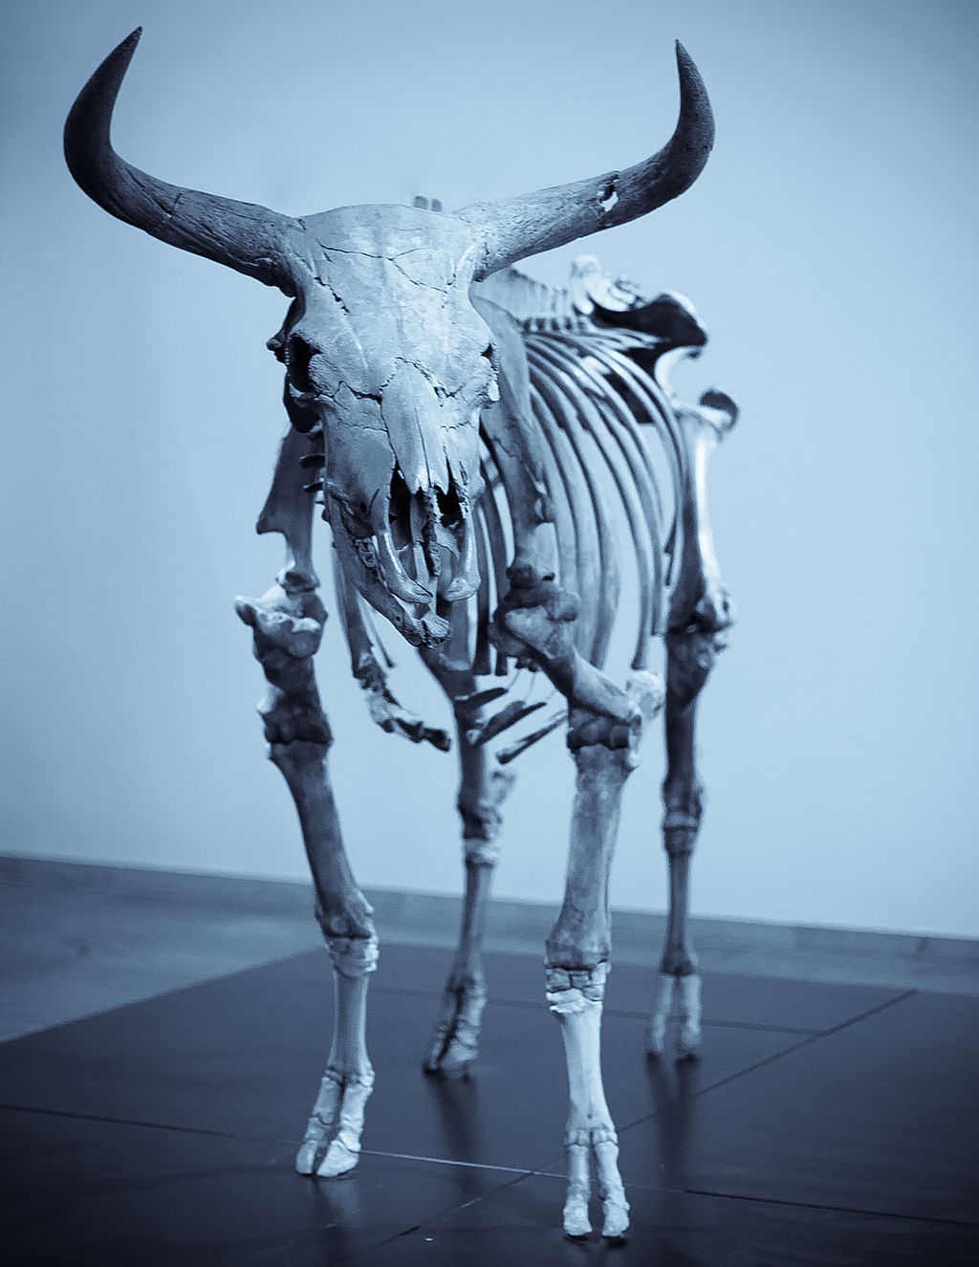
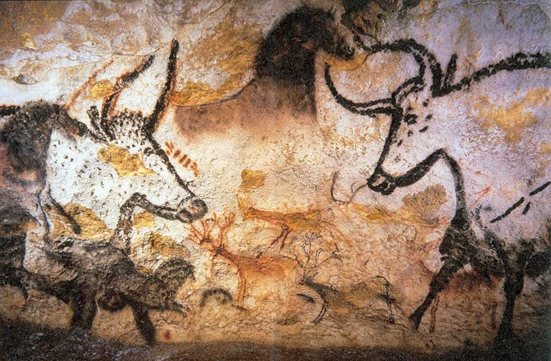
Job 1.1-1.7
Wild ox ~ KJV, unicorn
Possibly extent aurochs
6’
Cave painting on Lascaux, France

Slide 17
Job 1.1-1.7

Slide 18
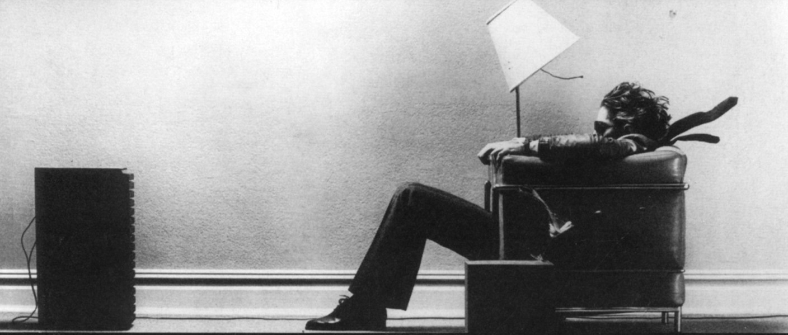
Job 1.1-1.7

Slide 19
Job 1.1-1.7
Job’s previous statements:
10:2a ~ I will say to God, “Do not condemn me;
Show me why You contend with me.”
13:22 ~ Then call, and I will answer;
Or let me speak, then You respond to me.
31:37 ~ I would declare to Him the number of my steps;
Like a prince I would approach Him.

Slide 20
Job 1.1-1.7

Slide 21
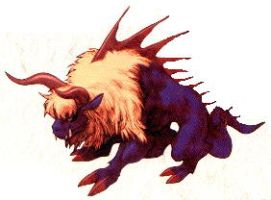
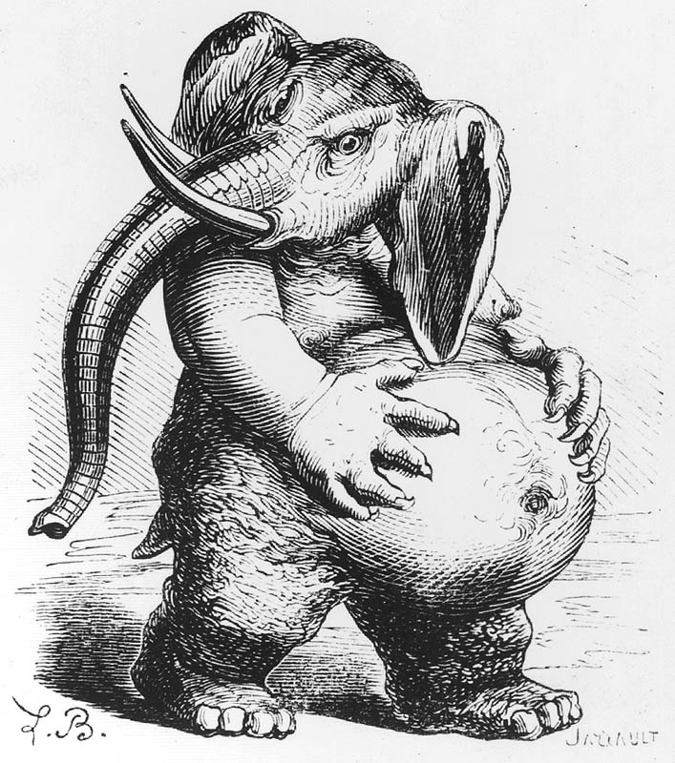
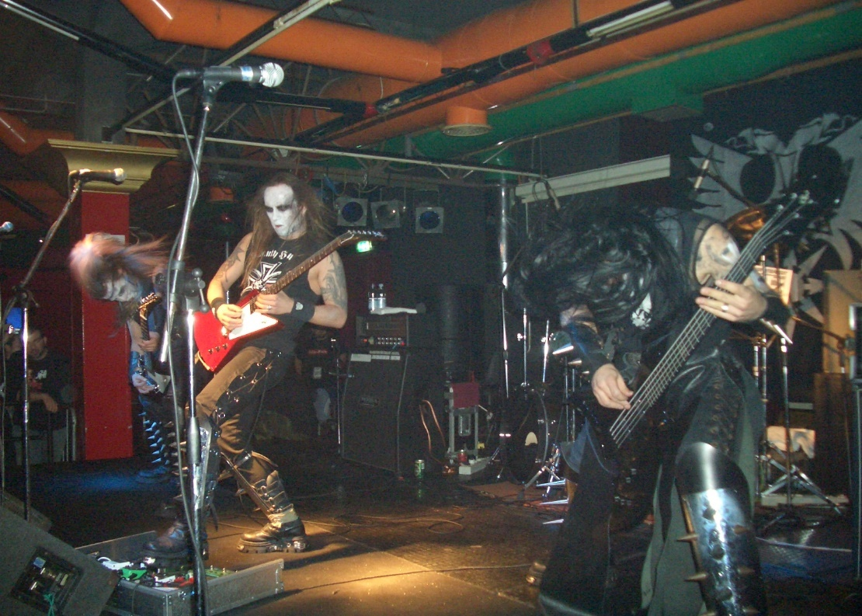
Job 1.1-1.7
Behemoth

Slide 22
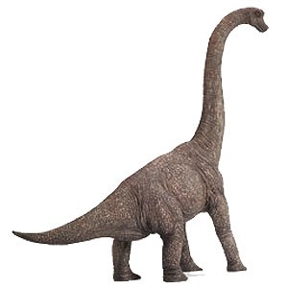
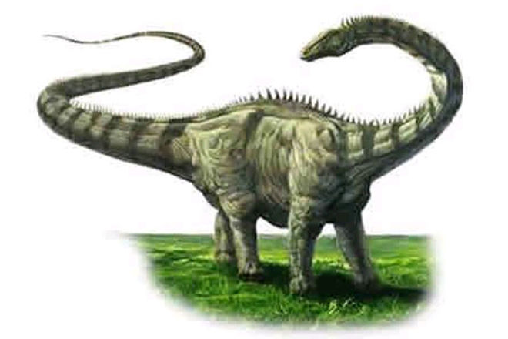
Job 1.1-1.7
Brachiosaurus
Diplodocus

Slide 23
Job 1.1-1.7

Slide 24
Job 1.1-1.7
Message ~ If you so much as lay a hand on him, you won’t live to tell the story.

Slide 25
Job 1.1-1.7

Slide 26
Job 1.1-1.7
Sneezings ~ KJV, neesings

Slide 27
Job 1.1-1.7

Slide 28

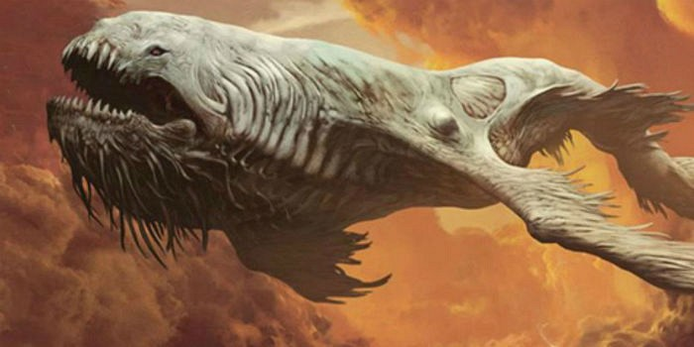
Job 1.1-1.7

Slide 29
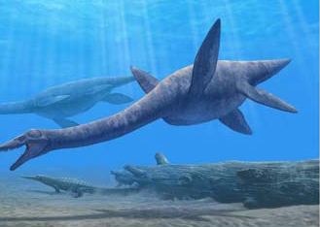
Job 1.1-1.7
Plesiosaurus

Slide 30
Job 1.1-1.7

