Slide 1
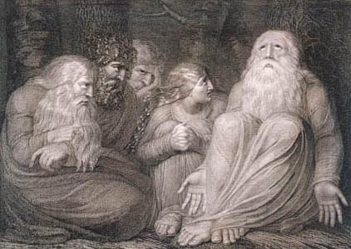


The book of
Job 32.1-37.24
A study of suffering and spiritual warfare
A CD of this message (free of charge) will be available immediately following the service .
It will also be available for podcast later this week at calvaryokc.com.

Slide 2
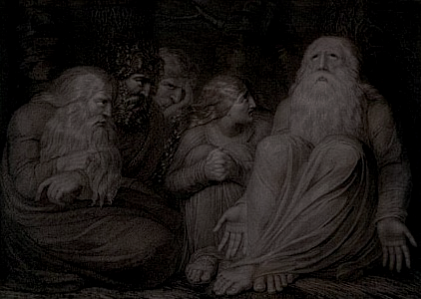
Job 32.1-37.24

Slide 3
Job 32.1-37.24
Elihu ~ He is my God

Slide 4
Job 32.1-37.24

Slide 5
Job 32.1-37.24
Gen. 22:20-21 ~ ²⁰ Now it came to pass after these things that it was told Abraham, saying, “Indeed Milcah also has borne children to your brother Nahor: ²¹ Huz his firstborn, Buz his brother, Kemuel the father of Aram,”
Huz ~ NIV, NASB – Uz
Buz, the nephew of Abraham, brother of Uz

Slide 6
Job 32.1-37.24

Slide 7
Job 32.1-37.24
Elihu quotes Job at least 16x

Slide 8
Job 32.1-37.24

Slide 9
Job 32.1-37.24
NASB, Indeed God speaks once, Or twice, yet no one notices it …

Slide 10
Job 32.1-37.24

Slide 11
Job 32.1-37.24
Thomas à Kempis (1380-1471) ~ “Accept suffering graciously. When you have reached such a point, all misery will seem sweet and you will relish it for Christ's sake and think that you have discovered paradise on earth. As long as you object to suffering you will be ill at ease. Accept it, and you will find peace.”

Slide 12
Job 32.1-37.24
John Michael Talbot ~ “I can look back at my darkest periods and realize that these were the times when the Lord was holding me closest. But I couldn't see his face because my face was in his breast-crying.”

Slide 13
Job 32.1-37.24

Slide 14
Job 32.1-37.24
Messenger ~ NIV, NASB – angel
malak
Ransom ~ kopher – covering or atonement

Slide 15
Job 32.1-37.24

Slide 16
Job 32.1-37.24
Perverted persons ~ qadesh – temple prostitute (as in NIV, HASB and ESV)

Slide 17
Job 32.1-37.24

Slide 18
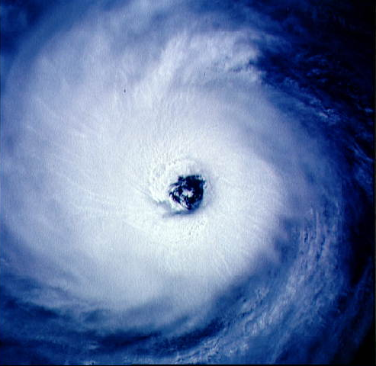
Job 32.1-37.24

Slide 19
Job 32.1-37.24

