Slide 1
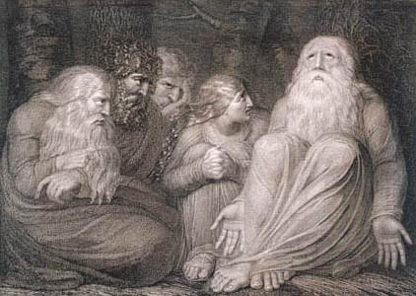


The book of
Job 20.1-31.40
A study of suffering and spiritual warfare
A CD of this message (free of charge) will be available immediately following the service .
It will also be available for podcast later this week at calvaryokc.com.

Slide 2
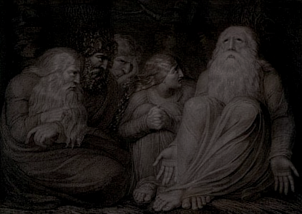
Job 20.1-31.40
Eliphaz: “I’ve had an experience and God has told me”
Bildad: “I’ve looked at history and the elders have told me”
Zophar: “I’ve thought about it and I have told me”

Slide 3
Job 20.1-31.40

Slide 4
Job 20.1-31.40
Keep mocking ~ KJV, mock on

Slide 5
Job 20.1-31.40

Slide 6
Job 20.1-31.40
Pails ~ ‘atiyn – only here in the Old Testament
Septuagint and Vulgate, bowels
Targum, breasts (KJV)
Syriac, sides (NIV)
Message ~ (they’re) fat and sassy

Slide 7
Job 20.1-31.40

Slide 8
Job 20.1-31.40
Be your gold (v. 25) ~ KJV, defense (weak support)

Slide 9
Job 20.1-31.40

Slide 10




Job 20.1-31.40

Slide 11
Job 20.1-31.40

Slide 12
Job 20.1-31.40
Jam. 13-16 ~ ¹³ Who is wise and understanding among you? Let him show by good conduct that his works are done in the meekness of wisdom. ¹⁴ But if you have bitter envy and self-seeking in your hearts, do not boast and lie against the truth. ¹⁵ This wisdom does not descend from above, but is earthly, sensual, demonic. ¹⁶ For where envy and self-seeking exist, confusion and every evil thing are there.
Sensual ~ psychikos – of the soul (or, originating in the self)

Slide 13
Job 20.1-31.40

Slide 14
Job 20.1-31.40
KJV ~ My bowels boiled, and rested not: the days of affliction prevented me.

Slide 15
Job 20.1-31.40

Slide 16
Job 20.1-31.40
One in eight internet searches is for pornography
Global porn revenues have declined by 50% since 2007
… due to the amount of free content online
9 out of 10 boys; 6 out of 10 girls have been exposed to pornography by age 18
Average age of initial exposure: 12

Slide 17
Job 20.1-31.40

