Slide 1
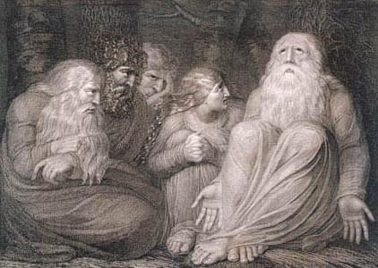


The book of
Job 11.1-19.29
A study of suffering and spiritual warfare
A CD of this message (free of charge) will be available immediately following the service .
It will also be available for podcast later this week at calvaryokc.com.

Slide 2
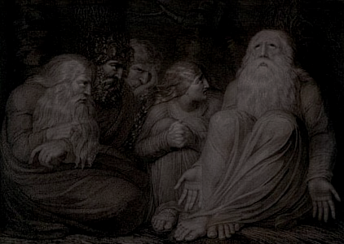
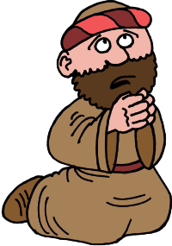
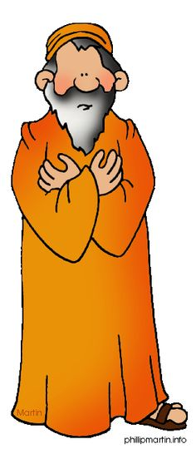

Job 11.1-19.28
Eliphaz the visionary
Bildad the traditionalist
Zophar the intellectual
Sparrow

Slide 3
Job 11.1-19.29

Slide 4
Job 11.1-19.28
4:18 ~ If He puts no trust in His servants,
If He charges His angels with error,

Slide 5
Job 11.1-19.29

Slide 6
Job 11.1-19.28
Joe Bayly ~ The View From A Hearse –
“I was sitting there torn by grief. Someone came and talked of God's dealings, of why it happened, of hope beyond the grave. He talked constantly. He said things I knew were true. I was unmoved, except to wish he'd go away. He finally did.”

Slide 7
Job 11.1-19.28
Joe Bayly ~ The View From A Hearse –
“Another come and sat beside me. He didn't talk. He didn't ask me leading questions. He just sat beside me for an hour and more, listened when I said something, answered briefly, prayed simply and left. I was moved. I was comforted. I hated to see him go.”

Slide 8
Job 11.1-19.29

Slide 9
Job 11.1-19.28
Shriveled (also NASB) ~ NIV, gauntness
KJV ~ you have filled me with wrinkles

Slide 10
Job 11.1-19.29

Slide 11
Job 11.1-19.28
I know ~ emphatic – I, even I know
Redeemer ~ ga`al – goel (Kinsman Redeemer)

Slide 12
Job 11.1-19.29

