Slide 1
4:1-5:31

Slide 2
4:1-5:31
Hard soil
~ outright rejection
Stony soil
~ Sunday morning rush
Thorny soil
~ Monday morning rip-off

Slide 3
4:1-5:31

Slide 4
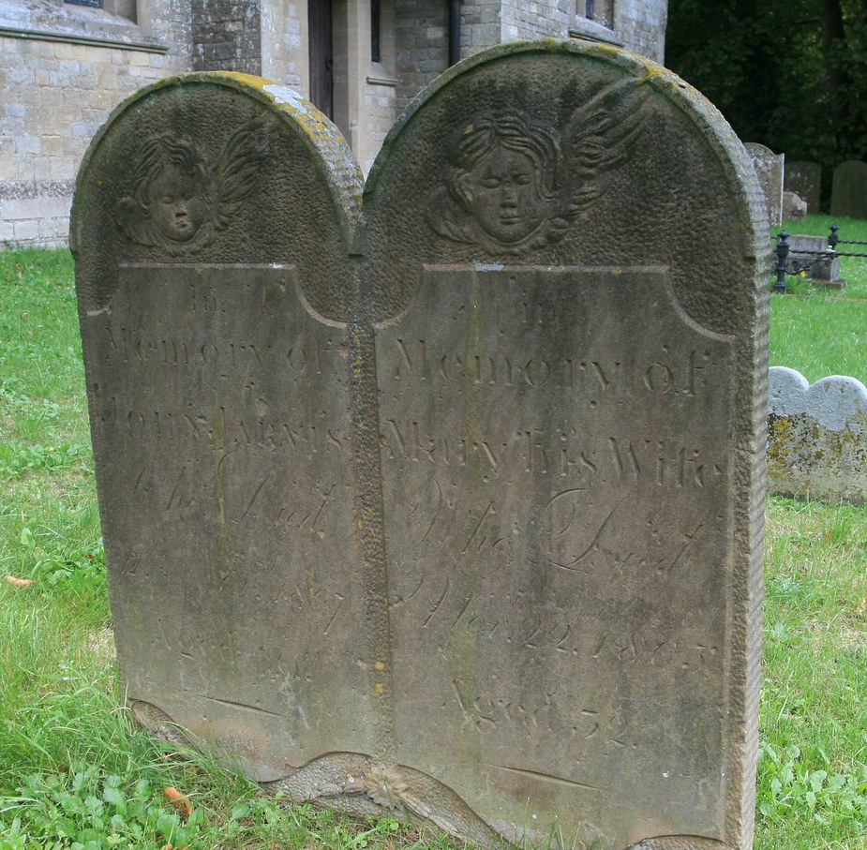
4:1-5:31
The Nation of Judah
c. 931-606 BC
“They didn’t know that they didn’t know”

Slide 5
4:1-5:31

Slide 6
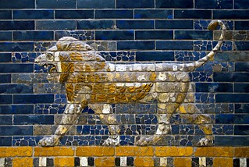
4:1-5:31
Ishtar Gate of Babylon

Slide 7
4:1-5:31

Slide 8
4:1-5:31
soul ~ KJV, bowels – me`ah
LXX ~ koilia – womb, belly
John 7:37-38 ~ ³⁷ On the last day, that great day of the feast, Jesus stood and cried out, saying, “If anyone thirsts, let him come to Me and drink. ³⁸ He who believes in Me, as the Scripture has said, out of his heart will flow rivers of living water.”
heart ~ koilia

Slide 9
4:1-5:31

Slide 10
4:1-5:31
silly ~ KJV, sottish – drunken

Slide 11
4:1-5:31

Slide 12
4:1-5:31
enlarge ~ KJV, rentest (literally, to rip open wide)

Slide 13
4:1-5:31

Slide 14
4:1-5:31
Matt. 11:29-30 ~ ²⁹ Take My yoke upon you and learn from Me, for I am gentle and lowly in heart, and you will find rest for your souls. ³⁰ For My yoke is easy and My burden is light.”

Slide 15
4:1-5:31

Slide 16
4:1-5:31
punish ~ literally visit (as KJV) – paqad

Slide 17
4:1-5:31

Slide 18
4:1-5:31
branches ~ KJV, battlements

Slide 19
4:1-5:31

Slide 20
4:1-5:31
Heb. 10:31 ~ It is a fearful thing to fall into the hands of the living God.

Slide 21
4:1-5:31

Slide 22
4:1-5:31
astonishing ~ shammah - KJV, wonderful

Slide 23
4:1-5:31

