Slide 1
1:1-2:11

Slide 2
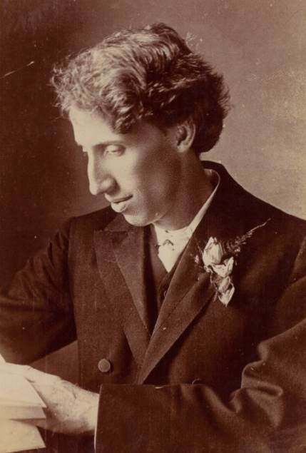
1:1-2:11
G. Campbell Morgan (1863-1945) ~ “For a people to boast in the glory of the past, and to deny the secret that made the past, is to perish.”

Slide 3
1:1-2:11
Jeremiah ~ whom Yahweh appoints

Slide 4
1:1-2:11

Slide 5
1:1-2:11
Anathoth
Jerusalem

Slide 6
1:1-2:11

Slide 7
1:1-2:11
Josiah
(640-609 BC)
Jehoahaz
(609 BC)
Jehoiakim
(608-598 BC)
Jehoiachin
(598 BC)
Zedekiah
(597-586 BC)
630 BC
620 BC
610 BC
600 BC
590 BC
Jeremiah called
(627 BC)
Book of the Law
(622 BC)
Nineveh falls
(612 BC)
1st captivity
(605 BC)
2nd captivity
(597 BC)
3rd captivity
(586 BC)

Slide 8
1:1-2:11

Slide 9
1:1-2:11
the word of the LORD ~ 51x

Slide 10
1:1-2:11

Slide 11
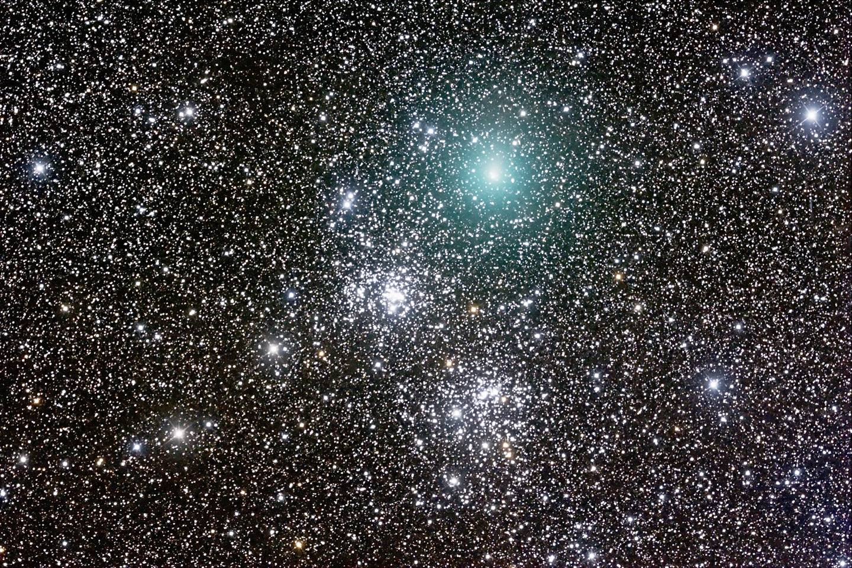
1:1-2:11
between 10⁷⁸ to 10⁸² atoms
ten quadrillion vigintillion
one-hundred thousand quadrillion vigintillion
This Photo by Unknown Author is licensed under CC BY-SA

Slide 12
1:1-2:11

Slide 13
1:1-2:11
youth ~ na’ar – similar to our English word, youth
KJV, NIV ~ child
NLT, too young

Slide 14
1:1-2:11

Slide 15
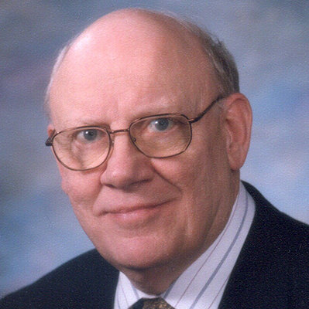
1:1-2:11
Warren Wiersbe (1927-2019) ~ “When God
calls us, however, He isn’t making a mistake;
and for us to hesitate or refuse to obey is to
act on the basis of unbelief and not faith. It’s
one thing for us to know our own weaknesses,
but it’s quite something else for us to say that our weaknesses prevent God from getting anything done. Instead of being an evidence of humility, this attitude reeks of pride.”

Slide 16
1:1-2:11

Slide 17
1:1-2:11
almond tree ~ shaqad (sha-KADE), from the word awake
ready ~ shaqad (sha-KAD)

Slide 18
1:1-2:11

Slide 19
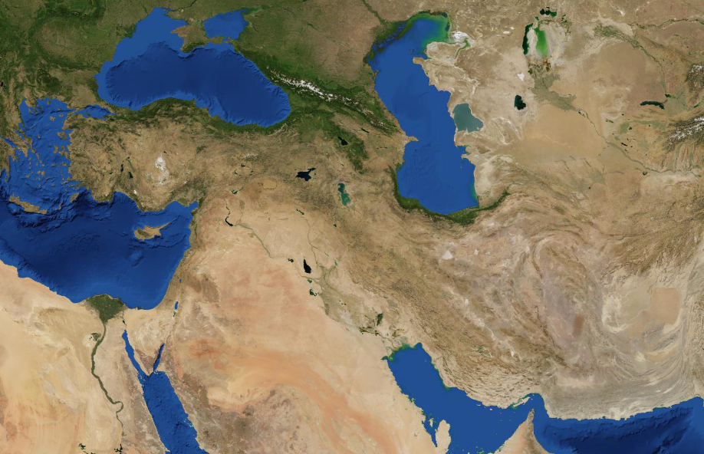
1:1-2:11
Battle of Carchemish
(605 BC)
Babylon
Jerusalem

Slide 20
1:1-2:11

Slide 21
1:1-2:11
Heb. 5:8 ~ though He was a Son, yet He learned obedience by the things which He suffered.

Slide 22
1:1-2:11

Slide 23
1:1-2:11
3 phases of a Jewish wedding
Shiddukhin: the Commitment
Erusin: the Betrothal
Nissuin: the Marriage

Slide 24
1:1-2:11
Paul spends 3 ½ years in Ephesus
Paul writes Ephesians
Less than 35 years
AD 50
AD 60
AD 70
AD 80
AD 90
Paul meets
with elders
Jesus: “You have left your 1st love

Slide 25
1:1-2:11

Slide 26
1:1-2:11
idols ~ hebel – vapor or worthless
KJV ~ walked after vanity and have become vain?
NIV ~ They followed worthless idols and became worthless themselves.

Slide 27
1:1-2:11

Slide 28
1:1-2:11
rulers ~ KJV, pastors – ra`ah, anyone who leads
ESV ~ shepherds
profit
s
false

Slide 29
1:1-2:11

