Slide 1

James 5.9- 20
A CD of this teaching will be available (free of charge) immediately following the service
A podcast of this teaching will be available on iTunes and calvaryokc.com later this week

Slide 2

James 5.9- 20
Perseverance ~ huopmonē
37x in the New Testament; 17x by Paul; 4x by James
NASB ~ endurance
KJV ~ patience

Slide 3
James 5.9- 20
David Guzik ~ "If a man were to attack me with a knife I would resist him with all my strength, and count it a tragedy if he succeeded. Yet if a surgeon comes to me with a knife, I welcome both him and the knife; let him cut me open, even wider than the knife-attacker, because I know his purpose is good and necessary."

Slide 4

James 5.9- 20

Slide 5
James 5.9- 20
Suffering ~ from 2 words – “bad” and “a very strong feeling”
Chuck Smith ~ "God doesn’t want to guide us by painful processes, but loves us so much that He will."

Slide 6
James 5.9- 20

Slide 7
James 5.9- 20
Luke 22.41-42 ~ ⁴¹ And He was withdrawn from them about a stone's throw, and He knelt down and prayed, ⁴² saying, "Father, if it is Your will, take this cup away from Me; nevertheless not My will, but Yours, be done."

Slide 8
James 5.9- 20
Rom. 8.26 ~ Likewise the Spirit also helps in our weaknesses. For we do not know what we should pray for as we ought, but the Spirit Himself makes intercession for us with groanings which cannot be uttered.

Slide 9
James 5.9- 20
James 4.13 ~ Instead you ought to say, "If the Lord wills, we shall live and do this or that."

Slide 10
James 5.9- 20
Is healing in the Atonement?
Matt. 8.16-17 ~ ¹⁶ When evening had come, they brought to Him many who were demon-possessed. ¹⁷ And He cast out the spirits with a word, and healed all who were sick, that it might be fulfilled which was spoken by Isaiah the prophet, saying:

Slide 11
James 5.9- 20
Is healing in the Atonement?
“He Himself took our infirmities
And bore our sicknesses.” (Is. 53.4)

Slide 12
James 5.9- 20
Is healing in the Atonement?
Phil. 2.25- 29
1 Tim. 5:23 ~ No longer drink only water, but use a little wine for your stomach's sake and your frequent infirmities.
2 Tim. 4:20 ~ Erastus stayed in Corinth, but Trophimus I have left in Miletus sick.

Slide 13
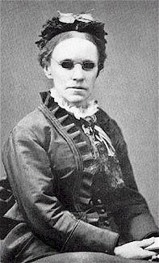
James 5.9- 20
"It seemed intended by the blessed
providence of God that I should be
blind all my life, and I thank him for
the dispensation. If perfect earthly
sight were offered me tomorrow I would not accept it. I might not have sung hymns to the praise of God if I had been distracted by the beautiful and interesting things about me."
"If I had a choice, I would still
choose to remain blind...for
when I die, the first face I
will ever see will be the face
of my blessed Savior."
Fanny Crosby

Slide 14
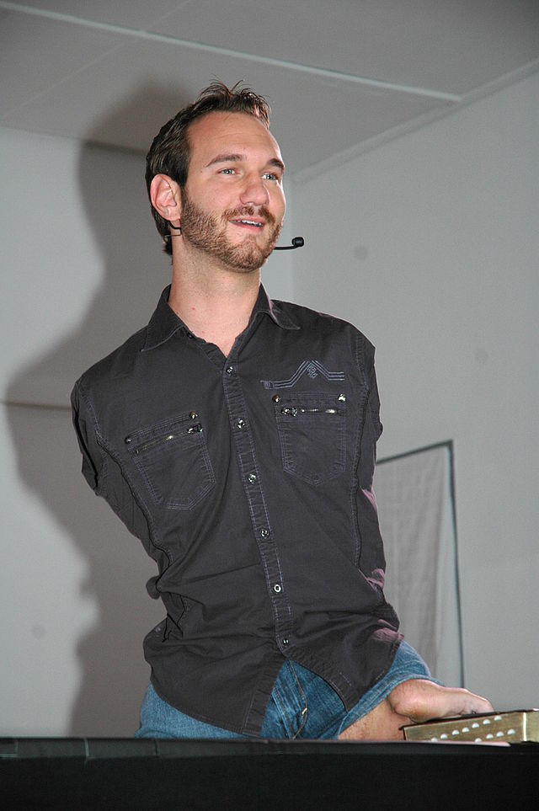
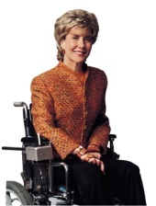
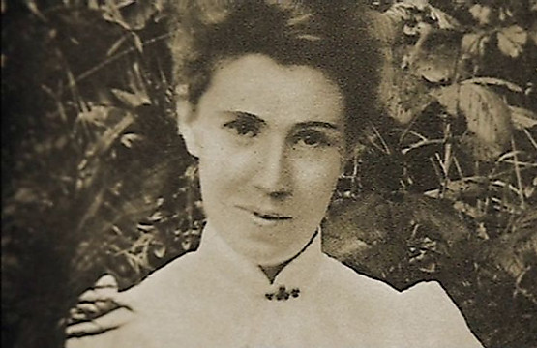
James 5.9- 20
Nick Vujicic
Amy Carmichael
Joni Eareckson Tada

Slide 15
James 5.9- 20
1 John 3.8b ~ … For this purpose the Son of God was manifested, that He might destroy the works of the devil.

Slide 16
James 5.9- 20
Matt. 8.16-17
Justification 1 Cor. 15.2
Sanctification 1 Cor. 1.18
Glorification 1 Cor. 3.15
Infirmity
Instantly
Period of Time
When we stand before Him

Slide 17
James 5.9- 20

Slide 18
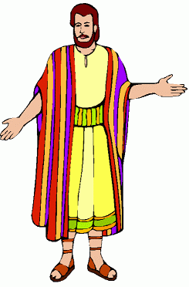
James 5.9- 20

Slide 19
James 5.9- 20

