Slide 1

James 4.6-17
A CD of this teaching will be available (free of charge) immediately following the service
A podcast of this teaching will be available on iTunes and calvaryokc.com later this week

Slide 2

James 4.6-17
C. H. Spurgeon ~ "Note that contrast; note it always. Observe how weak we are, how strong he is; how proud we are, how condescending he is; how erring we are, and how infallible he is; how changing we are, and how immutable he is; how provoking we are, and how forgiving he is. Observe how in us there is only ill, and how in him there

Slide 3
James 4.6-17
is only good. Yet our ill but draws his goodness forth, and still he blesseth. Oh! What a rich contrast!"

Slide 4
James 4.6-17
Matt. 5.3 ~ Blessed are the poor in spirit,
For theirs is the kingdom of heaven.

Slide 5

James 4.6-17

Slide 6
James 4.6-17
Submit ~ – a voluntary attitude of giving in, co-operating, assuming responsibility, and carrying a burden (Enhanced Strong's Lexicon)

Slide 7
James 4.6-17

Slide 8
James 4.6-17
v. 6) resist ~ to range in battle array (Thayer's)

Slide 9
James 4.6-17
John Trapp (1601-1669) ~ "God resisteth the proud, 'setteth himself in battle-array against such,' above all other sorts of sinner, as invaders of his territories, and foragers or plunderers of his chief treasures."
John Gill (1697-1771) ~ "(God) scorns the scorner"

Slide 10
James 4.6-17
v. 6) resist ~ to range in battle array (Thayer's)
v. 7) resist ~ to set oneself against (Thayer's)

Slide 11
James 4.6-17
Names of Satan:
Satan ~ satanas – accuser, adversary
Devil ~ diabolos – slanderer
Angel of Light (2 Cor. 11.14) ~ Lucifer (Is. 14.12)
Abaddon (Heb.)/Apollyon (Gr.) ~ destroyer (Rev. 9.11)

Slide 12
James 4.6-17
John 10:10 ~ The thief does not come except to steal, and to kill, and to destroy.
I have come that they may have life, and that they may have it more abundantly.

Slide 13
James 4.6-17
1 Pet. 4:12-13 ~ ¹² Beloved, do not think it strange concerning the fiery trial which is to try you, as though some strange thing happened to you; ¹³ but rejoice to the extent that you partake of Christ's sufferings, that when His glory is revealed, you may also be glad with exceeding joy.

Slide 14
James 4.6-17
Names of Satan:
Tempter ~ Matt. 4.3
Luke 4.13 ~ Now when the devil had ended every temptation, he departed from Him until an opportune time.

Slide 15
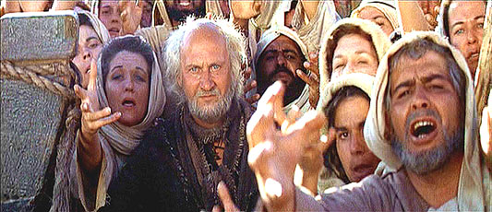
James 4.6-17

Slide 16
James 4.6-17

Slide 17
James 4.6-17
C. H. Spurgeon ~ "I desire to whisper one little truth in your ear, and I pray that it may startle you: You are submitting even now. You say, 'Not I; am lord of myself.' I know you think so, but all the while you are submitting to the devil. The verse before us hints at this. 'Submit yourselves unto God. Resist the devil, and he will

Slide 18
James 4.6-17
flee from you.' If you do not submit to God you never will resist the devil, and you will remain constantly under his tyrannical power. Which shall be your master, God or devil, for one of these must? No man is without a master."

Slide 19
James 4.6-17

Slide 20
James 4.6-17
Double-minded ~ literally, two-souled

Slide 21
James 4.6-17

