Slide 1

James 3.13- 4.6
A CD of this teaching will be available (free of charge) immediately following the service
A podcast of this teaching will be available on iTunes and calvaryokc.com later this week

Slide 2


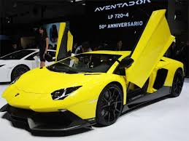
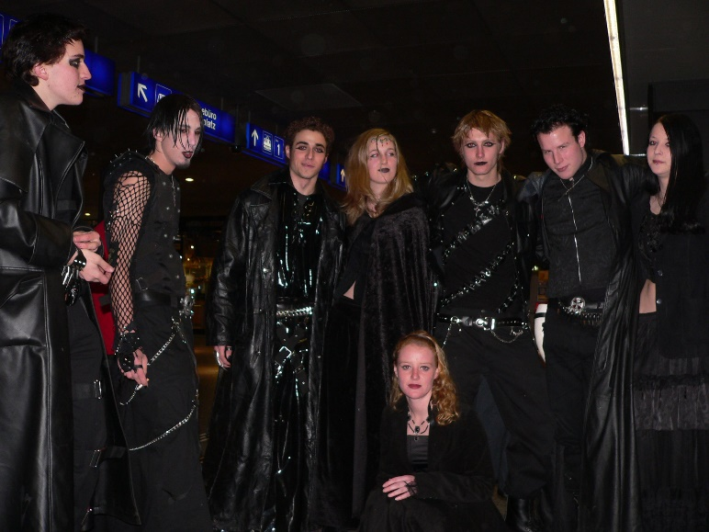



James 3.13- 4.6
WORLDLINESS

Slide 3

James 3.13- 4.6

Slide 4
James 3.13- 4.6
Conduct ~ KJV, conversation
Meekness ~ power under control

Slide 5
James 3.13- 4.6

Slide 6
James 3.13- 4.6
Three-fold enemy:
1. The World ~ you need to do what we say
2. Self ~ you need to do what you want
3. The Devil ~ you need to do either 1 or 2

Slide 7
James 3.13- 4.6

Slide 8
James 3.13- 4.6
Self-seeking ~ originally meant to spin wool
"The Marketing Department is pleased to announce that for the 2014 Softball Season, we came in 2nd place, having lost but one game all year. The Support Department, however, had a rather dismal season, as they won only one game."

Slide 9
James 3.13- 4.6

Slide 10
James 3.13- 4.6
Kenneth Wuest ~ But the wisdom which is from above is essentially pure, then peaceable, sweetly reasonable, satisfied with less than its due, compliant, full of mercy and good fruits,

Slide 11
James 3.13- 4.6

Slide 12
James 3.13- 4.6
Rom. 12.1 ~ I beseech you therefore, brethren, by the mercies of God, that you present your bodies a living sacrifice, holy, acceptable to God, which is your reasonable service.

Slide 13
James 3.13- 4.6
James 5.16 ~ Confess your trespasses to one another, and pray for one another, that you may be healed.

Slide 14
James 3.13- 4.6
Phil 4:8 ~ Finally, brethren, whatever things are true, whatever things are noble, whatever things are just, whatever things are pure, whatever things are lovely, whatever things are of good report, if there is any virtue and if there is anything praiseworthy — meditate on these things.

Slide 15
James 3.13- 4.6

Slide 16
James 3.13- 4.6
Ps. 37.4 ~ Delight yourself also in the Lord,
And He shall give you the desires of your heart.

Slide 17
James 3.13- 4.6
Pleasures ~ same as v. 1
NIV, desires
KJV, lusts
hēdonē ~ hedonism

Slide 18
James 3.13- 4.6

Slide 19
James 3.13- 4.6
D. L. Moody ~ "If you have truly become a friend of God, the world will give you up."

Slide 20
James 3.13- 4.6

Slide 21
James 3.13- 4.6
KJV & NIV ~ spirit, NKJ & NASB ~ Spirit
Human jealousy is insecurity
God's jealousy is born out of what's best for us

Slide 22
James 3.13- 4.6

Slide 23
James 3.13- 4.6
Rom. 5.20 ~ … but where sin increased, grace abounded all the more,
Abundance ~ perisseuō – 39x
huperperisseuō ~ super-abundance or abundance beyond measure

Slide 24
James 3.13- 4.6

