Slide 1

James 3.1-12
A CD of this teaching will be available (free of charge) immediately following the service
A podcast of this teaching will be available on iTunes and calvaryokc.com later this week

Slide 2

James 2.1-12
Matt. 12.33–37 ~ ³³ Either make the tree good and its fruit good, or else make the tree bad and its fruit bad; for a tree is known by its fruit. ³⁴ Brood of vipers! How can you, being evil, speak good things? For out of the abundance of the heart the mouth speaks. ³⁵ A good man out of the good treasure of his heart brings forth good things,

Slide 3
James 2.1-12
and an evil man out of the evil treasure brings forth evil things. ³⁶ But I say to you that for every idle word men may speak, they will give account of it in the day of judgment. ³⁷ For by your words you will be justified, and by your words you will be condemned.

Slide 4
James 2.1-12
2 Cor. 5.10 ~ For we must all appear before the judgment seat of Christ, that each one may receive the things done in the body, according to what he has done, whether good or bad.

Slide 5
James 2.1-12
Matt. 15.11 ~ Not what goes into the mouth defiles a man; but what comes out of the mouth, this defiles a man.

Slide 6

James 2.1-12

Slide 7
James 2.1-12
Prov. 10.19- 20 ~ ¹⁹ In the multitude of words sin is not lacking,
But he who restrains his lips is wise.
²⁰ The tongue of the righteous is choice silver;
The heart of the wicked is worth little.

Slide 8
James 2.1-12

Slide 9
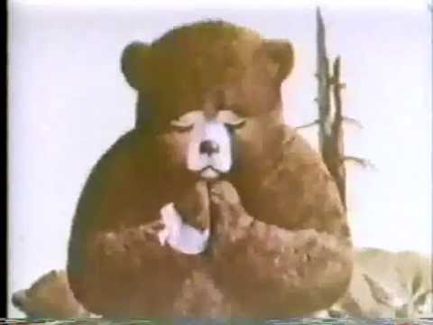
James 2.1-12
Only you … can prevent forest fires!

Slide 10
James 2.1-12

Slide 11

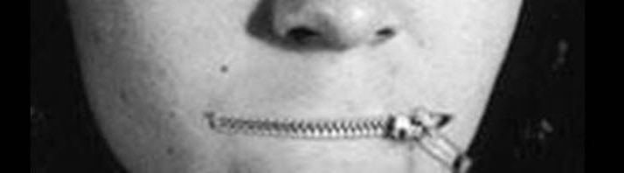
James 2.1-12

Slide 12
James 2.1-12
Thou art the master of the unspoken word.
But the spoken word art the master of you.

Slide 13
James 2.1-12

Slide 14
James 2.1-12
Will Rodgers (1879-1930) ~ "The only time people dislike gossip is when it’s about them."
Tacitus (AD 56-117) ~ "You are the lord of your tongue, but I am the master of my ears."

Slide 15
James 2.1-12

Slide 16
James 2.1-12
Prov. 18:21a ~ Death and life are in the power of the tongue,

Slide 17
James 2.1-12

