Slide 1

James 1.1-8
A CD of this teaching will be available (free of charge) immediately following the service
A podcast of this teaching will be available on iTunes and calvaryokc.com later this week

Slide 2

James 1.1-8
"Practical Makes Perfect"
Known as a "general" or "catholic" epistle
Probably the earliest of all the epistles (AD 45-50)

Slide 3
James 1.1-8
Anglicized form of Jacob (named after King James)
James the son of Zebedee (martyred early)
James the lesser (no prominence)
Jesus’ half-brother (James the Just)
"Old Camel-knees"

Slide 4
James 1.1-8
Matt. 1.24- 25 ~ ²⁴ Then Joseph, being aroused from sleep, did as the angel of the Lord commanded him and took to him his wife, ²⁵ and did not know her till she had brought forth her firstborn Son. And he called His name Jesus.

Slide 5

James 1.1-8

Slide 6
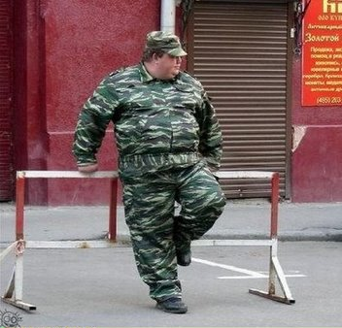
James 1.1-8
Pvt. Millkins

Slide 7
James 1.1-8

Slide 8
James 1.1-8
John 16:33 ~ These things I have spoken to you, that in Me you may have peace. In the world you will have tribulation; but be of good cheer, I have overcome the world.

Slide 9
James 1.1-8

Slide 10
James 1.1-8
Scattered abroad ~ diaspora
Literally, through (or scattered) the seed

Slide 11
James 1.1-8

Slide 12
James 1.1-8
Count ~ often translated to govern (from a root meaning to lead)
Various ~ multi-colored (same as Joseph's coat in Gen. 37.4 – LXX)

Slide 13
James 1.1-8
Patience ~ hupomonē
NASB, endurance
NIV, perseverance

Slide 14
James 1.1-8

Slide 15
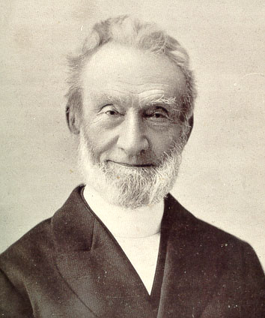
James 1.1-8
George Muller ~ "The beginning of anxiety is the end of faith, and the beginning of true faith is the end of anxiety."

Slide 16
James 1.1-8
Andrew Wainrib ~ “These (trials) are just speed bumps on the highway of life.”
Lost LA nightclub in Rodney King verdict riots
Lost Malibu home to fires the following year
Lost beachside cafe to earthquake the next year

Slide 17
James 1.1-8

Slide 18
James 1.1-8
Rom. 5.3-5 ~ ³ … we also glory in tribulations, knowing that tribulation produces perseverance; ⁴ and perseverance, character; and character, hope. ⁵ Now hope does not disappoint …

Slide 19
James 1.1-8

Slide 20
James 1.1-8
J. B. Phillips ~ ² When all kinds of trials and temptations crowd into your lives, my brothers, don't resent them as intruders, but welcome them as friends! ³ Realise that they come to test your faith and to produce in you the quality of endurance. ⁴ But let the process go on until that

Slide 21
James 1.1-8
endurance is fully developed, and you will find you have become men of mature character, men of integrity with no weak spots.

Slide 22
James 1.1-8

Slide 23
James 1.1-8
Double-minded ~ dipsuchos – literally, two-souled

Slide 24
James 1.1-8
Is. 55. 8 ~ "For My thoughts are not your thoughts, Nor are your ways My ways," says the Lord.

Slide 25
James 1.1-8

Slide 26
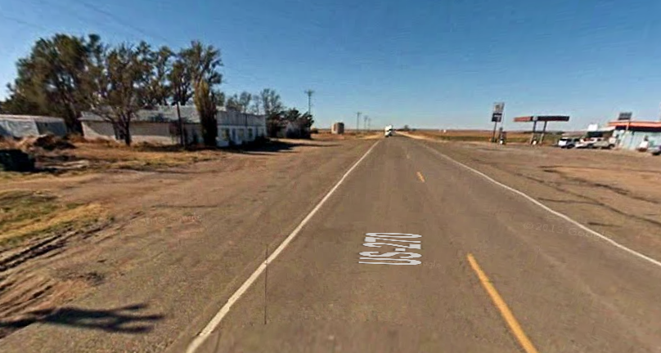
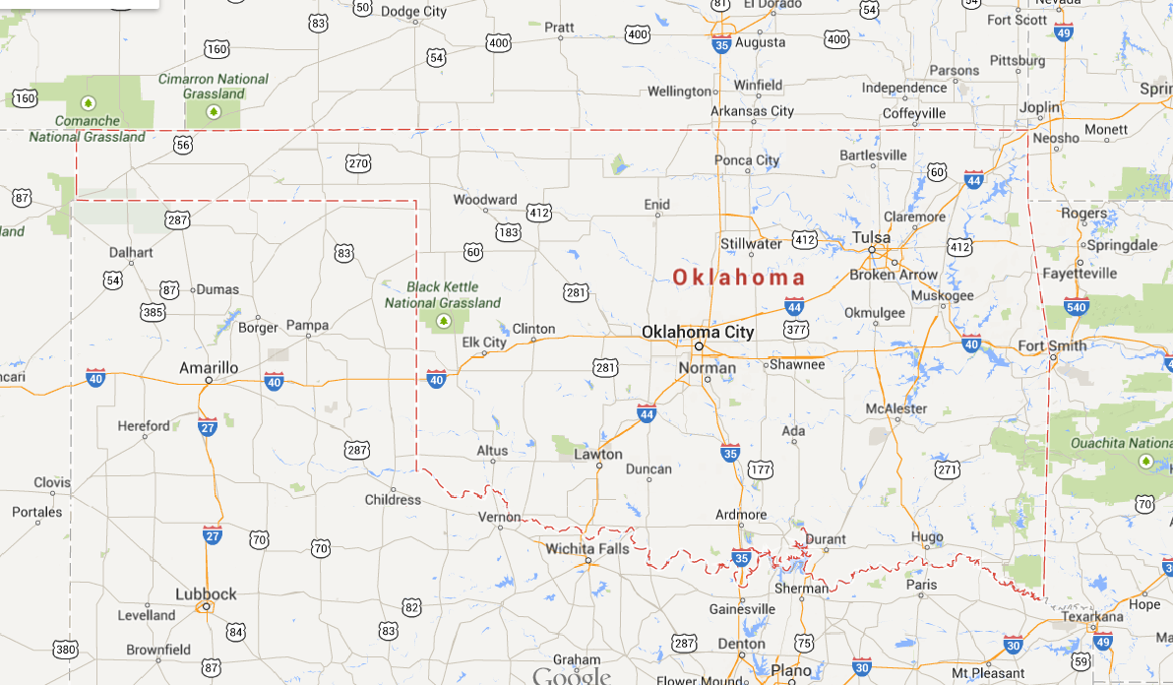
James 1.1-8
Slapout, OK

Slide 27
James 1.1-8

