Slide 1
65:1 – 66:24

Slide 2
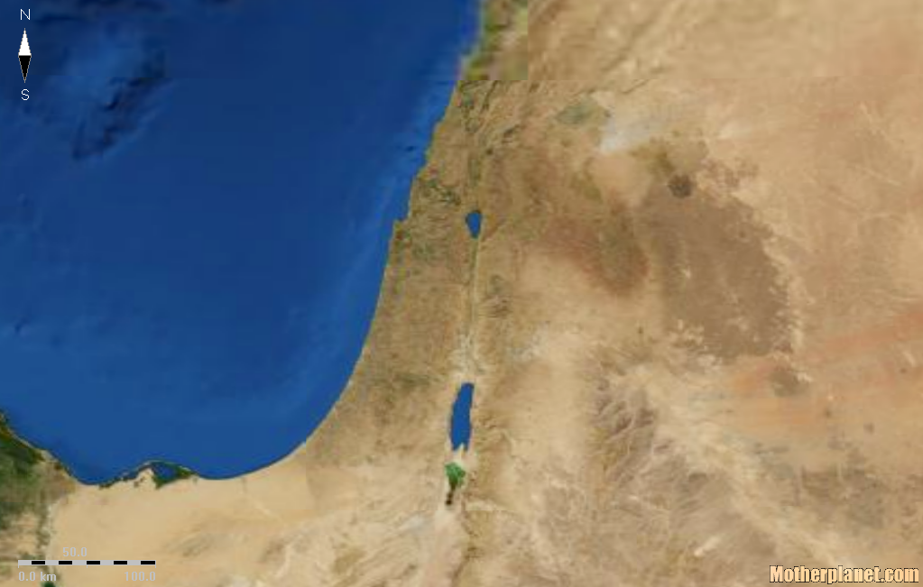
Sharon Valley
Achor Valley
65:1 – 66:24

Slide 3
KJV – prepare a table for that troop, and that furnish the drink offering unto that number.
Gad – god of good luck
Dan. 5:25 – And this is the inscription that was written: MENE, MENE, TEKEL, UPHARSIN.
Numbered, numbered, weighed and divided
Meni – from mene ; the god of destiny
65:1 – 66:24

Slide 4
Truth – amen
65:1 – 66:24

Slide 5
The Rapture
7 year Tribulation
1,000 year reign of Jesus
New Heavens and New Earth
Satan bound
Satan released
Satan cast into Lake of Fire
Ezekiel 38-39 war?
Jacob's Troubles
65:1 – 66:24

Slide 6
NCV – and a person who dies before he is a hundred will be thought of as a sinner.
65:1 – 66:24

Slide 7
Phil. 1:6 – being confident of this very thing, that He who has begun a good work in you will complete it until the day of Jesus Christ;
65:1 – 66:24

