Slide 1
63:1 – 64:12

Slide 2
Mal. 3:2a– But who can endure the day of His coming?
And who can stand when He appears?
63:1 – 64:12

Slide 3
Bozrah – fortress
Dyed – from a root meaning red
63:1 – 64:12

Slide 4
Rev. 19:13-15 – ¹³ He was clothed with a robe dipped in blood, and His name is called The Word of God. ¹⁴ And the armies in heaven, clothed in fine linen, white and clean, followed Him on white horses. ¹⁵ Now out of His mouth goes a sharp sword, that with it He should strike the nations. And He Himself will rule them with a rod of iron. He Himself treads the winepress of the fierceness and wrath of Almighty God.
63:1 – 64:12

Slide 5
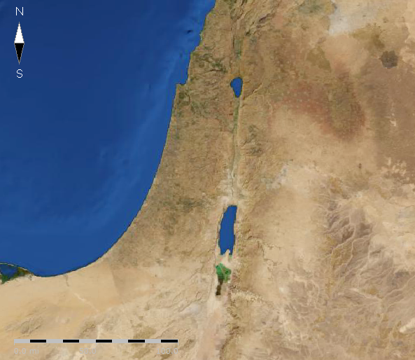
King of the North
Valley of Megiddo
Antichrist
King of the South
Dan. 11:40
Zech. 14:4
Jesus
Rev. 14:20
Bozrah
63:1 – 64:12

Slide 6
Rev. 5:2-5 – ² Then I saw a strong angel proclaiming with a loud voice, "Who is worthy to open the scroll and to loose its seals?" ³ And no one in heaven or on the earth or under the earth was able to open the scroll, or to look at it. ⁴ So I wept much, because no one was found worthy to open and read the scroll, or to look at it. ⁵ But one of the elders said to me, "Do not weep. Behold, the Lion of the tribe of Judah, the Root of David, has prevailed to open the scroll and to loose its seven seals."
63:1 – 64:12

Slide 7
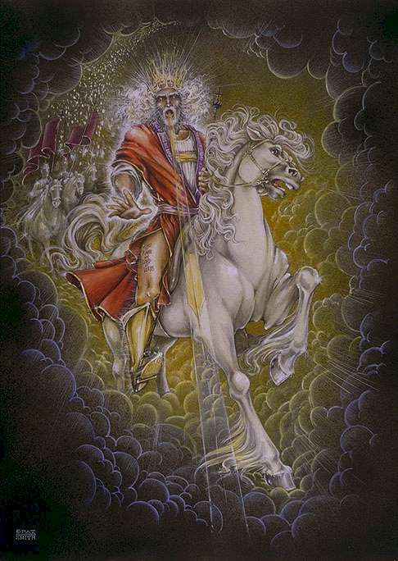
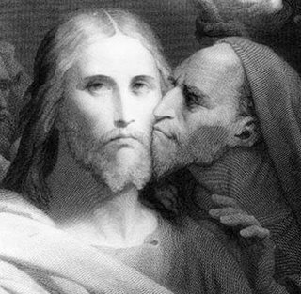
Trod-der
Trod-dee
63:1 – 64:12

Slide 8
Is. 61:1-2a – ¹ The Spirit of the Lord GOD is upon Me,
Because the Lord has anointed Me
To preach good tidings to the poor;
He has sent Me to heal the brokenhearted,
To proclaim liberty to the captives,
And the opening of the prison to those who are bound;
^{2a} To proclaim the acceptable year of the Lord,
And the day of vengeance of our God;
63:1 – 64:12

Slide 9
Kinsman Redeemer
The two-fold work
of the Ga'al :
Avenger of Blood
63:1 – 64:12

Slide 10
Within – literally, in the midst of (NASB) – NIV, among
63:1 – 64:12

Slide 11
Ps. 46:10 – Be still, and know that I am God; I will be exalted among the nations, I will be exalted in the earth!
63:1 – 64:12

Slide 12
Spurgeon – "Brethren, if our righteousnesses are so bad, what must our unrighteousnesses be?"
"Sirs, there is sin in our prayers; they need to be prayed over again. There is filth in the very tears that we shed in penitence; there is sin in our very holiness; there is unbelief in our faith; there is hatred in our very love; there is the slime of the serpent upon the fairest flower of our garden."
63:1 – 64:12

