Slide 1
61:1 – 62:12

Slide 2
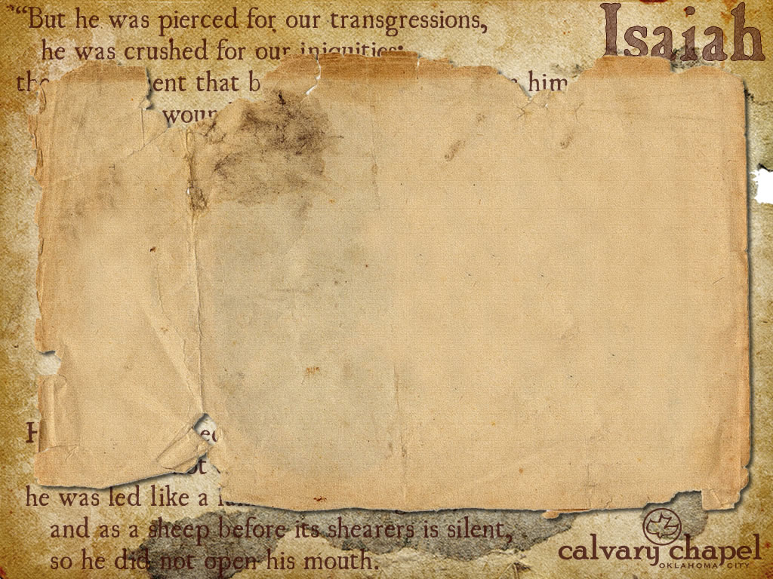

Luke 4:16-30
Heal – literally bind up (NIV, NASB, KJV)
61:1 – 62:12

Slide 3
Eph. 4:8-10 – ⁸ Therefore He says: "When He ascended on high, He led captivity captive, And gave gifts to men." ⁹ (Now this, "He ascended" —what does it mean but that He also first descended into the lower parts of the earth? ¹⁰ He who descended is also the One who ascended far above all the heavens, that He might fill all things.)
61:1 – 62:12

Slide 4
Ex. 34; Deut. 19 – The Avenger of Blood and the Cities of Refuge
Ga'al
61:1 – 62:12

Slide 5
Priests – 1st prophesied almost 3500 years ago (Ex. 19:6a – And you shall be to Me a kingdom of priests and a holy nation.)
61:1 – 62:12

Slide 6
Hephzibah – My Delight is in Her
Beulah –Married
61:1 – 62:12

Slide 7
J. Vernon McGee – "Prophecy is the mold into which history is poured."
8 prophecies – 1:10¹⁷
61:1 – 62:12

Slide 8
Approx. 40 authors
Written over 1500 years
3 different language
From every walk of life
Various literary styles
Numerous perspectives
Complete harmony
61:1 – 62:12

Slide 9
That which can be verified
That which cannot be verified
Horizontal line represents claims the Bible makes
Vertical line represents division between claims that can be verified and claims that cannot be verified
Blinking arrow represents the fact that with EVERY archeological find, the vertical line is ALWAYS moving to the right. Never has it ever moved left.
61:1 – 62:12

Slide 10
Luke 11:8 – I say to you, though he will not rise and give to him because he is his friend, yet because of his persistence he will rise and give him as many as he needs.
Persistence – KJV, importunity
Chutzpah
61:1 – 62:12

Slide 11
Matt. 11:12 – And from the days of John the Baptist until now the kingdom of heaven suffers violence, and the violent take it by force.
2 Pet. 3:11-12a – ¹¹ Therefore, since all these things will be dissolved, what manner of persons ought you to be in holy conduct and godliness, ¹² looking for and hastening the coming of the day of God…
61:1 – 62:12

Slide 12
Rev. 22:12a – And behold, I am coming quickly, and My reward is with Me,
61:1 – 62:12

