Slide 1
58:1 – 60:22

Slide 2
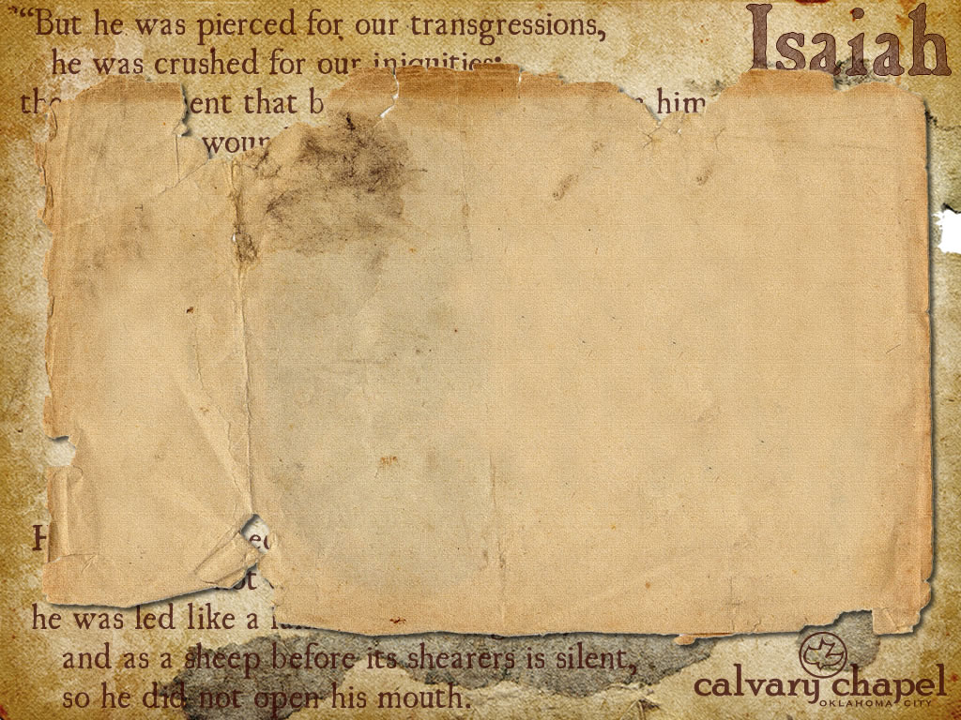
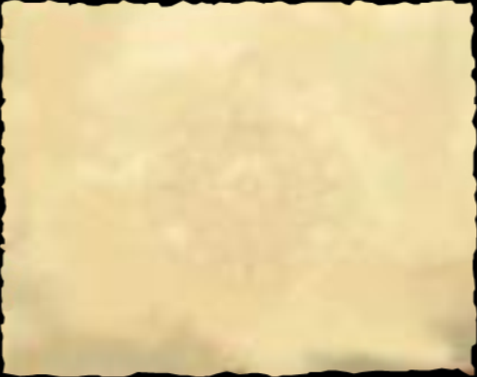
Micah 6:8 – He has shown you, O man, what is good; And what does the LORD require of you But to do justly, To love mercy, And to walk humbly with your God?
58:1 – 60:22

Slide 3
KJV, rereward
58:1 – 60:22

Slide 4
Jam. 1: 26-27 – ²⁶ If anyone among you thinks he is religious, and does not bridle his tongue but deceives his own heart, this one’s religion is useless. ²⁷ Pure and undefiled religion before God and the Father is this: to visit orphans and widows in their trouble, and to keep oneself unspotted from the world.
Strengthen – KJV, fat
– as in phat
58:1 – 60:22

Slide 5
Rev. 5:1-5 – ¹ And I saw in the right hand of Him who sat on the throne a scroll written inside and on the back, sealed with seven seals. ² Then I saw a strong angel proclaiming with a loud voice, "Who is worthy to open the scroll and to loose its seals?" ³ And no one in heaven or on the earth or under the earth was able to open the scroll, or to look at it. ⁴ So I wept much, because no one was found worthy to open and read the scroll, or to look at it.
⁵ But one of the elders said to me, "Do not weep. Behold, the Lion of the tribe of Judah, the Root of David, has prevailed to open the scroll and to loose its seven seals."
58:1 – 60:22

Slide 6
Redeemer – ga'al
When God will put an end to transgression
No more injustices
No more dealing with this earthly tent
No more car payments
No more struggling with sin
58:1 – 60:22

Slide 7
Rom. 11:25-26a – ²⁵ For I do not desire, brethren, that you should be ignorant of this mystery, lest you should be wise in your own opinion, that blindness in part has happened to Israel until the fullness of the Gentiles has come in. ^{26a} And so all Israel will be saved …
58:1 – 60:22

Slide 8
Gold – royalty
Incense – priesthood
58:1 – 60:22

Slide 9
Breast – shad (El Shaddai)
58:1 – 60:22

