Slide 1
56:1 – 57:21

Slide 2
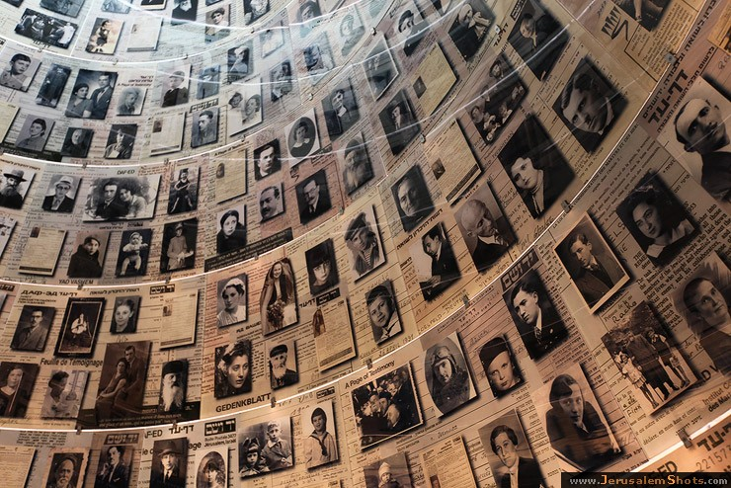
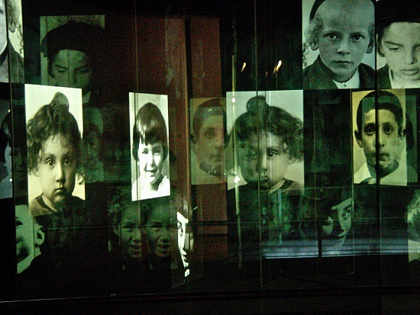
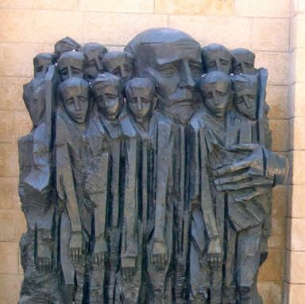
Place and a name – Yad Vashem
56:1 – 57:21

Slide 3
Exodus 31:16-17a – ¹⁶ Therefore the children of Israel shall keep the Sabbath, to observe the Sabbath throughout their generations as a perpetual covenant. ^{17a} It is a sign between Me and the children of Israel forever;
56:1 – 57:21

Slide 4
Rev. 19:17 – ¹⁷ Then I saw an angel standing in the sun; and he cried with a loud voice, saying to all the birds that fly in the midst of heaven, "Come and gather together for the supper of the great God, ¹⁸ that you may eat the flesh of kings, the flesh of captains, the flesh of mighty men, the flesh of horses and of those who sit on them, and the flesh of all people, free and slave, both small and great."
56:1 – 57:21

Slide 5
NIV, mute
56:1 – 57:21

Slide 6
Deut. 6:4 – Hear, O Israel: The LORD our God, the LORD is one!
Deut. 6:9 – You shall write them on the doorposts of your house and on your gates.
56:1 – 57:21

Slide 7
Sheol – grave (not, hell as in KJV)
56:1 – 57:21

Slide 8
Matt. 11:12 – And from the days of John the Baptist until now the kingdom of heaven suffers violence, and the violent take it by force.
James Denney – "The Kingdom of Heaven is not for the well-meaning but for the desperate."
56:1 – 57:21

Slide 9
Peace, peace – i. e. perfect peace
56:1 – 57:21

Slide 10
Three 9 chapter divisions of Isaiah 40-66
40-48
49-57
58-66
There is no peace … for the wicked
56:1 – 57:21

