Slide 1
54:1 – 55:13

Slide 2
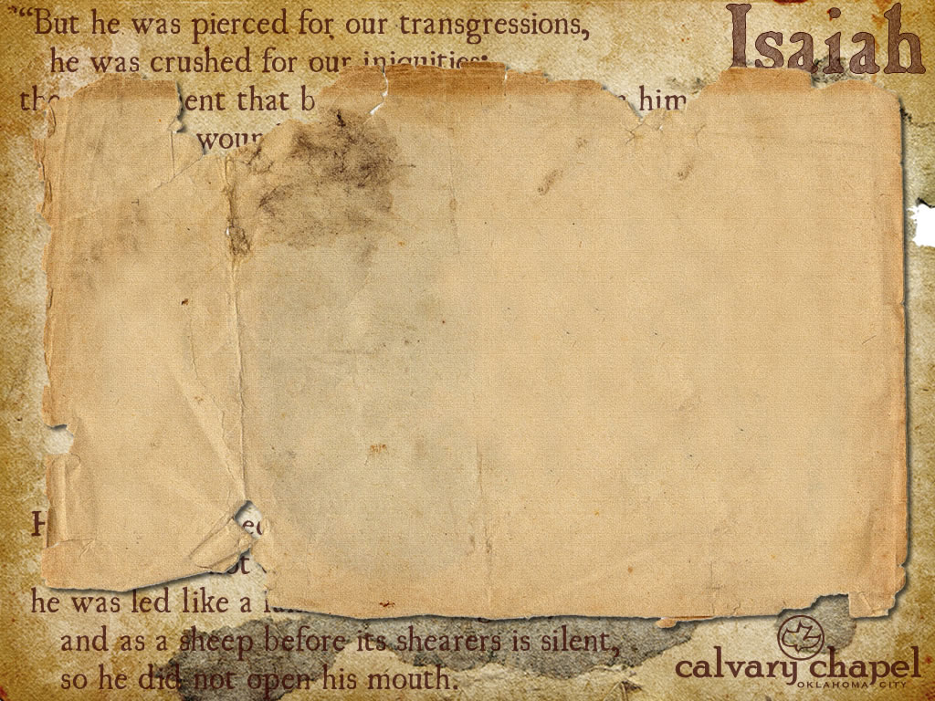

Either referring to the 70-year captivity or the Millennium
Principle of double reference
54:1 – 55:13

Slide 3
1st view: Married woman (Old Covenant); barren (New Covenant)
2nd view: Married woman (works salvation); barren (faith-walk)
54:1 – 55:13

Slide 4
God promised 300,000 sq. mi. (Josh. 1:4)
Has never occupied more than 30,000 sq. mi.)
54:1 – 55:13

Slide 5
Is. 64:6 – But we are all like an unclean thing, And all our righteousnesses are like filthy rags; We all fade as a leaf,
And our iniquities, like the wind,
Have taken us away.
54:1 – 55:13

Slide 6
Water: Eph. 5:26 – and cleanse her with the washing of water by the word,
Milk: 1 Pet. 2:2 – as newborn babes, desire the pure milk of the word,
Wine: Jer. 15:16 – Your words were found, and I ate them, and Your word was to me the joy and rejoicing of my heart;
54:1 – 55:13

Slide 7
Acts 17:26-27 – ²⁶ And He has made from one blood every nation of men to dwell on all the face of the earth, and has determined their preappointed times and the boundaries of their dwellings, ²⁷ so that they should seek the Lord, in the hope that they might grope for Him and find Him, though He is not far from each one of us;
54:1 – 55:13

Slide 8
TLB – This plan of Mine is not what you would work out, neither are my thoughts the same as yours.
54:1 – 55:13

