Slide 1
52:13 – 53:12

Slide 2
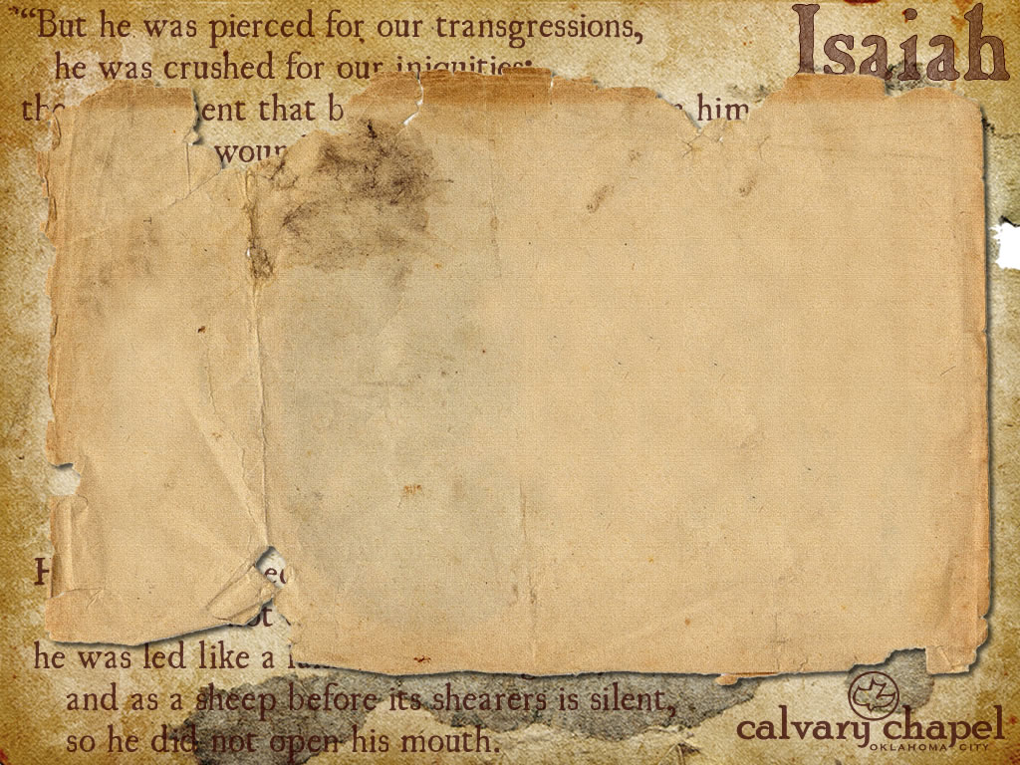
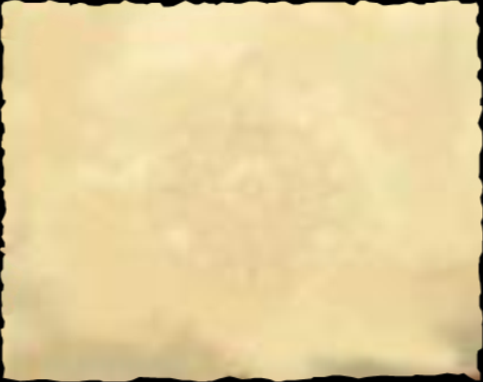
Quoted in all 4 Gospels
Matt. 8:17 (Is. 53:4)
Mark 15:28 (Is. 53:12)
Luke 22:37 (Is. 53:12)
John 12:38 (Is. 53:1)
52:13 – 53:12

Slide 3
LXX, Extolled – hupsoō; to elevate
John 3:14 – And as Moses lifted up the serpent in the wilderness, even so must the Son of Man be lifted up,
52:13 – 53:12

Slide 4
What if God was one of us
Just a slob like one of us
Like a stranger on the bus
Trying to make His way home
© 1996, Joan Osborne
52:13 – 53:12

Slide 5
Hallelujah, What a Savior!
"Man of Sorrows!" what a name
For the Son of God, who came
Ruined sinners to reclaim!
Hallelujah, what a Savior!
Bearing shame and scoffing rude,
In my place condemned He stood—
Sealed my pardon with His blood:
Hallelujah, what a Savior!
When He comes, our glorious King,
All His ransomed home to bring,
Then anew this song we'll sing;
Hallelujah, what a Savior!
Guilty, vile and helpless we,
Spotless Lamb of God was He;
Full atonement! Can it be?
Hallelujah, what a Savior!
Lifted up was He to die,
"It is finished," was His cry;
Now in heav'n exalted high:
Hallelujah, what a Savior!
52:13 – 53:12

Slide 6
Wounded – chalal
Carries the idea of violated, raped
In the Poal stem it means pierced (NASB, NIV)
52:13 – 53:12

Slide 7
Matt. 8: 17 – He Himself took our infirmities and bore our sicknesses
Penalty of sin
Power of sin
Presence of sin
Heb. 2:8 – We do not yet see all things under His feet
52:13 – 53:12

Slide 8
Satisfied – propitiation
52:13 – 53:12

