Slide 1
41:1 – 43:28

Slide 2
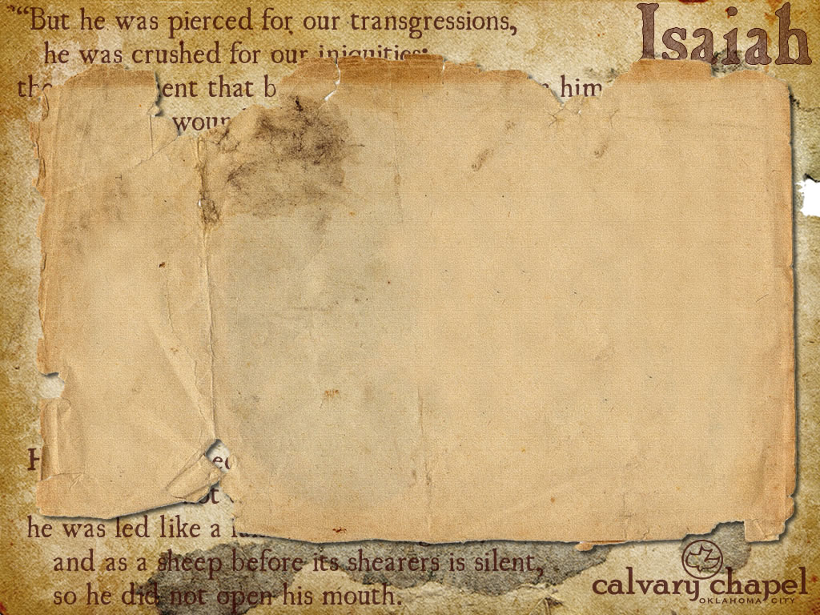

Cyrus, King of Persia – 559 BC to 529 BC
41:1 – 43:28

Slide 3
Redeemer – ga'al (go-el)
41:1 – 43:28

Slide 4
"Too many Christians still live with crossed fingers, sweating out their good luck as a portent of calamity. To see them, you would never guess that God's good pleasure, and not the goddess of fate, rules human destiny" (Edmund Clowney)
41:1 – 43:28

Slide 5
1
2
3
4
5
6
7
8
9
10
0
0
0
0
0
0
0
0
1:10
0
41:1 – 43:28

Slide 6
Redeemed – ga'al ; 24 of 27x in Isaiah is in 40-66
41:1 – 43:28

Slide 7
Created – bara; to make from nothing
Formed – yatsar; to fashion from existing materials
Made – asaw; having the idea of doing, making
41:1 – 43:28

Slide 8
Over 100 years before the Babylonian conquest
41:1 – 43:28

Slide 9
Psalm 8:8 – The birds of the air,
And the fish of the sea
That pass through the paths of the seas.
Matthew Maury (1791-1867) – Father of Oceanography
"The Bible is true and science is true, and therefore each, if truly read, but proves the truth of the other."
41:1 – 43:28

Slide 10
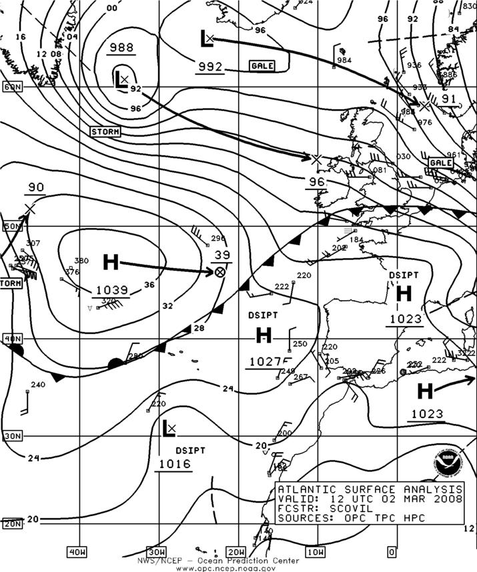
41:1 – 43:28

Slide 11
First father – either Adam or Abraham
41:1 – 43:28

