Slide 1
38:1 – 40:31

Slide 2
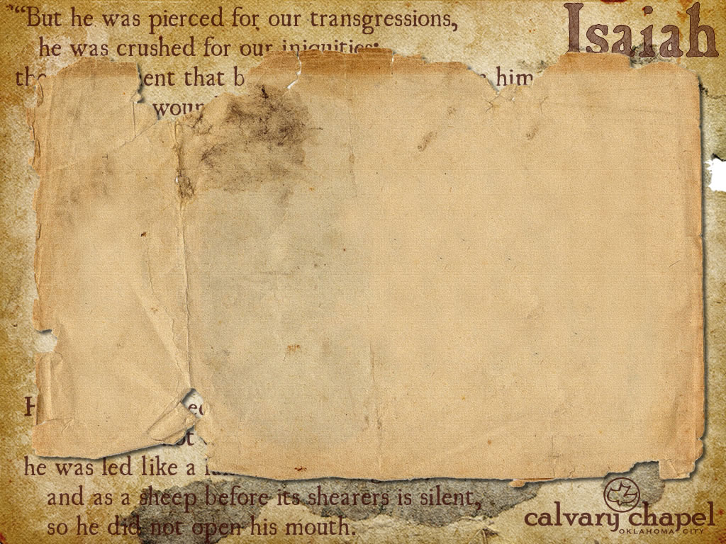

2 Kings 20:8 – And Hezekiah said to Isaiah, "What is the sign that the Lord will heal me, and that I shall go up to the house of the Lord the third day?"
38:1 – 40:31

Slide 3
To get his good-night kiss he stood
Beside my chair one night
And raised an eager face to me,
A face with love alight.
And as I gathered in my arms
The son God gave to me,
I thanked the lad for being good,
and hoped he'd always be.
His little arms crept round my neck
And then I heard him say
Five simple words I can't forget...
Five words that made me pray.
They turned a mirror on my soul,
On secrets no one knew,
They startled me, I hear them yet;
He said... "I wanna be like you." – Anonymous
38:1 – 40:31

Slide 4
Manasseh was born 3 years later
Sawed Isaiah w/ wooden saw
38:1 – 40:31

Slide 5
1st 39 chapters the theme is primarily judgment with a glimpse of grace
Last 27 chapters the theme is primarily grace with a reminder of judgment
3 parts of 9 chapters each
38:1 – 40:31

Slide 6
Comfort – 13x in 40-66
Burden – 16x in 1-39; none in 40-66
Woe – 20x in 1-39; 2x in 40-66
38:1 – 40:31

Slide 7
Double – i.e. sufficient
Propitiation
Justification is Christ's work earth-ward,
Propitiation is His work heaven-ward
Justification
38:1 – 40:31

Slide 8
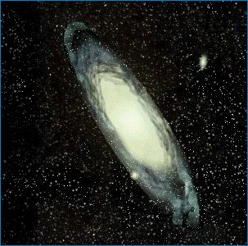
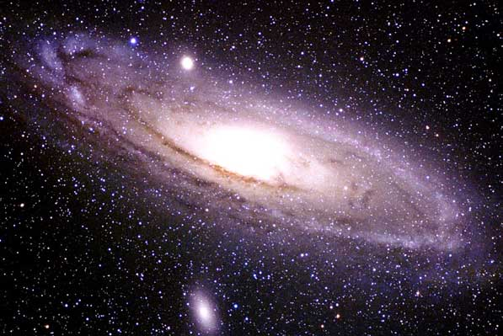
Light travels at 186,000 miles per sec; a light year is 96,000,000 miles
Milky Way
Andromeda
2,000,000 ly
100,000 ly
38:1 – 40:31

Slide 9

Milky Way contains 200 billion stars; Andromeda contains 1 trillion
Local Group
(36 galaxies)
38:1 – 40:31

Slide 10
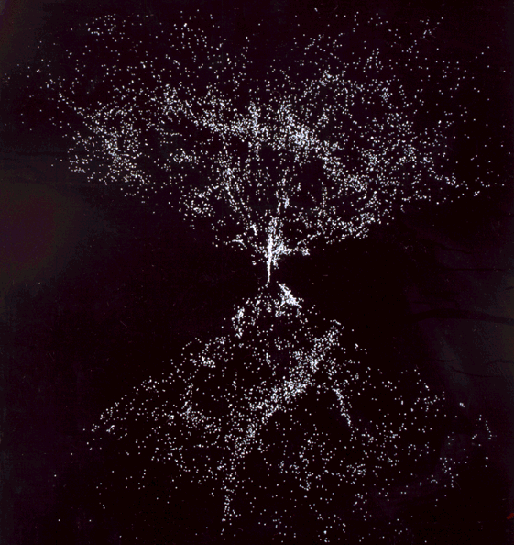
Cluster are larger than groups and contain between 50 – 1,000 galaxies
Super-clusters contain between 10 and 15 clusters
Super
Cluster
Cluster
38:1 – 40:31

Slide 11
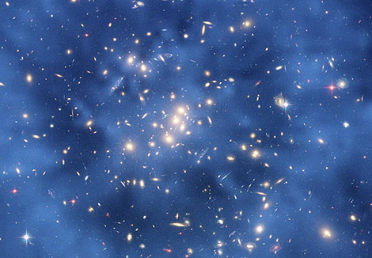
Observable universe is somewhere between 28 and 160 billion light years in diameter
38:1 – 40:31

Slide 12
Circle – chuwg; NASB (1971 ed.), vault
38:1 – 40:31

Slide 13
Wait – implies active hoping
Renew – implies exchanging for better
38:1 – 40:31

