Slide 1
31:1 – 34:17

Slide 2
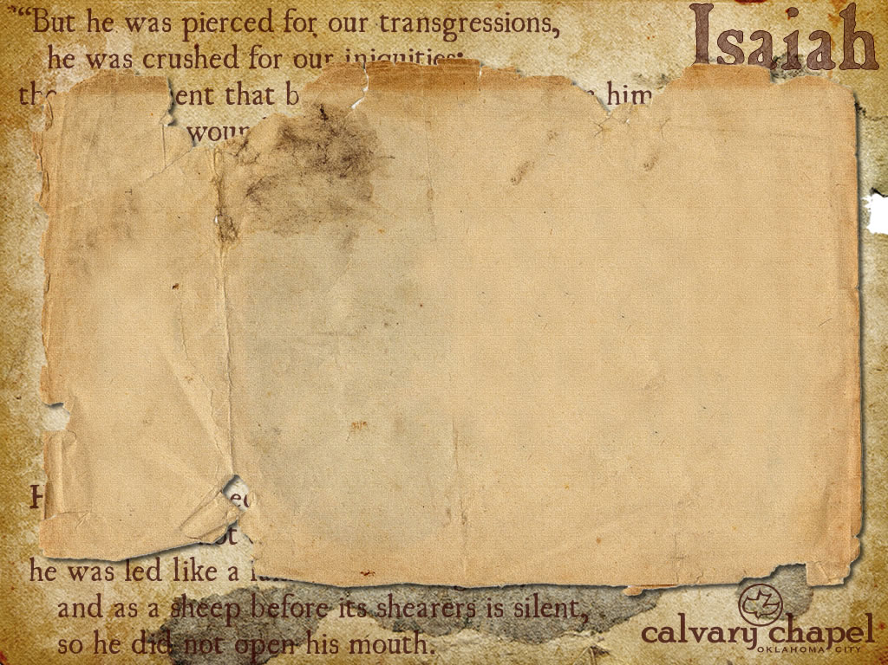

Ps. 20:7 – Some trust in chariots, and some in horses;
But we will remember the name of the Lord our God.
"Alas, how many in our day who profess to be the Lord’s are as abjectly dependent upon their fellow–men or upon an arm of flesh in some shape or other, as if they had never known the name of Jehovah at all. Jesus, be thou alone our rock and refuge, and never may we mar the simplicity of our faith." – Spurgeon
31:1 – 34:17

Slide 3



What's next?
Tribulation
Millennium
7 years
1000 years
31:1 – 34:17

Slide 4
Rash – NASB, hasty
31:1 – 34:17

Slide 5
KJV – the vile person shall no more be called liberal
31:1 – 34:17

Slide 6
Schemer – KJV, churl
31:1 – 34:17

Slide 7
NLT – In that day he will be your sure foundation, providing a rich store of salvation, wisdom, and knowledge. The fear of the LORD is the key to this treasure.
31:1 – 34:17

Slide 8
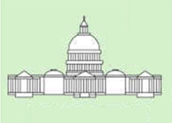

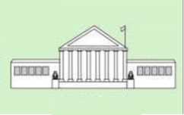
Three Branches of Government
Legislative
Executive
Judicial
31:1 – 34:17

Slide 9
2 Pet. 3:10 – But the day of the Lord will come as a thief in the night, in which the heavens will pass away with a great noise, and the elements will melt with fervent heat; both the earth and the works that are in it will be burned up.
Rev. 6:14 – Then the sky receded as a scroll when it is rolled up, and every mountain and island was moved out of its place.
Prophesied by Joel, Jesus (Mt. 24), Peter (Acts 2), and John (Rev. 6)
31:1 – 34:17

Slide 10
Wild oxen – KJV, unicorns
31:1 – 34:17

