Slide 1
28:1 – 30:24

Slide 2
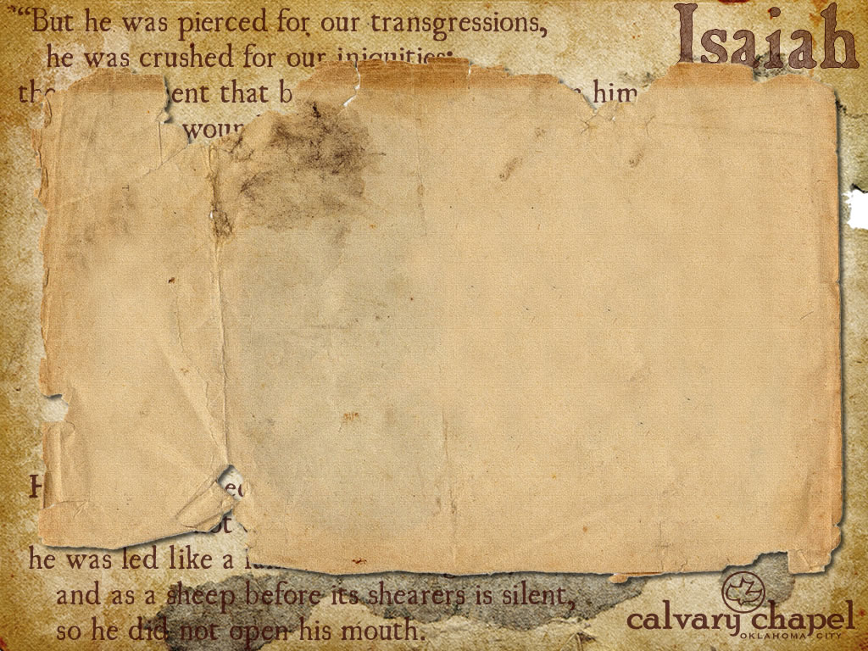
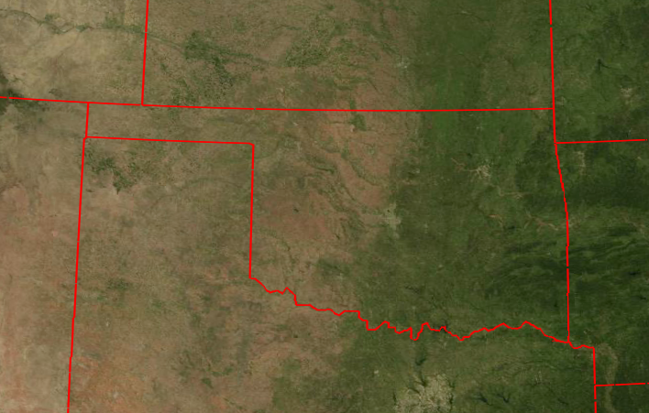

Only 20% of the land is naturally arable
Produces 95% of its own food needs
260 mi.
320 mi.
28:1 – 30:24

Slide 3
Red sky in morning, sailor take warning
Red sky at night, sailor's delight
Matt. 16:2-3 – ² He answered and said to them, “When it is evening you say, ‘It will be fair weather, for the sky is red’; ³ and in the morning, ‘It will be foul weather today, for the sky is red and threatening. Hypocrites! You know how to discern the face of the sky, but you cannot discern the signs of the times.
28:1 – 30:24

Slide 4
1 Cor. 14:2 – For he who speaks in a tongue does not speak to men but to God, for no one understands him; however, in the spirit he speaks mysteries.
1 Cor. 14:21 – In the law it is written: "With men of other tongues and other lips I will speak to this people; And yet, for all that, they will not hear Me," says the Lord.
28:1 – 30:24

Slide 5
Ps. 118:22-24 – ²² The stone which the builders rejected Has become the chief cornerstone. ²³ This was the LORD’S doing; It is marvelous in our eyes. ²⁴ This is the day the LORD has made; We will rejoice and be glad in it.
28:1 – 30:24

Slide 6
Ariel – Lion of God, a nickname for Jerusalem
28:1 – 30:24

Slide 7
1 Cor. 2:14 – But the natural man does not receive the things of the Spirit of God, for they are foolishness to him; nor can he know them, because they are spiritually discerned.
28:1 – 30:24

Slide 8
Monstrous
Menstruous
Unclean thing – NIV, menstrual cloth
KJV, menstruous cloth
28:1 – 30:24

Slide 9
Tophet – Gehenna
28:1 – 30:24

