Slide 1
15:1 – 18:7

Slide 2
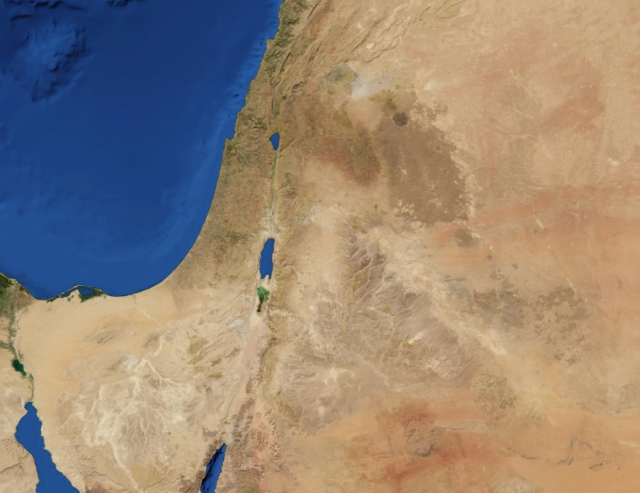
Moab – seed of the father
Moab
Jordan
15:1 – 18:7

Slide 3
Three-year old heifer – probably place name Eglath-shelishiyah
15:1 – 18:7

Slide 4
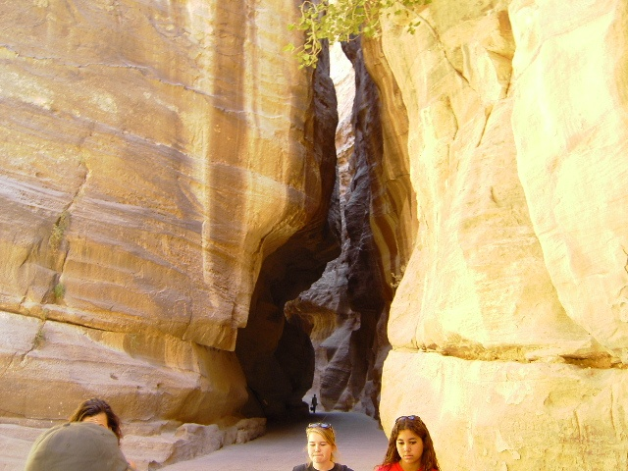
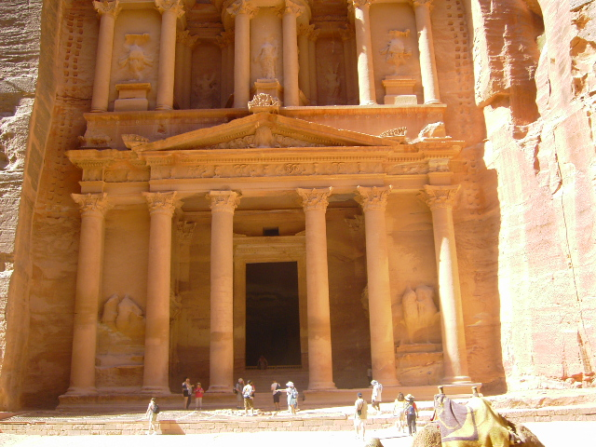
Sela – Petra
Moab
Jordan
Sela/Petra
15:1 – 18:7

Slide 5
Dan. 9:27 – Then he (the Antichrist) shall confirm a covenant with many for one week (seven years); But in the middle of the week He shall bring an end to sacrifice and offering. And on the wing of abominations shall be one who makes desolate, Even until the consummation, which is determined, Is poured out on the desolate.
15:1 – 18:7

Slide 6
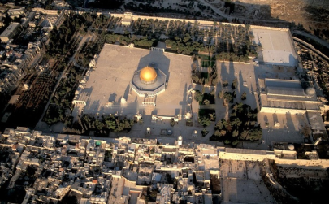
Dome of the Rock
Dome of the Spirits/Tablets
Western Wall
15:1 – 18:7

Slide 7
Rev. 11:1-2 – ¹ Then I was given a reed like a measuring rod. And the angel stood, saying, "Rise and measure the temple of God, the altar, and those who worship there. ² But leave out the court which is outside the temple, and do not measure it, for it has been given to the Gentiles. And they will tread the holy city underfoot for forty-two months."
15:1 – 18:7

Slide 8
2 Thess. 2:3-4 – ³ Let no one deceive you by any means; for that Day will not come unless the falling away comes first, and the man of sin is revealed, the son of perdition, ⁴ who opposes and exalts himself above all that is called God or that is worshiped, so that he sits as God in the temple of God, showing himself that he is God.
15:1 – 18:7

Slide 9
Matt. 24:15-21 – ¹⁵ Therefore when you see the "abomination of desolation," spoken of by Daniel the prophet, standing in the holy place (whoever reads, let him understand), ¹⁶ then let those who are in Judea flee to the mountains. ¹⁷ Let him who is on the housetop not go down to take anything out of his house. ¹⁸ And let him who is in the field not go back to get his
clothes. ¹⁹ But woe to those who are pregnant and to those who are nursing babies in those days! ²⁰ And pray that your flight may not be in winter or on the Sabbath. ²¹ For then there will be great tribulation, such as has not been since the beginning of the world until this time, no, nor ever shall be.
15:1 – 18:7

Slide 10
Rev. 12:14 – But the woman was given two wings of a great eagle, that she might fly into the wilderness to her place, where she is nourished for a time and times and half a time, from the presence of the serpent.
15:1 – 18:7

Slide 11
Num. 24:17 – I see Him, but not now; I behold Him, but not near; A Star shall come out of Jacob; A Scepter shall rise out of Israel, And batter the brow of Moab,
15:1 – 18:7

Slide 12
Tiglath-Pileser in 732 BC
15:1 – 18:7

Slide 13
Buzzing wings – insects
Ethiopia – Cush
15:1 – 18:7

