Slide 1
12:1 – 14:32

Slide 2
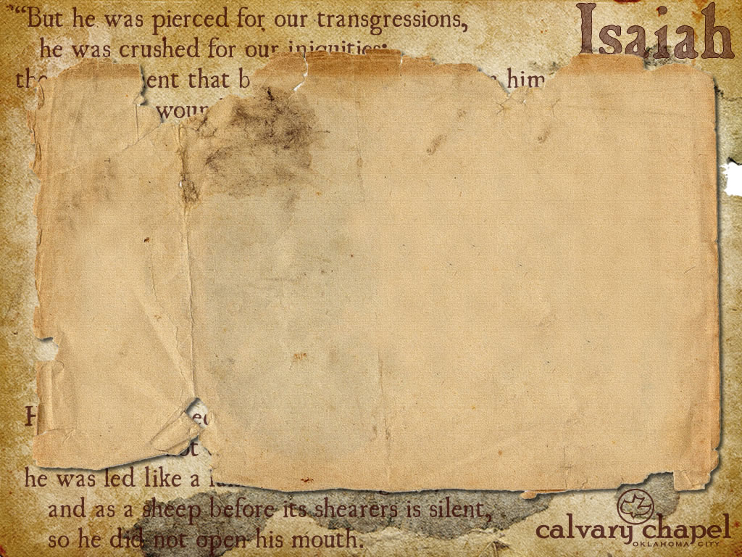
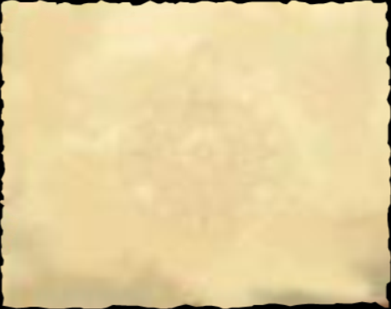
The Wasserman Test for syphilis
Digitalis, discovered by Doctor Nuslin
Insulin, discovered by Doctor Minofsky
Chloral Hydrate, discovered by Doctor Lifreich
The Schick Test for Diphtheria
Vitamins, discovered by Doctor Funk
Streptomycin, discovered by Doctor Waksman
The Polio Pill by Doctor Sabin, and the Polio Vaccine by Doctor Jonas Salk
12:1 – 14:32

Slide 3
Nobel Prize winners since 1980 …
Chemistry: 19
Physiology and Medicine: 23
Physics: 16
Economics: 17
1/1000th of the world's population
> Population of Greater Los Angeles
12:1 – 14:32

Slide 4
Burden – massa' ; from word meaning lift up or to carry
NIV, NASB – oracle
12:1 – 14:32

Slide 5
Origin of rebellious government
Gen. 10:9 – He (Nimrod) was a mighty hunter before the LORD; therefore it is said, "Like Nimrod the mighty hunter before the LORD."
Idolatry
Ninus and Ishtar
12:1 – 14:32

Slide 6
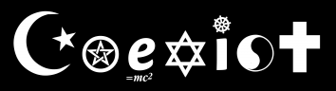
Islam
Science
Buddhism
Christianity
Wicca
Judaism
Toaism
12:1 – 14:32

Slide 7
Rev. 6:12-13 –¹² I looked when He opened the sixth seal, and behold, there was a great earthquake; and the sun became black as sackcloth of hair, and the moon became like blood. ¹³ And the stars of heaven fell to the earth, as a fig tree drops its late figs when it is shaken by a mighty wind.
12:1 – 14:32

Slide 8
Woodsman – KJV, feller
12:1 – 14:32

Slide 9
Lucifer – heylel; literally shining one
12:1 – 14:32

Slide 10
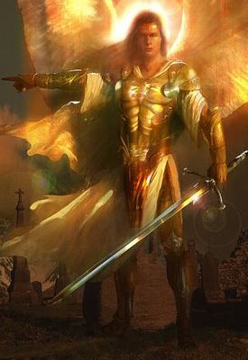
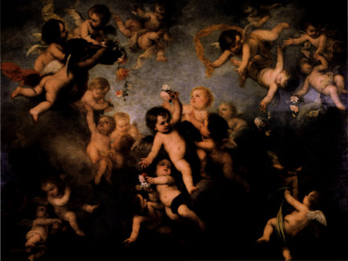
Eze. 28:14 – You were the anointed cherub who covers
Covers – cakak; to cover protectively
12:1 – 14:32

Slide 11
Philistia – KJV; Palestina
12:1 – 14:32

