Slide 1
9:1 – 11:16

Slide 2
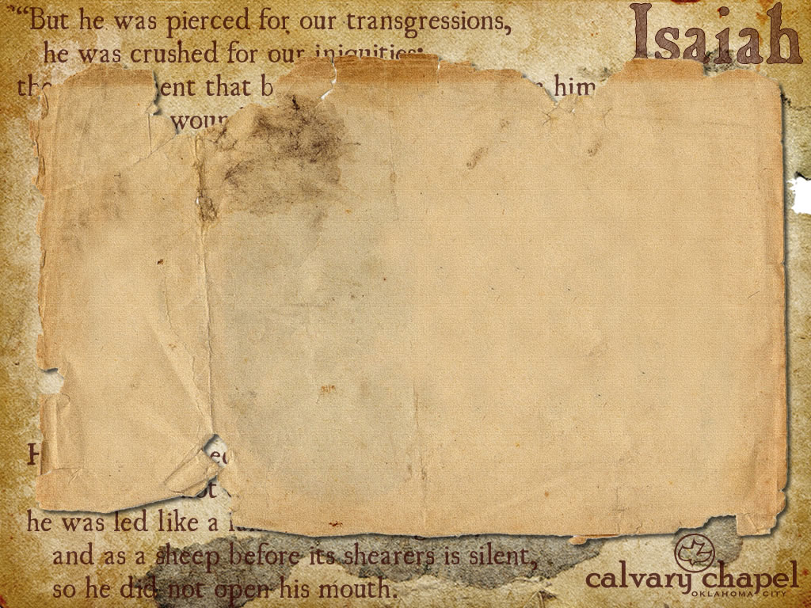

Heavily oppressed her – NASB, better - but later on He shall make it glorious
9:1 – 11:16

Slide 3
Increased its joy – KJV reads - and not increased the joy
9:1 – 11:16

Slide 4
The Child was born (Jesus) but …
the Son was given (2nd person of the Godhead)
91:1 – 11:16

Slide 5
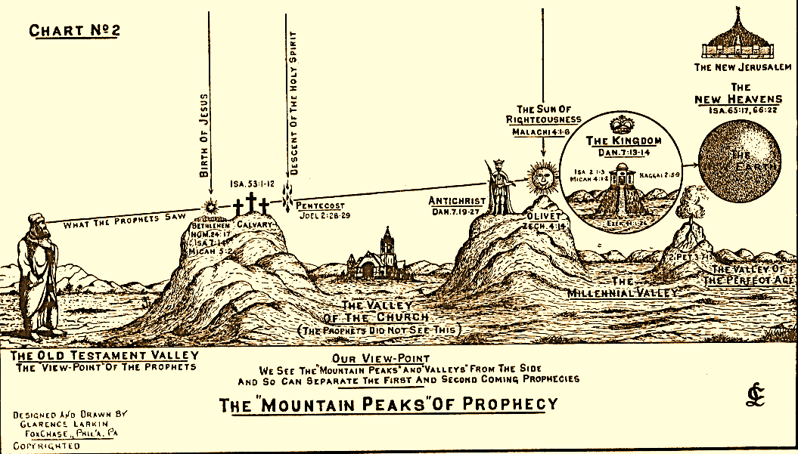
91:1 – 11:16

Slide 6
Everlasting Father – better, Father of Eternity
Relationship to time, not the Trinity
9:1 – 11:16

Slide 7
Better, to Him will increase government and peace…
9:1 – 11:16

Slide 8
Arkansas: A man has a legal right to beat his wife, but only once a month.
FL: Illegal for single, divorced, or widowed women to parachute on Sunday afternoons.
L.A.: A man can legally beat his wife with a leather strap, as long as it is less than two inches wide, or she gives him permission to use a wider strap, preferably in advance.
Greene, NY: Illegal to eat peanuts and walk backwards on the sidewalk during a concert.
OK: Criminals can be fined, arrested or jailed for making faces at a dog.
Hartford, CT: Crossing the street walking on your hands is not allowed.
OK: Whale hunting is strictly forbidden throughout the entire state.
9:1 – 11:16

Slide 9
Him = Assyria
Ungodly nation = Judah
9:1 – 11:16

Slide 10
Nothing is greater than being used by the Lord
Nothing is worse than thinking you had something to do with it
9:1 – 11:16

Slide 11
Rev. 1:4, 3:1, 4:5, 5:6 – seven Spirits of God
The seven-fold Spirit of God
9:1 – 11:16

Slide 12
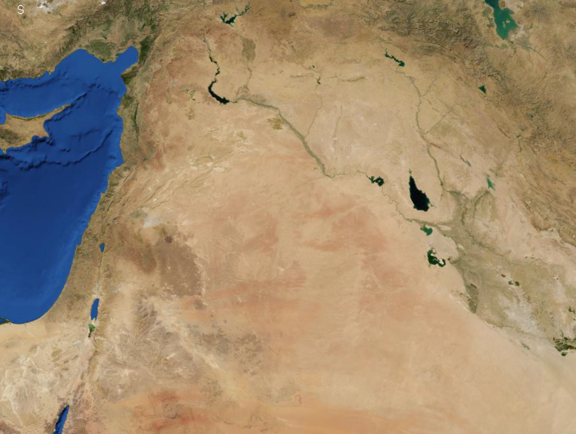
Israel
Millennial
Borders
9:1 – 11:16

