Slide 1
6:1 – 8:22

Slide 2
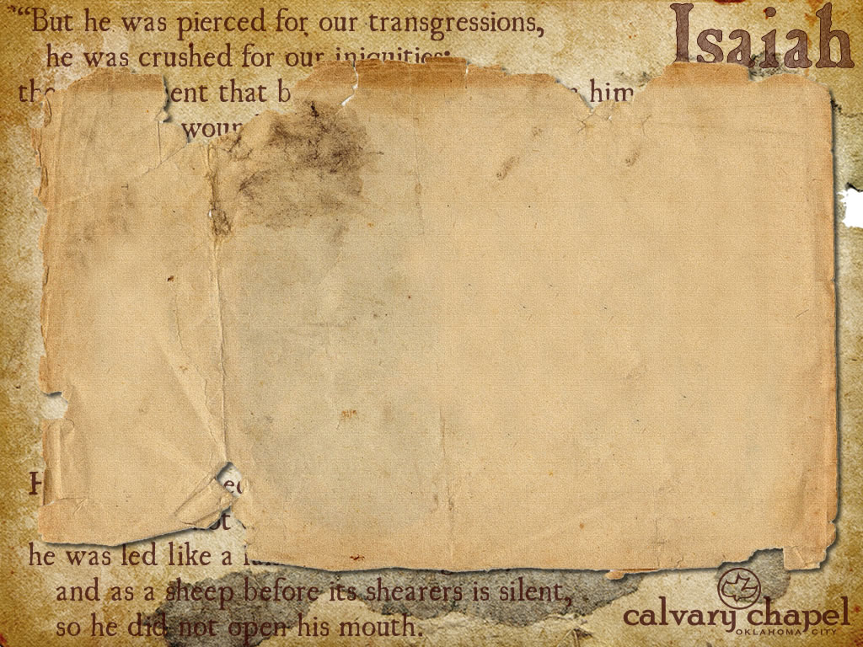

Uzziah is also called Azariah
6:1 – 8:22

Slide 3
Seraphim (burning ones)
Eze. 1:5 – Living creatures (4 wings, 4 faces)
Rev. 4:8 --Living creatures (6 wings, four different creatures)
Cherubim = protectors of God's holiness
Seraphim = proclaimers of God's holiness
6:1 – 8:22

Slide 4
Holy 3x – total emphasis
Holy!
6:1 – 8:22

Slide 5
Literally Behold me!
6:1 – 8:22

Slide 6
John 12:41 – These things Isaiah said when he saw His glory and spoke of Him."
6:1 – 8:22

Slide 7
John 3:19 – And this is the condemnation, that the light has come into the world, and men loved darkness rather than light, because their deeds were evil
6:1 – 8:22

Slide 8
Shear-Jashub – a remnant will return
6:1 – 8:22

Slide 9
Virgin – almah
Matt. 1:22-23 – 22 So all this was done that it might be fulfilled which was spoken by the Lord through the prophet, saying: ²³ Behold, the virgin shall be with child, and bear a Son, and they shall call His name Immanuel, which is translated, "God with us."
parthenos
6:1 – 8:22

Slide 10
Maher-Shalal-Hash-Baz – quick to the spoil
6:1 – 8:22

Slide 11
Conspiracy – queser; also translated treason
6:1 – 8:22

Slide 12
KJV, gin
6:1 – 8:22

Slide 13
Mutter – literally moan
6:1 – 8:22

Slide 14
Romaine – "Go home and read your Bible!"
6:1 – 8:22

Slide 15
Rev. 22:11-12 – ¹¹ "He who is unjust, let him be unjust still; he who is filthy, let him be filthy still; he who is righteous, let him be righteous still; he who is holy, let him be holy still. ¹² And behold, I am coming quickly, and My reward is with Me, to give to every one according to his work."
6:1 – 8:22

