Slide 1
1:1 – 2:22

Slide 2
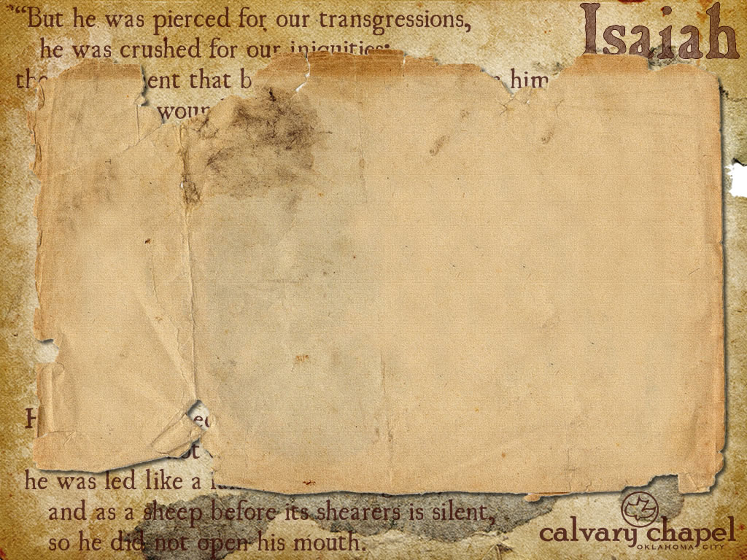

Isaiah's ministry
739 – c. 686 BC
770 BC
760 BC
750 BC
740 BC
730 BC
720 BC
710 BC
700 BC
690 BC
680 BC
670 BC
Uzziah
768-739BC
Jotham
739-735BC
Ahaz
735-715BC
Hezekiah
715-686BC
1:1 – 2:22

Slide 3
Historical events cover period of 58 years
Uzziah's death (739 BC)
Tradition says he was martyred by Manasseh
1:1 – 2:22

Slide 4
Deutero- (1-39; 40-66)
Trito- (1-39; 40-55; 56-66)
DDS (Isaiah A - 200 BC)
LXX - at least 150 BC
1:1 – 2:22

Slide 5
John 12:38 - … that the word of Isaiah the prophet might be fulfilled, which he spoke: "Lord, who has believed our report? And to whom has the arm of the Lord been revealed?" (53:1)
39-40 - Therefore they could not believe, because Isaiah said again: "He has blinded their eyes and hardened their hearts, Lest they should see with their eyes, Lest they should understand with their hearts and turn, So that I should heal them." (6:10)
1:1 – 2:22

Slide 6
Theme of chapters 1-39 – Law and judgment (1-39)
Theme of chapters 40-66 – Grace, salvation and restoration
Quoted no less than 65x in New Testament
Mentioned by name 22x
1:1 – 2:22

Slide 7
Crib – NASB, NIV; manger (feed trough)
1:1 – 2:22

Slide 8
Stricken, sick (v. 5) and bruises are the same 3 words in 53:4, 5
Smitten by God, borne our griefs, by His stripes
1:1 – 2:22

Slide 9
Had enough – literally, fed up
Selfish giving (v. 11)
Superficial worship (vv. 12-14)
Shallow prayers (v. 15)
1:1 – 2:22

Slide 10
Sadhu Sundar Singh – "Should I worship Him from fear of hell, may I be cast into it. Should I serve Him from desire of gaining heaven, may He keep me out. But should I worship Him from love alone, may He reveal Himself to me, that my whole heart may be filled with His love and presence."
1:1 – 2:22

Slide 11
"Come now?"
or, "Come now?"
1:1 – 2:22

Slide 12
Joel 3:10 – Beat your plowshares into swords And your pruning hooks into spears; Let the weak say, `"I am strong."
1:1 – 2:22

Slide 13
Rev. 6:15-17– ¹⁵ And the kings of the earth, the great men, the rich men, the commanders, the mighty men, every slave and every free man, hid themselves in the caves and in the rocks of the mountains, ¹⁶ and said to the mountains and rocks, "Fall on us and hide us from the face of Him who sits on the throne and from the wrath of the Lamb! ¹⁷ "For the great day of His wrath has come, and who is able to stand?"
1:1 – 2:22

Slide 14

Sever – chadal, literally cease; same as 53:3 – He is despised and rejected by men
1:1 – 2:22

