Slide 1
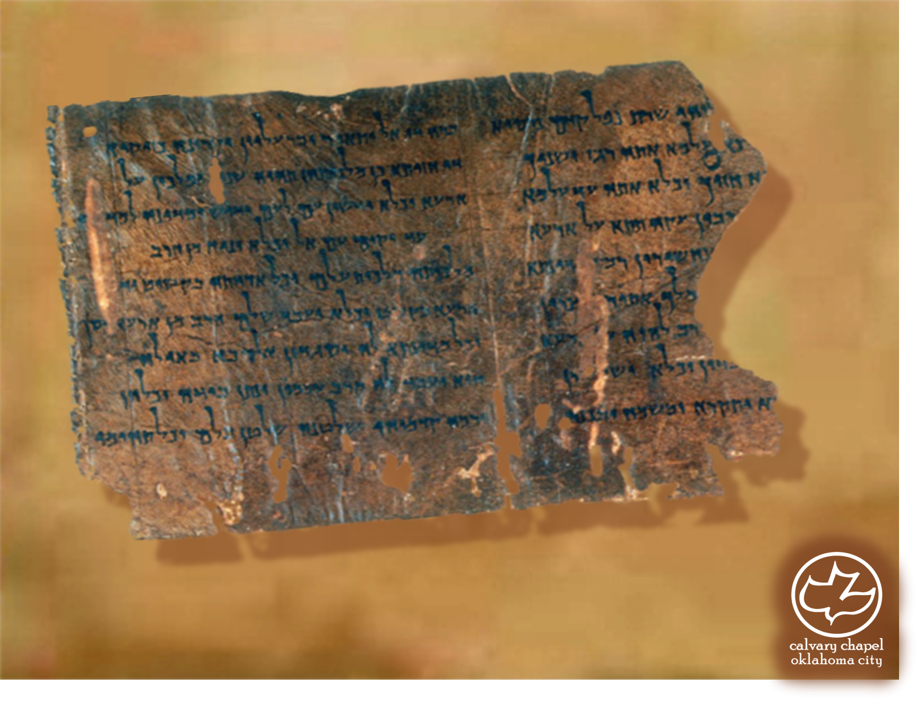

Minor Prophets … Major Message:
Hosea 12:1-14:9
A CD of this message will be available (free of charge) immediately following today's message
This message will be available via podcast later this week at calvaryokc.com

Slide 2
Hosea 12:1-14:9
Grasping the wind ~ 9x in Eccl.

Slide 3
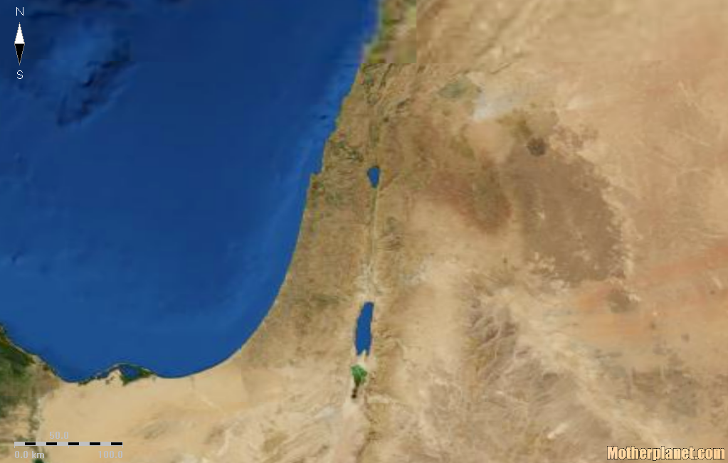
Hosea 12:1-14:9
Israel
Northern Kingdom
Samaria
Ephraim

Slide 4
Hosea 12:1-14:9
Ps 34:18 ~ The Lord is near to those who have a broken heart, and saves such as have a contrite spirit

Slide 5
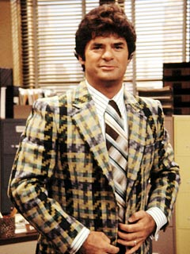
Hosea 12:1-14:9
Cunning Canaanite ~ NIV, NASB, KJV - Merchant

Slide 6
Hosea 12:1-14:9
Jer. 8:22 ~ Is there no balm in Gilead, Is there no physician there? Why then is there no recovery For the health of the daughter of my people?

Slide 7
Hosea 12:1-14:9
NIV ~ "They offer human sacrifice and kiss the calf-idols.”

Slide 8
Hosea 12:1-14:9
Is. 43:11 ~ I, even I, am the Lord, and besides Me there is no savior
Is. 45:21 ~ There is no other God besides Me, a just God and a savior; there is none besides Me

Slide 9
Hosea 12:1-14:9
Daniel 7
Lion
Babylon
Bear
Medo-Persia
Leopard
Greece

Slide 10
Hosea 12:1-14:9
Dr. J. W. Storer - "Hosea gives us a marvelously touching call to consider the deathless love of God; the exceeding sinfulness of sin; the judgment which must inevitably come to those who play Him false; and then, His patient seeking and rescue of His people."
K. Owen White - "A careful study of his book will lead us to see that he teaches that Jehovah is a God of wrath because He is a God of infinite love. It is because He is capable of such matchless love that He is also capable of divine wrath. God has revealed His love, He has demonstrated His love, He has acted in love, He has shared His love. Such love outraged, rejected, and spurned, demands retribution. "

