Slide 1
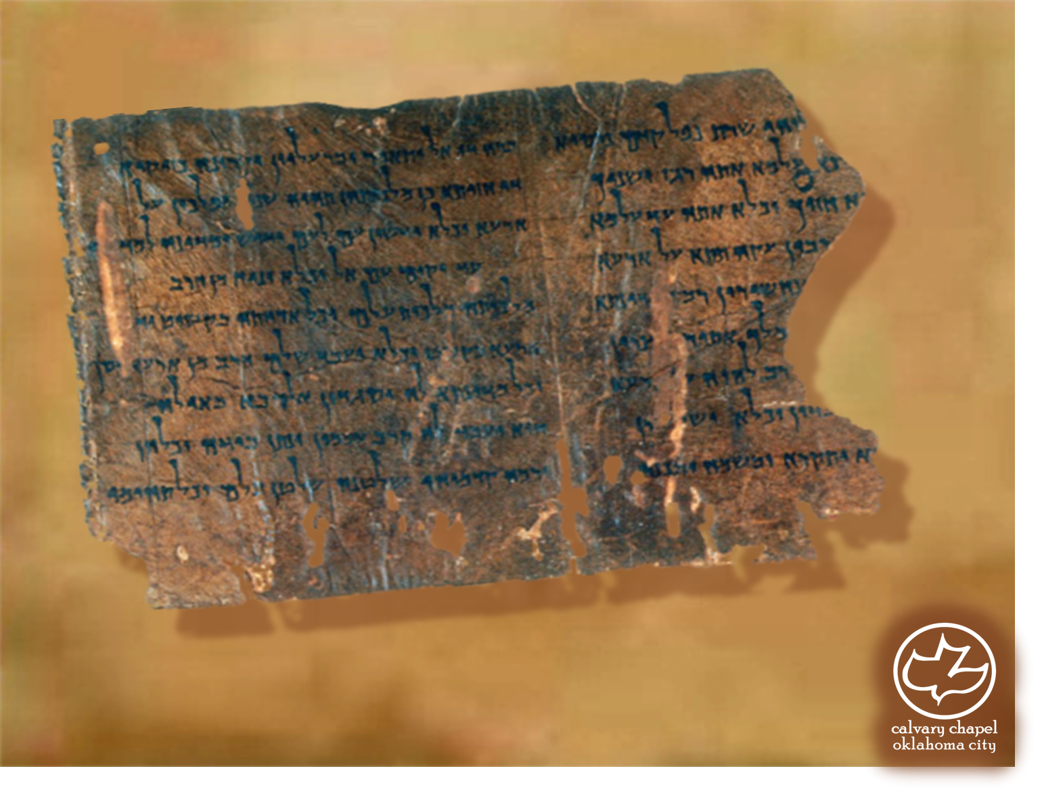

Minor Prophets … Major Message:
Hosea 6:1-8:14
A CD of this message will be available (free of charge) immediately following today's message
This message will be available via podcast later this week at calvaryokc.com

Slide 2
Hosea 6:1-8:14
SINNERS IN THE HANDS OF AN ANGRY GOD
– Jonathan Edwards
Enfield, Connecticut
July 8, 1741
Deut. 32:35 ~ Their foot shall slide in due time.

Slide 3
Hosea 6:1-8:14
Unconverted men walk over the pit of hell on a rotten covering, and there are innumerable places in this covering so weak that they will not bear their weight, and these places are not seen …
Your wickedness makes you as it were heavy as lead, and to tend downwards with great weight and pressure towards hell; and if God should let

Slide 4
Hosea 6:1-8:14
you go, you would immediately sink and swiftly descend and plunge into the bottomless gulf, and your healthy constitution, and your own care and prudence, and best contrivance, and all your righteousness, would have no more influence to uphold you and keep you out of hell, than a spider’s web would have to stop a falling rock …
The bow of God’s wrath is bent,

Slide 5
Hosea 6:1-8:14
and the arrow made ready on the string, and justice bends the arrow at your heart, and strains the bow, and it is nothing but the mere pleasure of God, and that of an angry God, without any promise or obligation at all, that keeps the arrow one moment from being made drunk with your blood.

Slide 6
Hosea 6:1-8:14
Num. 32:23 ~ But if you do not do so, then take note, you have sinned against the LORD; and be sure your sin will find you out.

Slide 7
Hosea 6:1-8:14
Backsliding is replacing God with bad form
Religion is replacing bad form with good form

Slide 8
Hosea 6:1-8:14
Uncovered ~ literally, uncovered himself

Slide 9
Hosea 6:1-8:14
Jug. 16:20 ~ And she said, "The Philistines are upon you, Samson!" So he awoke from his sleep, and said, "I will go out as before, at other times, and shake myself free!" But he did not know that the Lord had departed from him.

Slide 10
Hosea 6:1-8:14
Treacherous ~ NIV, faulty

Slide 11
Hosea 6:1-8:14
David Guzik ~ ”Israel saw their problem, but not their sin. When God’s hand is against man, he easily sees he has a problem but often does not see it as sin against the LORD. So when Israel had problems, they wailed upon their beds, but not to the LORD. They sought remedies, but not from the Most High.”

Slide 12
Hosea 6:1-8:14
KJV ~ Thy calf, O Samaria, hath cast thee off

Slide 13
Hosea 6:1-8:14
Jenny Sanford – “Remember, you may choose your sin, but you cannot choose the consequences.”

