Slide 1
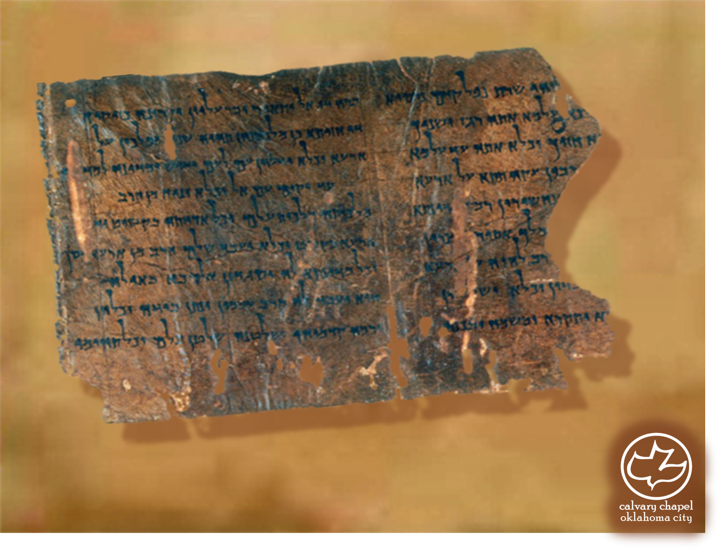

Minor Prophets … Major Message:
Hosea 3:1-5:15
A CD of this message will be available (free of charge) immediately following today's message
This message will be available via podcast later this week at calvaryokc.com

Slide 2
Hosea 3:1-5:15
J. Lewis Powell: 50,000 years = 5,000 years
Left cave 10 yr. ago
5 yr. ago Invented writing
Discovered electricity 10 days ago
Invented airplane yesterday
Invented TV this morning
4000
3000
2000
1000
Church began
2 yr. ago
Printing press 15 mo. ago
Invented radio last night
Invented jet plane a few sec. ago

Slide 3
Hosea 3:1-5:15
Dan. 12:4 ~ "But you, Daniel, shut up the words, and seal the book until the time of the end; many shall run to and fro, and knowledge shall increase."

Slide 4
Hosea 3:1-5:15
Deut. 17:12 ~ Now the man who acts presumptuously and will not heed the priest who stands to minister there before the LORD your God, or the judge, that man shall die.
NLT ~ Don’t point your finger at someone else and try to pass the blame! Look, you priests, my complaint is with you!

Slide 5
Hosea 3:1-5:15
TLB ~ The priests rejoice in the sins of the people; they lap it up and lick their lips for more!

Slide 6
Hosea 3:1-5:15
NIV ~ They consult a wooden idol and are answered by a stick of wood

Slide 7
Hosea 3:1-5:15
Brides ~ NIV, better – daughters-in-law

Slide 8
Hosea 3:1-5:15
Not Bethel ~ (House of God) where one of the golden calves were
Beth Aven (house of wickedness, idolatry or vanity)

Slide 9
Hosea 3:1-5:15
KJV ~ For Israel slideth back as a backsliding heifer:

Slide 10
Hosea 3:1-5:15
Landmark ~ KJV, bound
NASB, boundary; NIV, boundary stones

Slide 11
Hosea 3:1-5:15
Jareb ~ contender, warrior (probably Tiglath-Pileser III)

Slide 12
Hosea 3:1-5:15
Matt 23:39 ~ for I say to you, you shall see Me no more till you say, “Blessed is He who comes in the name of the Lord!"

