Slide 1
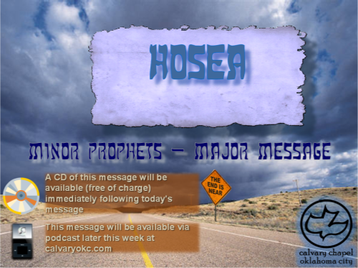
1:1-2:23

Slide 2
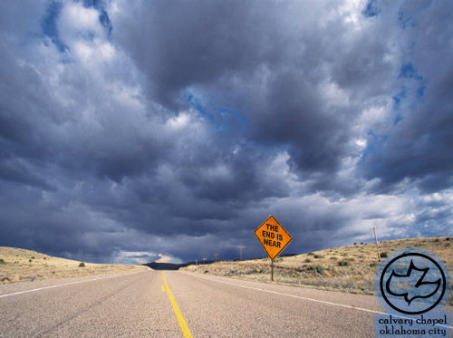
Hosea
1:1-2:23
Shallum
Pekahiah
Hoshea
Jeroboam II
Zechariah
Menahem
Pekah
790BC
770BC
750BC
730BC
710BC
690BC
Hosea
Uzziah
Jotham
Ahaz
Hezekiah

Slide 3
Hosea
1:1-2:23
Hosea ~ salvation
Contemporary of Isaiah and Micah (in the South)
And Amos in the North

Slide 4

Hosea
1:1-2:23

Slide 5
Hosea
1:1-2:23
Gomer ~ complete, to bring to an abrupt end
Diblaim ~ two fig cakes

Slide 6
Hosea
1:1-2:23

Slide 7
Hosea
1:1-2:23
Jezreel ~ God will sow

Slide 8
Hosea
1:1-2:23

Slide 9
Hosea
1:1-2:23
Lo-Ruhamah – no mercy

Slide 10
Hosea
1:1-2:23

Slide 11
Hosea
1:1-2:23
Rom. 9:14-15 ~ ¹⁴ What shall we say then? Is there unrighteousness with God? Certainly not! ¹⁵ For He says to Moses, "I will have mercy on whomever I will have mercy, and I will have compassion on whomever I will have compassion."

Slide 12
Hosea
1:1-2:23

Slide 13
Hosea
1:1-2:23
Lo-Ammi ~ not my people
Literally, I will not be your I AM

Slide 14
Hosea
1:1-2:23

Slide 15
Hosea
1:1-2:23
My people ~ (KJV, NASB) Ammi
Mercy is shown ~ (KJV, NASB) Ruhamah

Slide 16
Hosea
1:1-2:23

Slide 17
Hosea
1:1-2:23
Judges 10:14 ~ Go and cry out to the gods which you have chosen; let them deliver you in your time of distress.

Slide 18
Hosea
1:1-2:23

Slide 19
Hosea
1:1-2:23
David Guzik ~ “When God hedges our way with thorns, we usually don’t like it. We sometimes think God is against us when the thorns hurt and we can’t find the wrong paths. But it is really one of the sweetest expressions of God’s
love to ‘hedge up your way
with thorns’ and to wall us in.”

Slide 20
Hosea
1:1-2:23

Slide 21
Hosea
1:1-2:23
Spurgeon ~ “This is a singular kind of power: ‘I will allure her;’ not, ‘I will drive her’ not even, ‘I will draw her,’ or, ‘I will drag her;’ or, ‘I will force her.’ No, ‘I will allure her.’ It is a very remarkable word, and it teaches us that the allurement of love surpasses in power all other forces. That is how
the devil ruins us; he tempts us
with honeyed words, sweet
utterances, with the baits of pleasure and the like; and the Lord in mercy determines that, in all truthfulness, he will outbid the devil, and he will win us to himself by fascinations, enticements, and allurements which shall be stronger than any force of resistance we may offer. This is a wonderfully precious word: ‘I will allure her.’”

Slide 22
Hosea
1:1-2:23

Slide 23
Hosea
1:1-2:23
Valley of Achor ~ trouble or disturbance

Slide 24
Hosea
1:1-2:23

Slide 25
Hosea
1:1-2:23
My Husband ~ KJV, NASB – Ishi
My Master ~ KJV, NASB – Baali

Slide 26
Hosea
1:1-2:23

Slide 27
Hosea
1:1-2:23
Lovingkindness ~ chesed - steadfast, committed love

Slide 28
Hosea
1:1-2:23

