Slide 1

12:18-13:6

Slide 2





12:18-13:6
Phat
Immortal
150 years
15 years

Slide 3
12:18-13:6
Hebrews 12:18-13:6 ~ ¹⁸ For you have not come to the mountain that may be touched and that burned with fire, and to blackness and darkness and tempest, ¹⁹ and the sound of a trumpet and the voice of words, so that those who heard it begged that the word should not be spoken to them anymore. ²⁰ (For they could not endure what was commanded: “And if so much as a beast touches the mountain, it shall be stoned or shot with an arrow.” ²¹ And so terrifying was the sight that Moses said, “I am exceedingly afraid and trembling.”)
²² But you have come to Mount Zion and to the
city of the living God, the heavenly

Slide 4
12:18-13:6
Hebrews 12:18-13:6 ~ Jerusalem, to an innumerable company of angels, ²³ to the general assembly and church of the firstborn who are registered in heaven, to God the Judge of all, to the spirits of just men made perfect, ²⁴ to Jesus the Mediator of the new covenant, and to the blood of sprinkling that speaks better things than that of Abel.
²⁵ See that you do not refuse Him who speaks. For if they did not escape who refused Him who spoke on earth, much more shall we not escape if we turn away from Him who speaks from heaven, ²⁶ whose voice then shook the earth; but now He has promised, saying, “Yet
once more I shake not only the earth,

Slide 5
12:18-13:6
Hebrews 12:18-13:6 ~ but also heaven.” ²⁷ Now this, “Yet once more,” indicates the removal of those things that are being shaken, as of things that are made, that the things which cannot be shaken may remain.
²⁸ Therefore, since we are receiving a kingdom which cannot be shaken, let us have grace, by which we may serve God acceptably with reverence and godly fear. ²⁹ For our God is a consuming fire.
^{13:1} Let brotherly love continue. ² Do not forget to entertain strangers, for by so doing some have unwittingly entertained angels.

Slide 6
12:18-13:6
Hebrews 12:18-13:6 ~ ³ Remember the prisoners as if chained with them—those who are mistreated—since you yourselves are in the body also.
⁴ Marriage is honorable among all, and the bed undefiled; but fornicators and adulterers God will judge.
⁵ Let your conduct be without covetousness; be content with such things as you have. For He Himself has said, “I will never leave you nor forsake you.” ⁶ So we may boldly say:
“The Lord is my helper;
I will not fear.
What can man do to me?”

Slide 7

12:18-13:6

Slide 8
12:18-13:6
Now that I’m older, here’s what I’ve discovered:
1. I started out with nothing, and I still have most of it.
2. My wild oats are mostly enjoyed with prunes and all-bran.
3. Funny, I don’t remember being absent-minded.
4. Funny, I don’t remember being absent-minded.
5. If all is not lost, then where the heck is it?
6. It was a whole lot easier to get older, than it was to get wiser.
7. Some days, you’re the top dog, some days
you’re the hydrant.

Slide 9
12:18-13:6
Now that I’m older, here’s what I’ve discovered:
8. I wish the buck really did stop here; I sure could use a few of them.
9. It is hard to make a comeback when you haven’t been anywhere.
10. The world only beats a path to your door
when you’re in the bathroom.
11. When I’m finally holding all the right cards, everyone wants to play chess.
12. It is not hard to meet expenses … they’re everywhere.

Slide 10
12:18-13:6
Now that I’m older, here’s what I’ve discovered:
13. The only difference between a rut and a grave is the depth.
14. These days, I spend a lot of time thinking about the hereafter . . . I go somewhere to get something, and then wonder what I’m “here after.”
15. If God wanted me to touch my toes, He’d have put them on my knees.
16. Funny, I don’t remember being absent-minded.

Slide 11
12:18-13:6

Slide 12
12:18-13:6
fellowship
brother
Lord
friend

Slide 13
12:18-13:6
AWESOME
SACRED
glorious
Divine

Slide 14
12:18-13:6

Slide 15
12:18-13:6
Mark 10:29-30 ~ ²⁹ So Jesus answered and said, “Assuredly, I say to you, there is no one who has left house or brothers or sisters or father or mother or wife or children or lands, for My sake and the gospel’s, ³⁰ who shall not receive a hundredfold now in this time – houses and brothers and sisters and mothers and children and lands, with persecutions – and in the age to come, eternal life.

Slide 16
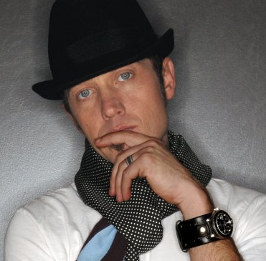
12:18-13:6
Love Feels Like
I am tired, I am drained
But the fight in me remains
I am weary, I am worn
Like I’ve never been before
This is harder than I thought
Harder than I thought it'd be
Harder than I thought
Takin’ every part of me
Harder than I thought
So much harder than I thought it’d be
But empty’s never felt so full
tobymac

Slide 17
12:18-13:6
general assembly ~ panēguris – pan (all) + agora (public market) – a festive gathering
made perfect ~ telioō – they have arrived at the desired goal

Slide 18
12:18-13:6

Slide 19
12:18-13:6
Mediator ~ mesitēs – only used of Jesus and Moses (Gal. 3:19-20 – the mediator of the Old Covenant)
Jesus’ blood cried out for mercy
Abel’s blood cried out for justice

Slide 20
12:18-13:6

Slide 21
12:18-13:6
Five Warnings Passages in Hebrews:
1. Heb. 2:1-4
~ do not drift
2. Heb. 3:7-4:10
~ do not depart
3. Heb. 5:11-6:20
~ do not discard
4. Heb. 10:26-39
~ do not despise
5. Heb. 12:14-29
~ do not decline
Charles Simeon (1759-1836) ~ “However advanced a man may be in piety or age, he is still in danger of falling.”

Slide 22
12:18-13:6

Slide 23
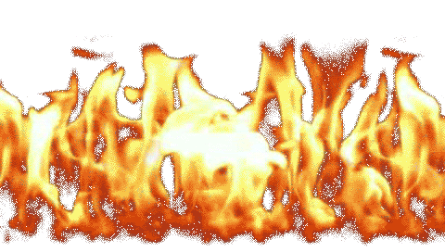
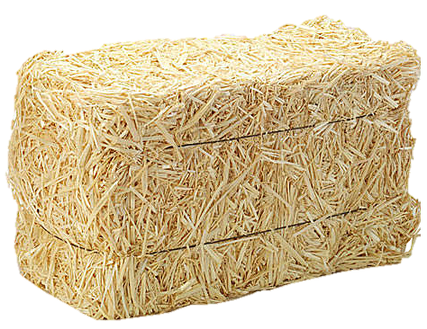
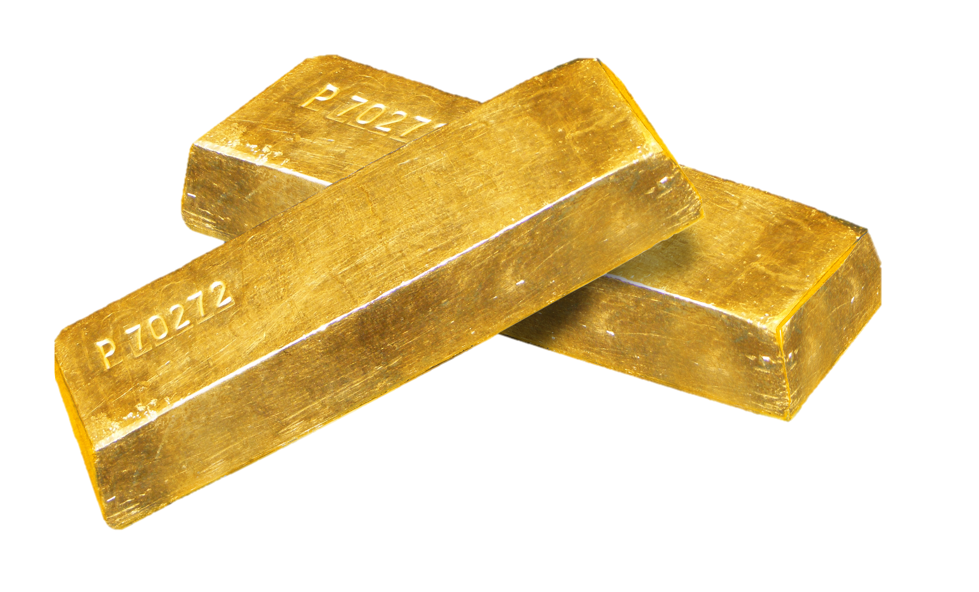
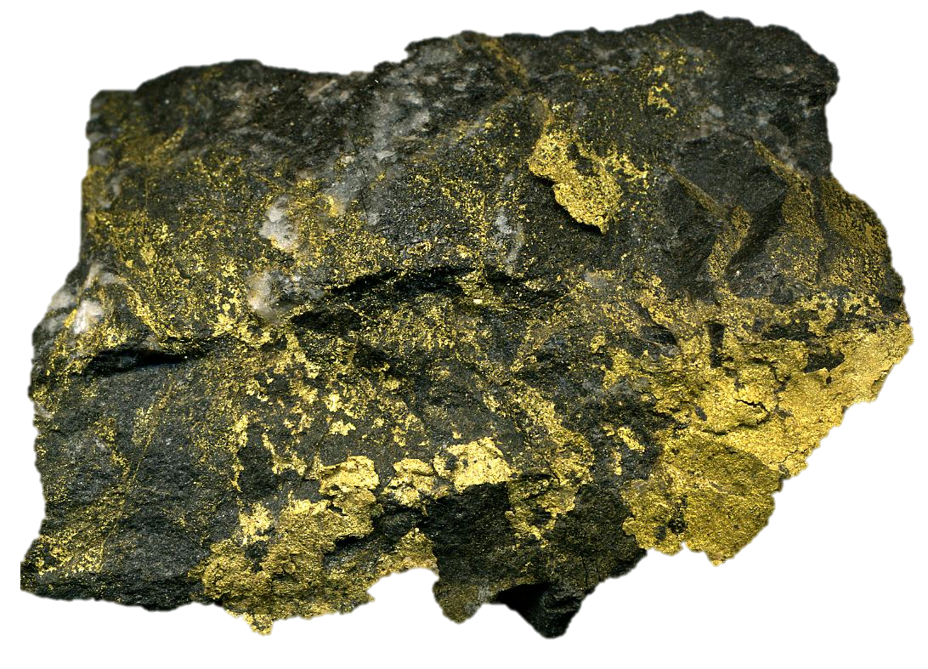
12:18-13:6
Fire
destroys
what it cannot
purify
purifies
destroy

Slide 24
12:18-13:6

Slide 25
12:18-13:6
brotherly love ~ philadelphia
Literally, keep on practicing brotherly love
1 Pet. 1:22 ~ Since you have purified your souls in obeying the truth through the Spirit in sincere love of the brethren, love one another fervently with a pure heart,
philos
agapaō

Slide 26
12:18-13:6

Slide 27
12:18-13:6
entertain strangers ~ philos + zenos (foreigners)
Usually translated hospitality
angels ~ angelos – also, messenger
Used of John the Baptist (Matt. 11:10), John’s disciples (Luke 7:24), Jesus’ advance team (Luke 9:52), Satan (2 Cor. 11:14) and possibly the pastors of the seven churches of Asia (Rev. 2:1, 8, 12, 18; 3:1, 5, 14)

Slide 28
12:18-13:6

Slide 29
12:18-13:6
fornicators ~ pornos

Slide 30
12:18-13:6

Slide 31
12:18-13:6
covetousness ~ literally, love of money (as NASB, NIV)
Heb. 10:17 ~ Their sins and their lawless deeds I will remember no more. (Jer. 31:34)
Two Greek words for “no” (ou, mē)
Merrihew Standard Version ~ Their moral and spiritual failures I will, in no possible way, remember anymore.

Slide 32
12:18-13:6
v. 5b ~ I will never leave you nor forsake you. (Deut. 31:6; Josh. 1:5)
never ~ ou mē
nor ~ oude (“but not”) followed by ou mē

Slide 33
12:18-13:6
gar eirēke ou mē se anō oude
For He has said not not you I might leave but not
ou mē se egkataleipō
not not you I might leave behind
MSV ~ These are the very words of Jesus, “Not only will I never, ever, at any time leave you but there is also no, not any, possible way I will ever, at any time, abandon you.”

Slide 34
12:18-13:6
You wanna not feel alone, lean on man
You wanna not be alone, lean on Jesus

Slide 35
12:18-13:6

