Slide 1
11:1-19

Slide 2
11:1-19
Heaven
Two roads
Be perfect
Grace thru faith in Jesus

Slide 3
11:1-19

Slide 4
11:1-19
Hebrews 11:1–19 ~ ¹ Now faith is the substance of things hoped for, the evidence of things not seen. ² For by it the elders obtained a good testimony.
³ By faith we understand that the worlds were framed by the word of God, so that the things which are seen were not made of things which are visible.
⁴ By faith Abel offered to God a more excellent sacrifice than Cain, through which he obtained witness that he was righteous, God testifying of his gifts; and through it he being dead still speaks.
⁵ By faith Enoch was taken away so that he did

Slide 5
11:1-19
Hebrews 11:1–19 ~ not see death, “and was not found, because God had taken him”; for before he was taken he had this testimony, that he pleased God. ⁶ But without faith it is impossible to please Him, for he who comes to God must believe that He is, and that He is a rewarder of those who diligently seek Him.
⁷ By faith Noah, being divinely warned of things not yet seen, moved with godly fear, prepared an ark for the saving of his household, by which he condemned the world and became heir of the righteousness which is according to faith.

Slide 6
11:1-19
Hebrews 11:1–19 ~ ⁸ By faith Abraham obeyed when he was called to go out to the place which he would receive as an inheritance. And he went out, not knowing where he was going. ⁹ By faith he dwelt in the land of promise as in a foreign country, dwelling in tents with Isaac and Jacob, the heirs with him of the same promise; ¹⁰ for he waited for the city which has foundations, whose builder and maker is God.
¹¹ By faith Sarah herself also received strength to conceive seed, and she bore a child when she was past the age, because she judged Him faithful

Slide 7
11:1-19
Hebrews 11:1–19 ~ who had promised. ¹² Therefore from one man, and him as good as dead, were born as many as the stars of the sky in multitude —innumerable as the sand which is by the seashore.
¹³ These all died in faith, not having received the promises, but having seen them afar off were assured of them, embraced them and confessed that they were strangers and pilgrims on the earth. ¹⁴ For those who say such things declare plainly that they seek a homeland. ¹⁵ And truly if they had called to mind that country from which they had come out,

Slide 8
11:1-19
Hebrews 11:1–19 ~ they would have had opportunity to return. ¹⁶ But now they desire a better, that is, a heavenly country. Therefore God is not ashamed to be called their God, for He has prepared a city for them.
¹⁷ By faith Abraham, when he was tested, offered up Isaac, and he who had received the promises offered up his only begotten son, ¹⁸ of whom it was said, “In Isaac your seed shall be called,” ¹⁹ concluding that God was able to raise him up, even from the dead, from which he also received him in a figurative sense,

Slide 9
11:1-19

Slide 10
11:1-19
“No, dear. There’s not room with your daddy in here.”
“Mommy, can I sleep in your bed tonight?”
“No, Honey. I have to sleep with your daddy.”
“Then will you sleep with me?”
“Daddy’s a big sissy!”

Slide 11
11:1-19

Slide 12
11:1-19
substance ~ hupostasis – opposite of hypothetical
Heb. 1:3 ~ who being the brightness of His glory and the express image of His
hupostasis
person
Also translated confidence (2 Cor. 9:4, 11-17; Heb. 3:14)
evidence of things ~ literally, the practice of proof (legal term)
NLT ~ Faith shows the reality of what we hope for; it is the evidence of things we cannot see.

Slide 13
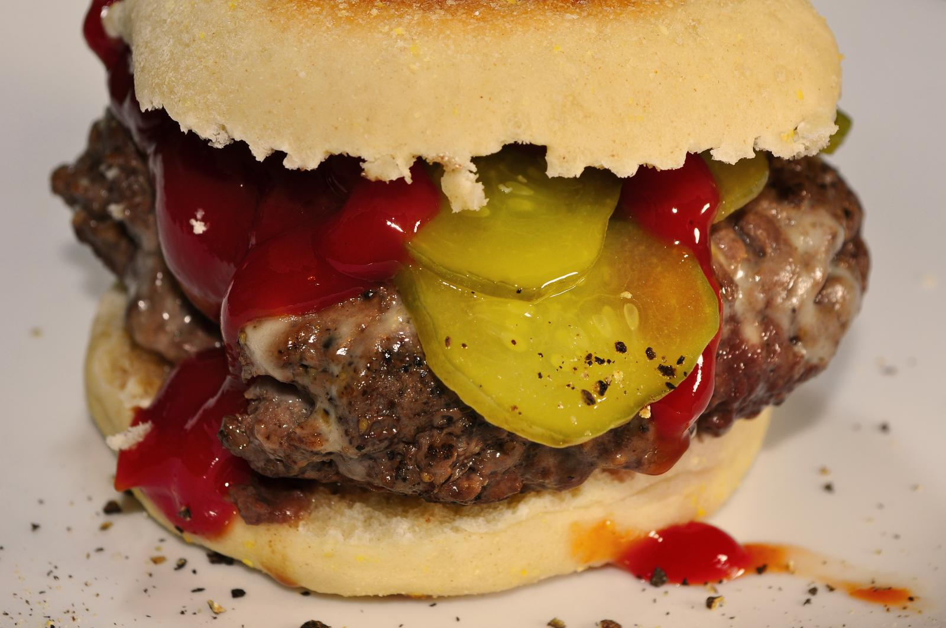
11:1-19
Faith is not
The ketchup on the burger of good works

Slide 14
11:1-19

Slide 15
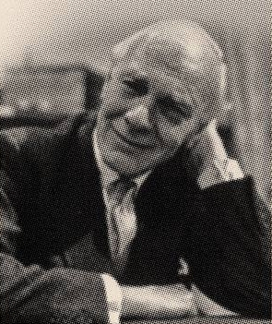
11:1-19
Malcolm Muggeridge (1903-1990) ~ “Faith is a ... form of knowledge which transcends the intellect.”

Slide 16
11:1-19
trust
Now is the substance of things hoped for, the evidence of things not seen.
faith

Slide 17
11:1-19

Slide 18
11:1-19
nanometer = 1 billionth of a meter
1/10,000,000,000 of a meter
Neutron
-
Proton
-
+
+
0.1 nm
+
+
-
Electron
-

Slide 19
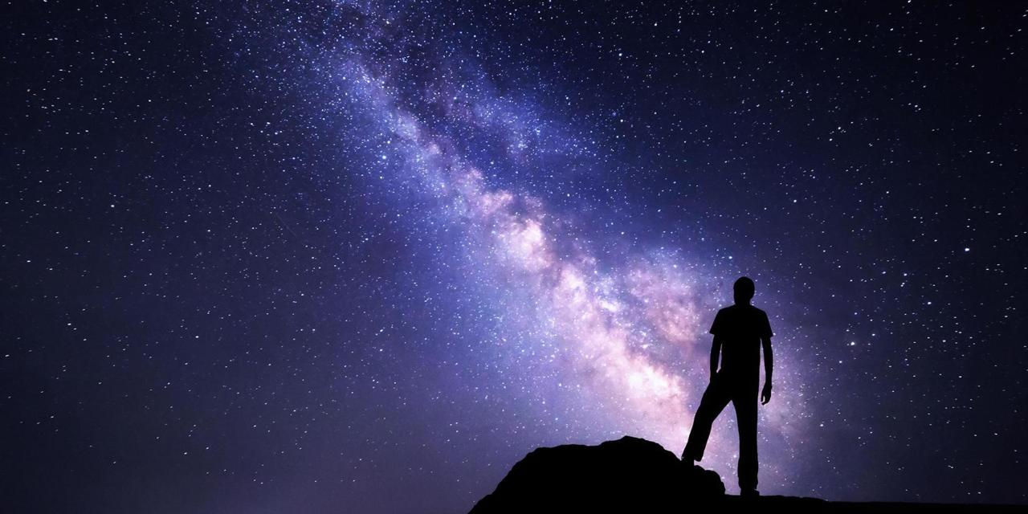
11:1-19
nanometer = 1 billionth of a meter
1/10,000,000,000 of a meter

Slide 20
11:1-19

Slide 21
11:1-19
Heb 11:1 (Merrihew Standard Version) ~ In the same way that atoms (which are too small to be seen with the naked eye) make all physical things visible, so faith makes all spiritual things visible.

Slide 22
11:1-19
Ps. 51:5 ~ Behold, I was brought forth in iniquity, And in sin my mother conceived me.

Slide 23
11:1-19

Slide 24
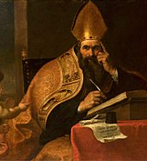
11:1-19
Saint Augustine (AD 354-430) ~ “If you believe what you like in the gospel, and reject what you don't like, it is not the gospel you believe, but yourself.”

Slide 25
11:1-19

Slide 26
11:1-19
Faith (pleasing God) is two-fold:
We must believe that He is
involved in our lives.
2.
1.

Slide 27
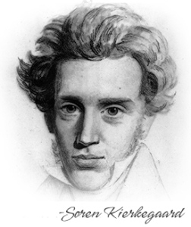
11:1-19
Søren Kierkegaard (1813-1855) ~
“It is so hard to believe because it is so hard to obey.”
“I don’t understand”
“Oh, now I see”
“Life is understood backwards, but it is lived forwards.”

Slide 28
11:1-19

Slide 29
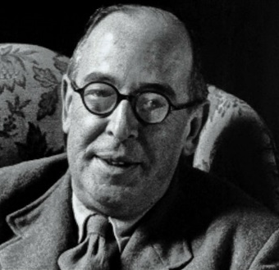
11:1-19
C. S. Lewis (1898-1963) ~ “A man can accept what Christ has done without knowing how it works; indeed, he certainly won’t know how it works until he’s accepted it.”

Slide 30
11:1-19
faith in …
Not
faith
abilities
.
stuff
each other
Jesus

Slide 31
11:1-19
A man of faith …
1) is moved (changed) by his faith (v. 7)
2) walks in obedience (vv. 8-10)
3) accepts his/her own humanity (vv. 11-12)
4) has an eternal focus (vv. 13-16)
5) grows in his faith (vv. 17-19)
6) knows sin’s satisfaction is temporary vv. 24-26)
7) doesn’t give up (vv. 32-38)

Slide 32
11:1-19
A man of faith …
1) is moved (changed) by his faith (v. 7)
2) walks in obedience (vv. 8-10)
3) accepts his/her own humanity (vv. 11-12)
4) has an eternal focus (vv. 13-16)
5) grows in his faith (vv. 17-19)

Slide 33
11:1-19

Slide 34
11:1-19
Abraham called at 75 y/o
Isaac between 15-30 y/o at Mt. Moriah
Isaac born at 100 y/o
Abraham was between 115-130 y/o (waited 40-65 yr.)
1975 BC
1965 BC
1955 BC
1945 BC
1935 BC
1925 BC
Abraham’s call
Isaac born
Mt. Moriah

Slide 35
11:1-19

Slide 36
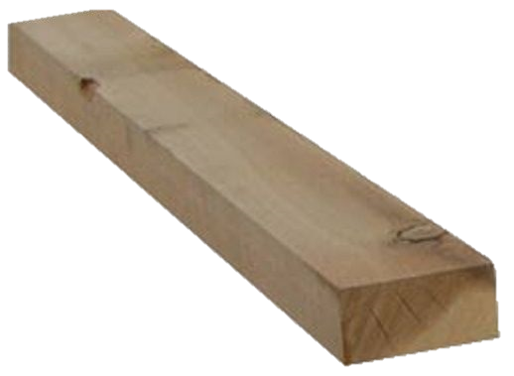
11:1-19
Me
Is there a faith
store some-
where?
faith
store
Where can I get some?
What is faith?
Stubborn will

Slide 37
11:1-19

