Slide 1

10:11-39

Slide 2

10:11-39
Hebrews 10:11–39 ~ ¹¹ And every priest stands ministering daily and offering repeatedly the same sacrifices, which can never take away sins. ¹² But this Man, after He had offered one sacrifice for sins forever, sat down at the right hand of God, ¹³ from that time waiting till His enemies are made His footstool. ¹⁴ For by one offering He has perfected forever those who are being sanctified.
¹⁵ But the Holy Spirit also witnesses to us; for after He had said before,
¹⁶ “This is the covenant that I will make with them

Slide 3
10:11-39
Hebrews 10:11–39 ~ after those days, says the Lord: I will put My laws into their hearts, and in their minds I will write them,” ¹⁷ then He adds, “Their sins and their lawless deeds I will remember no more.” ¹⁸ Now where there is remission of these, there is no longer an offering for sin.
¹⁹ Therefore, brethren, having boldness to enter the Holiest by the blood of Jesus, ²⁰ by a new and living way which He consecrated for us, through the veil, that is, His flesh, ²¹ and having a High Priest over the house of God, ²² let us draw near with a true heart in full assurance of faith, having our hearts sprinkled from an evil

Slide 4
10:11-39
Hebrews 10:11–39 ~ conscience and our bodies washed with pure water. ²³ Let us hold fast the confession of our hope without wavering, for He who promised is faithful. ²⁴ And let us consider one another in order to stir up love and good works, ²⁵ not forsaking the assembling of ourselves together, as is the manner of some, but exhorting one another, and so much the more as you see the Day approaching.
²⁶ For if we sin willfully after we have received the knowledge of the truth, there no longer remains a sacrifice for sins, ²⁷ but a certain fearful expectation of

Slide 5
10:11-39
Hebrews 10:11–39 ~ judgment, and fiery indignation which will devour the adversaries. ²⁸ Anyone who has rejected Moses’ law dies without mercy on the testimony of two or three witnesses. ²⁹ Of how much worse punishment, do you suppose, will he be thought worthy who has trampled the Son of God underfoot, counted the blood of the covenant by which he was sanctified a common thing, and insulted the Spirit of grace? ³⁰ For we know Him who said, “Vengeance is Mine, I will repay,” says the Lord. And again, “The Lord will judge His people.”

Slide 6
10:11-39
Hebrews 10:11–39 ~ ³¹ It is a fearful thing to fall into the hands of the living God.
³² But recall the former days in which, after you were illuminated, you endured a great struggle with sufferings: ³³ partly while you were made a spectacle both by reproaches and tribulations, and partly while you became companions of those who were so treated; ³⁴ for you had compassion on me in my chains, and joyfully accepted the plundering of your goods, knowing that you have a better and an enduring possession for yourselves in heaven.

Slide 7
10:11-39
Hebrews 10:11–39 ~ ³⁵ Therefore do not cast away your confidence, which has great reward. ³⁶ For you have need of endurance, so that after you have done the will of God, you may receive the promise:
³⁷ “For yet a little while,
And He who is coming will come and will not tarry.
³⁸ Now the just shall live by faith;
But if anyone draws back,
My soul has no pleasure in him.”
³⁹ But we are not of those who draw back to perdition, but of those who believe to the saving of the soul.

Slide 8

10:11-39

Slide 9
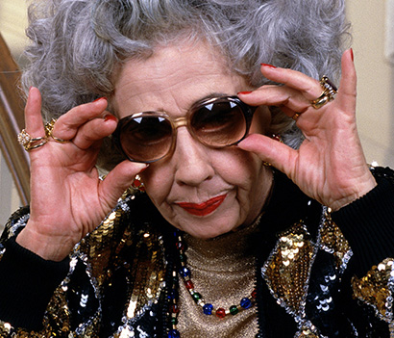
10:11-39
My Dear Boichika and That Person You Married,
I hope you are well. Please don’t worry about me. I’m just fine considering I can’t breathe or eat. The important thing is that you have a nice holiday, thousands of miles away from your
ailing mame. I’ve sent along my last
ten dollars in this card, which I hope
you’ll on my beautiful grand-
children, who I never see. They look
anemic in their pictures, poor, thin babies.
Thank you so much for the birthday flowers,
Jewish Muter (Mother)

Slide 10
10:11-39
dear boy. I put them in the freezer so they’ll stay fresh for my funeral. I know I’ll need them any day.
Which reminds me — we buried Aunt Lucy last week. I know she died years ago, but I got to yearning for a good funeral, so Aunt Minnie and I
dug her up and had the services all
over again. I would have invited you,
but I know that woman you live with
would have never let you come. I bet
she’s never even watched that videotape of my hemorrhoid surgery, has she?

Slide 11
10:11-39
I am still suffering.
Well son, it’s time for me to drag myself to bed now. I lost my cane beating off the muggers last week, but don’t you worry about me. I’m also getting used to the cold since they turned my heat off
and am grateful because the frost
on my bed numbs the constant pain.
Now don’t you even think about
sending any more money, because
I know you need it for those expensive
family holidays you take every year,

Slide 12
10:11-39
though you never come see me. Give my love to my darling grand-babies and my regards to whatever-her-name-is — the one with the black roots who stole you screaming from my bosom.
Love Always,
Your poor, old Muter

Slide 13
10:11-39

Slide 14
10:11-39
3 things are too great for me, yea, 4 that really blow my mind:
1) God became a Man
Phil. 2:5-8 (Phillips) ~ ⁵ Let Christ himself be your example as to what your attitude should be. ⁶ For he, who had always been God by nature, did not cling to his prerogatives as God’s equal, ⁷ but stripped himself of all privilege by consenting to be a slave by nature and being born as mortal man. And, having become man, ⁸ he humbled himself by living a life of utter obedience, even to the extent of dying, and the death he died was
the death of a common criminal.

Slide 15
10:11-39
3 things are too great for me, yea, 4 that really blow my mind:
2) He took my place
Rom. 5:10 ~ For if when we were enemies we were reconciled to God through the death of His Son, much more, having been reconciled, we shall be saved by His life.
3) A Man is at the right hand of the Father
Eph. 1:20 ~ which He worked in Christ when He raised Him from the dead and seated Him at His right hand in the heavenly places,

Slide 16
10:11-39
3 things are too great for me, yea, 4 that really blow my mind:
4) I’m in Him
Col. 2:10 ~ … and you are complete in Him, who is the head of all principality and power.

Slide 17
10:11-39
3 things are too great for me, yea, 4 that really blow my mind:
1) God became a Man
2) He took my place
3) A Man is at the right hand of the Father
4) I’m in Him

Slide 18
10:11-39

Slide 19




10:11-39
perfected ~ perfect tense (John. 19:30)
messed up
not bad
so-so
yucky
Best day
loser
good
Normal day
Dork vomit
Perfect
Feelings-o-meter

Slide 20
10:11-39

Slide 21
10:11-39
no ~ ou and mē
ou ~ no or not
mē ~ no or not
“You don’t never use a double negative in English”

Slide 22
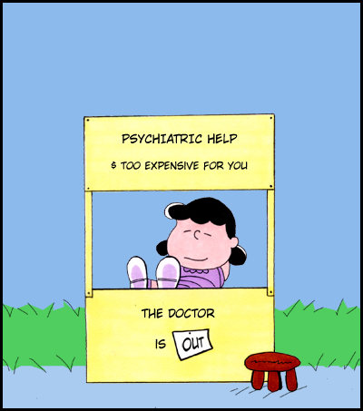
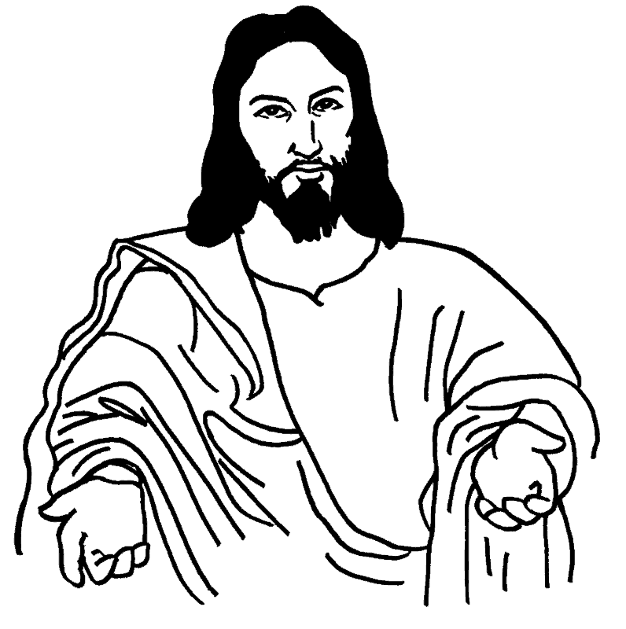
10:11-39
You wanna not feel guilty, see a psychiatrist
You wanna not be guilty, see Jesus

Slide 23
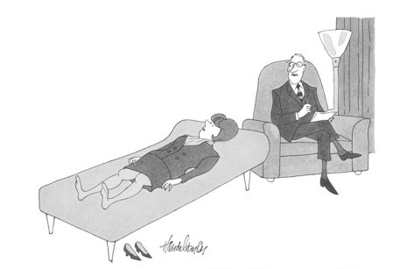
10:11-39
You know, you should be ashamed of yourself.
After all these years of therapy and you still feel guilty?

Slide 24
10:11-39

Slide 25
10:11-39
new (v. 20) ~ not neos or kainos
But, prosphatos ~ newly slaughtered or butchered

Slide 26
10:11-39

Slide 27
10:11-39
22) Let us draw near … in full assurance of faith
23) Let us hold fast the confession of our hope
24) Let us consider one another to stir up love
love
stir ~ KJV, provoke
NIV, spur
NASB, stimulate
paraxusmos ~ paroxysm – a sudden outburst of action or emotion; convulsion
Often translated, “incite”

Slide 28
10:11-39

Slide 29
10:11-39
assembling ~ episunagōgē – upon + with + bring
2 Thess. 2:1 ~ Now, brethren, concerning the coming of our Lord Jesus Christ and our gathering together to Him …
exhorting ~ parakaleō – alongside + call ~ to provide what is needed
approaching ~ engizō – at hand (Matt. 3:2)

Slide 30
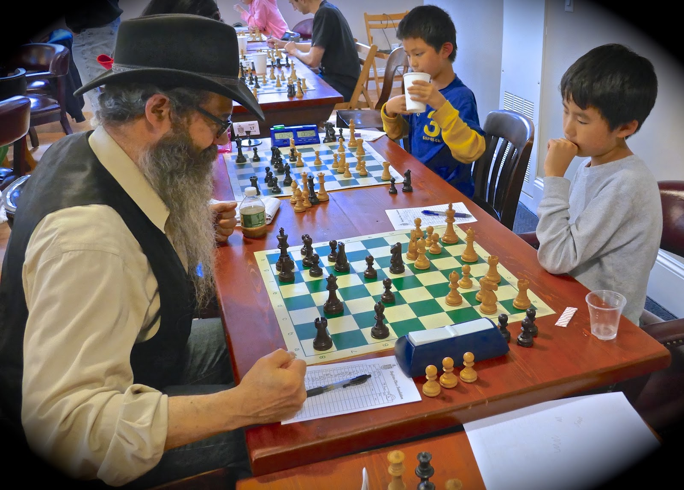
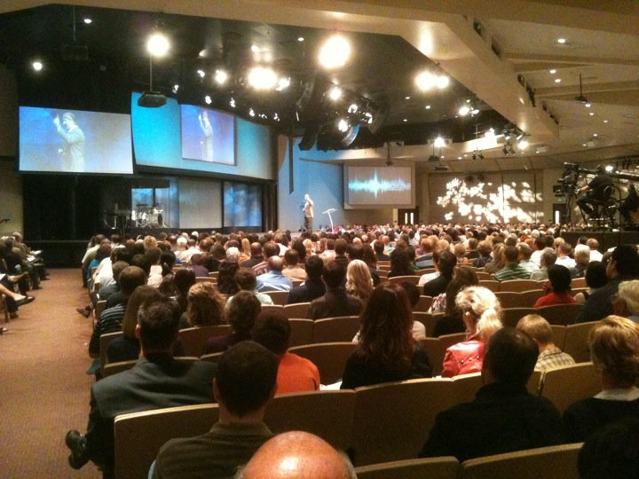
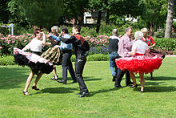
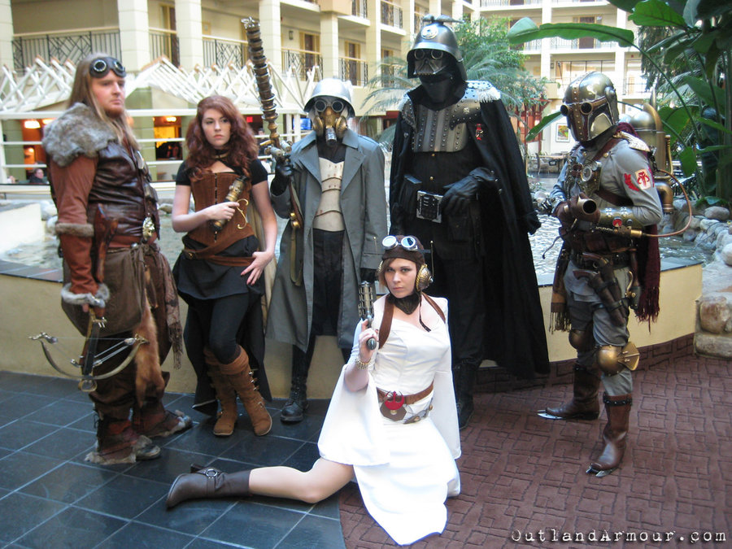
10:11-39
Square dance clubs
Chess
clubs
Jesus
Clubs?
Cosplay
clubs
This Photo by Unknown Author is licensed under CC BY-SA

Slide 31
10:11-39

Slide 32
10:11-39
1 Pet. 4:7-10 ~ ⁷ But the end of all things is at hand; therefore be serious and watchful in your prayers. ⁸ And above all things have fervent love for one another, for “love will cover a multitude of sins.” ⁹ Be hospitable to one another without grumbling. ¹⁰ As each one has received a gift , minister it to one another, as good stewards of the manifold grace of God.
hand ~ engizō
fervent ~ to stretch out
gift ~ charisma

Slide 33
10:11-39

Slide 34
10:11-39
Five Warnings Passages in Hebrews:
1. Heb. 2:1-4
~ do not drift
2. Heb. 3:7-4:10
~ do not depart
3. Heb. 5:11-6:20
~ do not discard
4. Heb. 10:26-39
~ do not despise
5. Heb. 12:14-29

Slide 35
10:11-39
Deut. 17:2-5 ~ ² If there is found among you … a man or a woman … ³ who has gone and served other gods and worshiped them, either the sun or moon or any of the host of heaven … ⁴ And if it is indeed true and certain that such an abomination has been committed in Israel, ⁵ then you shall bring out to your gates that man or woman who has committed that wicked thing, and shall stone to death that man or woman with stones.

Slide 36
10:11-39
sin unto death? (1 John 5:17)
2 Pet. 2:21 ~ For it would have been better for them not to have known the way of righteousness, than having known it, to turn from the holy commandment delivered to them.

Slide 37
10:11-39
Not saved in the 1st place?
brethren ~ v. 19
received (v. 26) ~ lambanō – take with the hand, to lay hold of
knowledge (v. 26) ~ epignōsis – to know by experience
Backslidden?
Rejecters? ~ despised (KJV, v. 28)

Slide 38
10:11-39

Slide 39
10:11-39
Habakkuk 2:3-4
Rom. 1:17 ~
the just shall live by faith
Gal. 3:11 ~
the just shall live by faith
Heb. 10:38 ~
the just shall live by faith

Slide 40
10:11-39

Slide 41
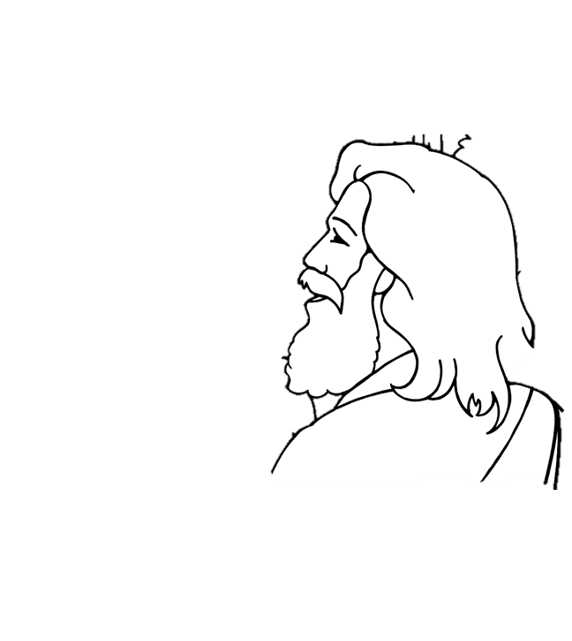
10:11-39
Jesus is driving a pickup truck and you are riding in the bed. You hit a bump, but the tailgate is down and you are thrown out.
loseyoursalvationism
Pickup truck theology

Slide 42
10:11-39
Jesus is driving a pickup truck and you are riding in the bed. You hit a bump, but the tailgate is up and it protects you.
oncesavedalwayssavedism
Pickup truck theology

Slide 43
10:11-39
Jesus is driving a pickup truck. You hit a bump, but you are up front in the cab with Him so you don’t have to worry about it.
Calvaryism
Pickup truck theology

Slide 44
10:11-39

Slide 45
10:11-39
9 little Christians stayed up very late. 1 overslept Sunday, then there were 8
8 little Christians on their way to Heaven. 1 took the low road and then there were 7
10 little Christians standing in line. 1 disliked the pastor, then there were 9
4 little Christians each one busy as a bee. 1 got his feelings hurt, then there were 3
8 splendid Christians if they doubled as before. In just so many Sundays, we'd have 1,024
7 little Christians with eyes firmly fixed. 1 disliked music, then there were 6
2 earnest Christians, each won one more. That doubled the number, then there were 4
6 little Christians seemed very much alive, but 1 fell away then there were 5
1 little Christian can't do much 'tis true, brought his friend to Bible study, then there were 2
2 little Christians, our rhyme is nearly done, differed with each other, then there was 1
4 sincere Christians worked early and late. Each won another then there were 8
5 little Christians pulling for Heaven’s shore, but 1 stopped to rest, then there were 4
3 little Christians knew not what to do. 1 joined the fast crowd, then there were 2

Slide 46
10:11-39

Slide 47
10:11-39
A. W. Tozer (1897-1963), The Pursuit of God ~ “Like the eye which sees everything in front of it and never sees itself, faith is occupied with the Object upon which it rests and pays no attention to itself at all. While we are looking at God, we do not see ourselves — blessed riddance. The man who has struggled to purify himself and has had nothing but repeated failures will experience real relief when he stops tinkering with his soul and looks away to the perfect One.”

Slide 48
10:11-39

Slide 49
10:11-39
Paul Brand (author of “Fearfully and Wonderfully Made”) ~ “The body poorly protects what it does not feel. In the spiritual Body, also, loss of feeling inevitably leads to atrophy and inner deterioration. So much of the sorrow in the world is due to the selfishness of one living organism that simply does not care when another suffers. In Christ’s Body we suffer because we do not suffer enough.”

Slide 50
10:11-39

