Slide 1

9:11-10:10

Slide 2

9:11-10:10
Hebrews 9:11-10:10 ~ ¹¹ But Christ came as High Priest of the good things to come, with the greater and more perfect tabernacle not made with hands, that is, not of this creation. ¹² Not with the blood of goats and calves, but with His own blood He entered the Most Holy Place once for all, having obtained eternal redemption. ¹³ For if the blood of bulls and goats and the ashes of a heifer, sprinkling the unclean, sanctifies for the purifying of the flesh, ¹⁴ how much more shall the blood of Christ, who through the eternal Spirit offered Himself without spot to God, cleanse your conscience

Slide 3
9:11-10:10
Hebrews 9:11-10:10 ~ from dead works to serve the living God? ¹⁵ And for this reason He is the Mediator of the new covenant, by means of death, for the redemption of the transgressions under the first covenant, that those who are called may receive the promise of the eternal inheritance.
¹⁶ For where there is a testament, there must also of necessity be the death of the testator. ¹⁷ For a testament is in force after men are dead, since it has no power at all while the testator lives. ¹⁸ Therefore not even the first covenant was dedicated without blood.

Slide 4
9:11-10:10
Hebrews 9:11-10:10 ~ ¹⁹ For when Moses had spoken every precept to all the people according to the law, he took the blood of calves and goats, with water, scarlet wool, and hyssop, and sprinkled both the book itself and all the people, ²⁰ saying, “This is the blood of the covenant which God has commanded you.” ²¹ Then likewise he sprinkled with blood both the tabernacle and all the vessels of the ministry. ²² And according to the law almost all things are purified with blood, and without shedding of blood there is no remission.

Slide 5
9:11-10:10
Hebrews 9:11-10:10 ~ ²³ Therefore it was necessary that the copies of the things in the heavens should be purified with these, but the heavenly things themselves with better sacrifices than these. ²⁴ For Christ has not entered the holy places made with hands, which are copies of the true, but into heaven itself, now to appear in the presence of God for us; ²⁵ not that He should offer Himself often, as the high priest enters the Most Holy Place every year with blood of another — ²⁶ He then would have had to suffer often since the foundation of the world; but now, once at the end of the ages,

Slide 6
9:11-10:10
Hebrews 9:11-10:10 ~ He has appeared to put away sin by the sacrifice of Himself. ²⁷ And as it is appointed for men to die once, but after this the judgment, ²⁸ so Christ was offered once to bear the sins of many. To those who eagerly wait for Him He will appear a second time, apart from sin, for salvation.
^{10:1} For the law, having a shadow of the good things to come, and not the very image of the things, can never with these same sacrifices, which they offer continually year by year, make those who approach perfect. ² For then would they not have ceased to be offered?

Slide 7
9:11-10:10
Hebrews 9:11-10:10 ~ For the worshipers, once purified, would have had no more consciousness of sins. ³ But in those sacrifices there is a reminder of sins every year. ⁴ For it is not possible that the blood of bulls and goats could take away sins.
⁵ Therefore, when He came into the world, He said:
“Sacrifice and offering You did not desire,
But a body You have prepared for Me.
⁶ In burnt offerings and sacrifices for sin
You had no pleasure.
⁷ Then I said, ‘Behold, I have come—

Slide 8
9:11-10:10
Hebrews 9:11-10:10 ~ In the volume of the book it is written of Me—
To do Your will, O God.’”
⁸ Previously saying, “Sacrifice and offering, burnt offerings, and offerings for sin You did not desire, nor had pleasure in them” (which are offered according to the law), ⁹ then He said, “Behold, I have come to do Your will, O God.” He takes away the first that He may establish the second. ¹⁰ By that will we have been sanctified through the offering of the body of Jesus Christ once for all.

Slide 9

9:11-10:10

Slide 10
9:11-10:10
The Trinity in operation
the blood of Christ
through the eternal Spirit
offered Himself … to God

Slide 11
9:11-10:10
3 kinds of works
1. Evil works
evil “works of the flesh” (Gal. 5:19-21)
2. Good works
good “fruit of the Spirit” (Gal. 5:22-23)
3. Dead works
any attempt to find favor, earn acceptance or be made righteous before God by one’s own effort, ability or willpower.

Slide 12

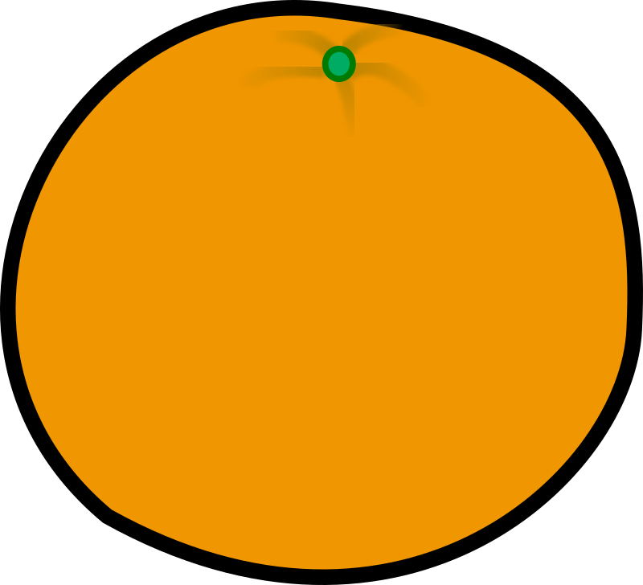
9:11-10:10
Dead works
=
=
<
/
Good works
This Photo by Unknown Author is licensed under CC BY-SA

Slide 13
9:11-10:10

Slide 14
9:11-10:10
3 “ifications” of the Christian walk
Justification ~ saves from the penalty of sin
Sanctification ~ saves from the power of sin
Glorification ~ saves from the presence of sin

Slide 15
9:11-10:10

Slide 16

9:11-10:10
Col. 2:16-17 ~ ¹⁶ So let no one judge you in food or in drink, or regarding a festival or a new moon or sabbaths, ¹⁷ which are a shadow of things to come, but the substance is of Christ.

Slide 17
9:11-10:10

Slide 18
9:11-10:10
In the Old Testament,
they were constantly reminded of their sin
In the New Testament,
we are constantly reminded of Christ’s victory
SIN

Slide 19
9:11-10:10

Slide 20
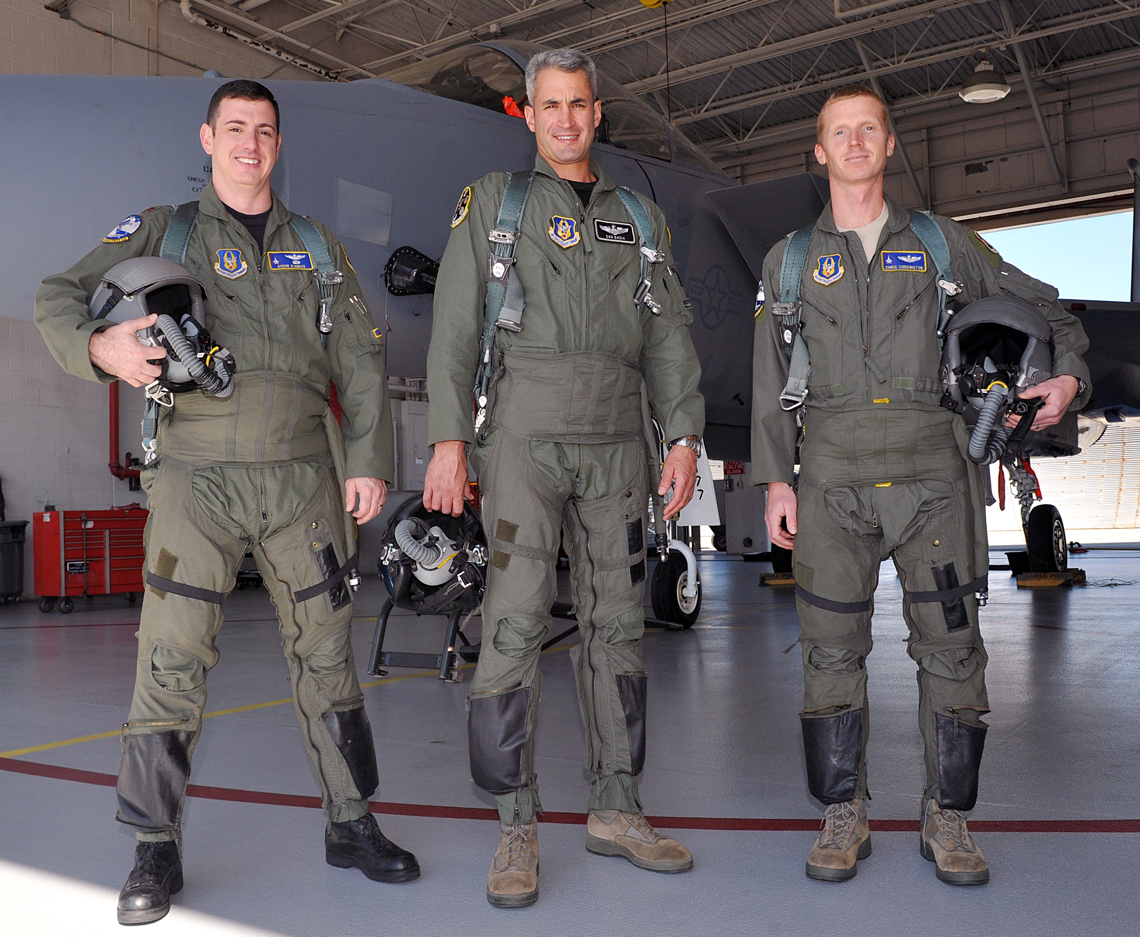
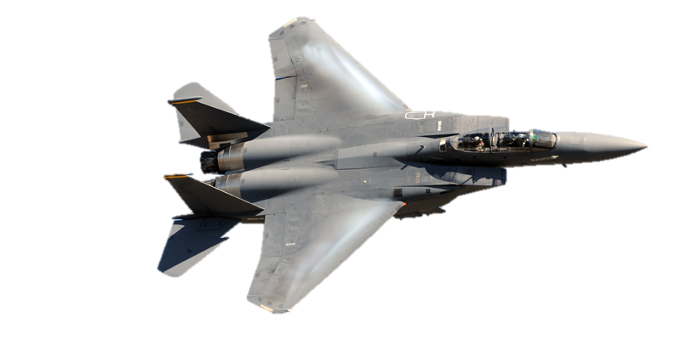
9:11-10:10
F-15 Eagle
pilots

Slide 21
9:11-10:10

Slide 22
9:11-10:10
takes away ~ anaireō – 20 of 23x translated kill, slay or put to death

Slide 23
9:11-10:10

Slide 24
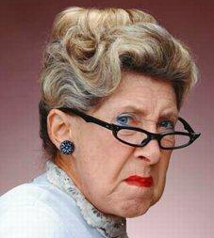


9:11-10:10
What is sanctification?
Lemon-sucking expression?
Pompous piety?

Slide 25
9:11-10:10
Sanctified ~ hagiazō – set apart
Not only set apart from sin, but to Jesus

Slide 26
9:11-10:10

