Slide 1
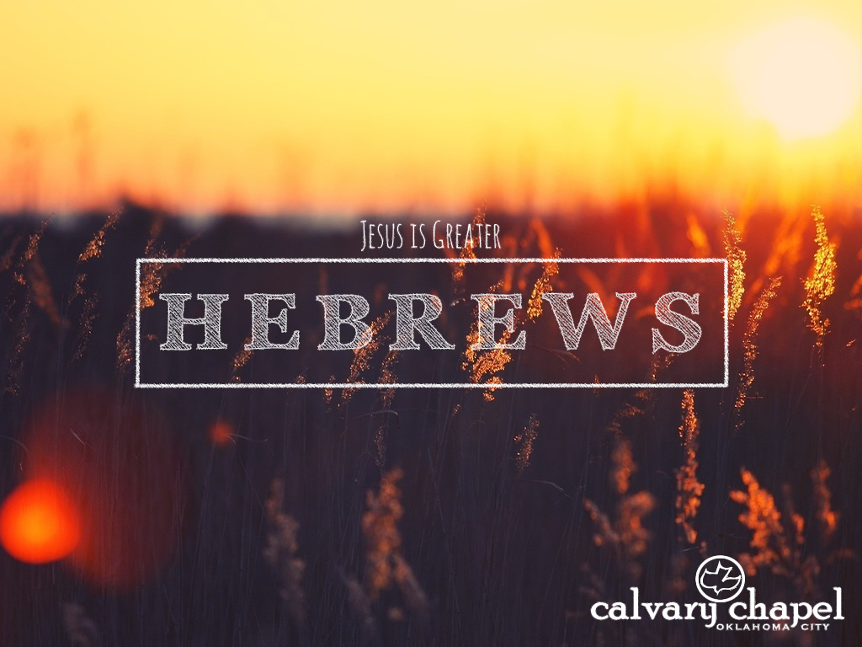
8:7-9:10

Slide 2
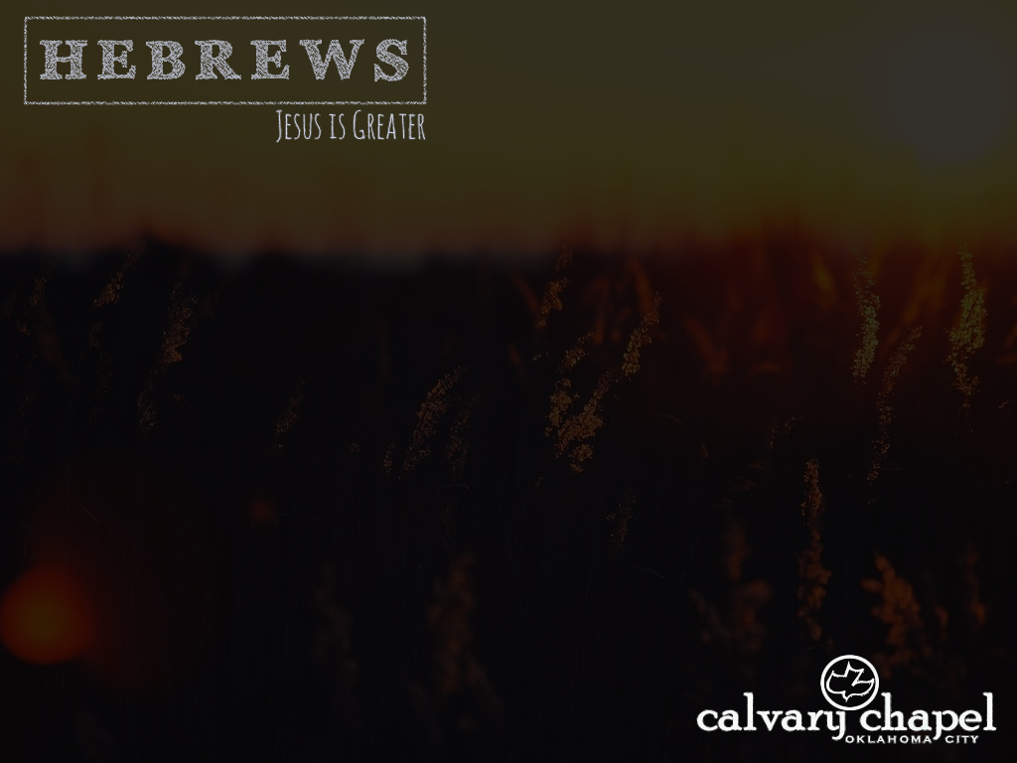
8:7-9:10
Hebrews 8:7–9:10 ~ ⁷ For if that first covenant had been faultless, then no place would have been sought for a second. ⁸ Because finding fault with them, He says: “Behold, the days are coming, says the Lord, when I will make a new covenant with the house of Israel and with the house of Judah — ⁹ not according to the covenant that I made with their fathers in the day when I took them by the hand to lead them out of the land of Egypt; because they did not continue in My covenant, and I disregarded them, says the Lord. ¹⁰ For this is the covenant that I will make with

Slide 3
8:7-9:10
Hebrews 8:7–9:10 ~ the house of Israel after those days, says the Lord: I will put My laws in their mind and write them on their hearts; and I will be their God, and they shall be My people. ¹¹ None of them shall teach his neighbor, and none his brother, saying, ‘Know the Lord,’ for all shall know Me, from the least of them to the greatest of them. ¹² For I will be merciful to their unrighteousness, and their sins and their lawless deeds I will remember no more.”
¹³ In that He says, “A new covenant,” He has made the first obsolete.

Slide 4
8:7-9:10
Hebrews 8:7–9:10 ~ Now what is becoming obsolete and growing old is ready to vanish away.
^{9:1} Then indeed, even the first covenant had ordinances of divine service and the earthly sanctuary. ² For a tabernacle was prepared: the first part, in which was the lampstand, the table, and the showbread, which is called the sanctuary; ³ and behind the second veil, the part of the tabernacle which is called the Holiest of All, ⁴ which had the golden censer and the ark of the covenant overlaid on all sides with gold, in which were the golden pot that had the manna,

Slide 5
8:7-9:10
Hebrews 8:7–9:10 ~ Aaron’s rod that budded, and the tablets of the covenant; ⁵ and above it were the cherubim of glory overshadowing the mercy seat. Of these things we cannot now speak in detail.
⁶ Now when these things had been thus prepared, the priests always went into the first part of the tabernacle, performing the services. ⁷ But into the second part the high priest went alone once a year, not without blood, which he offered for himself and for the people’s sins committed in ignorance; ⁸ the Holy Spirit indicating this, that the way into the Holiest of All

Slide 6
8:7-9:10
Hebrews 8:7–9:10 ~ was not yet made manifest while the first tabernacle was still standing. ⁹ It was symbolic for the present time in which both gifts and sacrifices are offered which cannot make him who performed the service perfect in regard to the conscience — ¹⁰ concerned only with foods and drinks, various washings, and fleshly ordinances imposed until the time of reformation.

Slide 7
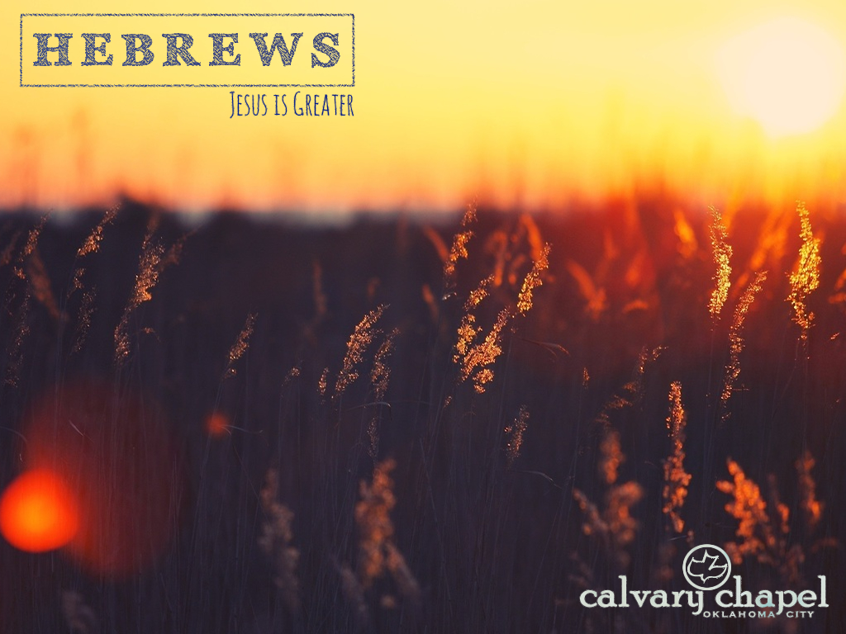
8:7-9:10

Slide 8
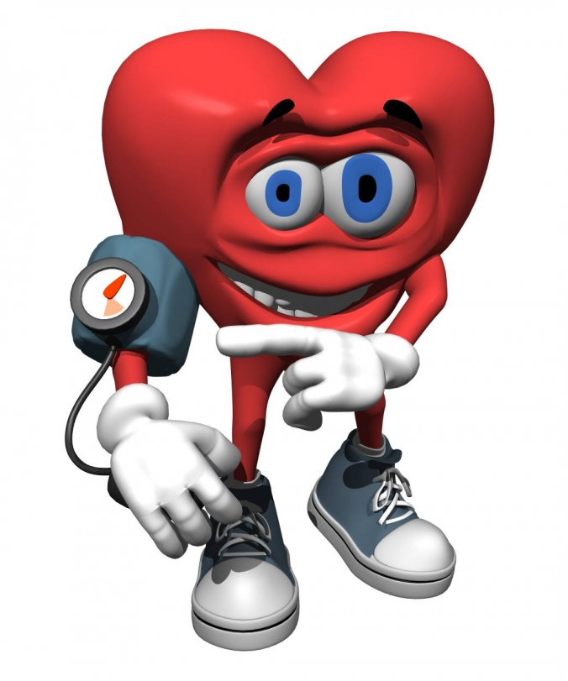
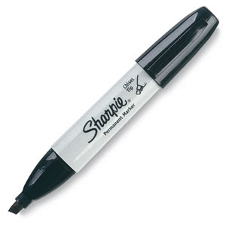
8:7-9:10
PK’s no-charge, easy-to-follow, DIY tips
Before attempting to remove stubborn stains from a garment always circle the stain in permanent pen so that when you remove the garment from the washing machine you can easily locate the area of the stain and check that it has gone.
High blood pressure sufferers: Simply cut yourself and bleed for awhile, thus reducing the pressure in your veins.

Slide 9

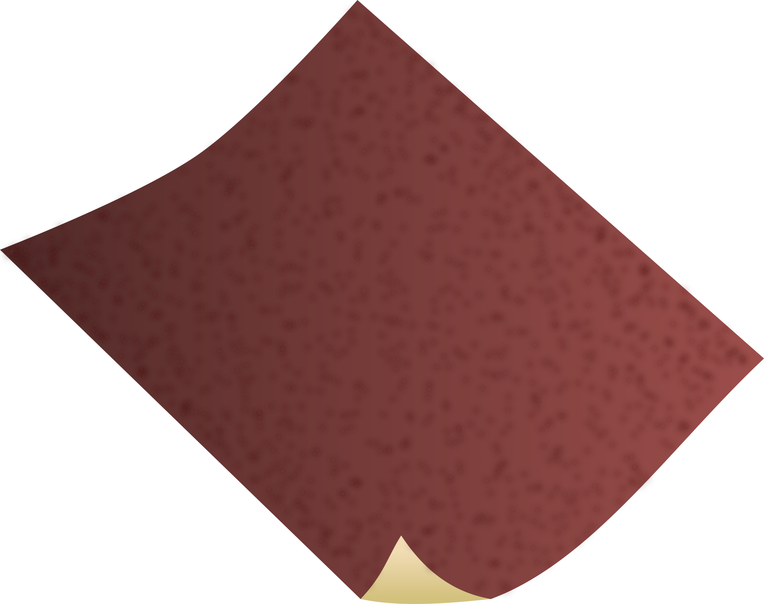
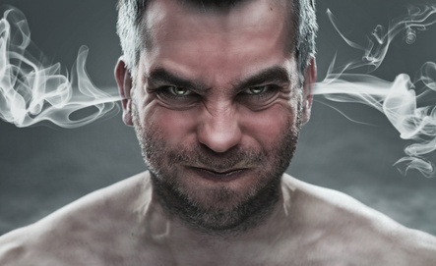
8:7-9:10
PK’s no-charge, easy-to-follow, DIY tips
Olympic athletes: Conceal the fact that you have taken performance enhancing drugs by simply running a little slower and letting someone else win.
Create instant designer stubble by sucking a magnet and dipping your chin in a bowl of iron fillings.
A sheet of sandpaper makes a cheap and effective substitute for costly maps when navigating the Sahara desert.

Slide 10
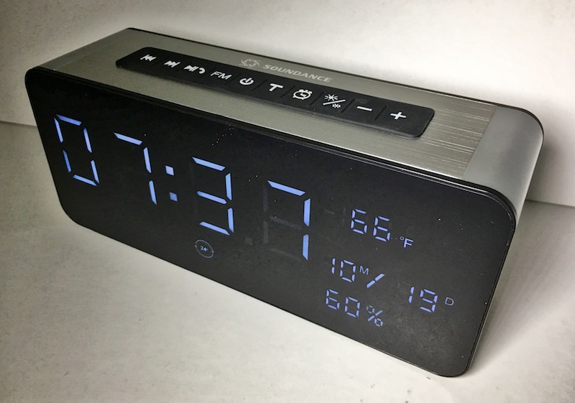
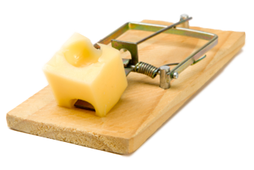

8:7-9:10
PK’s no-charge, easy-to-follow, DIY tips
Tape a chocolate bar to the outside of your microwave. If the chocolate melts you will know that the microwaves are escaping and it is time to have the oven serviced.
A mouse trap, placed on top on of your alarm clock will prevent you from rolling over and going back to sleep.
This Photo by Unknown Author is licensed under CC BY-SA

Slide 11
8:7-9:10

Slide 12
8:7-9:10
Two kinds of covenants:
1) Conditional (Mosaic ~ “if” – “then”)
2) Unconditional (Abrahamic)
1st covenant was faulty on 2 levels:
(9:9 NLT ~ This is an illustration pointing to the present time. For the gifts and sacrifices that the priests offer are not able to cleanse the consciences of the people who bring them.)
1) It was never designed to remove sin
2) The Israelites broke it

Slide 13
8:7-9:10

Slide 14
8:7-9:10
Heb. 11b ~ ‘Know the Lord,’ for all shall know Me, from the least of them to the greatest of them.
1st Know ~ ginōskō – to come to know, to know by experience
2nd know ~ oida – to see or perceive, to know fully

Slide 15
8:7-9:10

Slide 16
8:7-9:10
6:1-2 ~ ¹ Therefore, leaving the discussion of the elementary principles of Christ, let us go on to perfection, not laying again the foundation of repentance from dead works and of faith toward God, ² of the doctrine of baptisms, of laying on of hands, of resurrection of the dead, and of eternal judgment.

Slide 17
8:7-9:10

Slide 18
8:7-9:10
Charles Spurgeon (Power of Prayer in a Believer's Life) ~ “Prayer comes spontaneously from those who abide in Jesus. Prayer is the natural outgushing of a soul in communion with Jesus. As the leaf and fruit come out of the vine branch without any conscious effort and simply because of its living union with the stem, so prayer buds and blossoms and fruits out of souls abiding in Jesus. As stars shine, so do abiders pray. They do not say to themselves, ‘It is time for us to get to our task and pray.’ No they pray as wise men eat - namely, when the desire for it is upon them.

Slide 19
8:7-9:10
Charles Spurgeon (Power of Prayer in a Believer's Life) ~ They do not cry out as under bondage, ‘At this time, I ought to be in prayer, but I do not feel like it. What a weariness it is!’ They have a glad errand at the mercy seat and rejoice to go there. Hearts abiding in Christ send forth supplications as fire sends out flames and sparks. Souls abiding in Jesus open the day with prayer; prayer surrounds them as an atmosphere all day long; at night they fall asleep praying. They are able to joyfully say, ‘When I awake, I am still with thee.’” (Ps. 139:18

Slide 20
8:7-9:10

Slide 21
8:7-9:10
Ark
God’s Presence
Veil
Table of Showbread
Outer Court
Our prayers
Golden Altar
Menorah
Holiest of All
Sanctuary
Bronze Laver
Bronze Altar

Slide 22
8:7-9:10
Where was the Golden Altar of Incense?
1) It had been moved by the time of Herod’s Temple?
2) The author is referring to its ministry pertaining to the Holy of Holies?

Slide 23
8:7-9:10
Where was the Golden Altar of Incense?
Lev. 16:12-13 ~ ¹² Then he shall take a censer full of burning coals of fire from the altar before the Lord, with his hands full of sweet incense beaten fine, and bring it inside the veil. ¹³ And he shall put the incense on the fire before the Lord, that the cloud of incense may cover the mercy seat that is on the Testimony, lest he die.

Slide 24
8:7-9:10
Where was the Golden Altar of Incense?
1) It had been moved by the time of Herod’s Temple?
2) The author is referring to its ministry pertaining to the Holy of Holies?
3) The author is recognizing the veil of separation had been taken away?

Slide 25

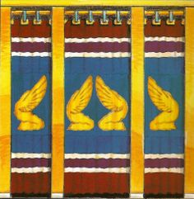

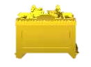
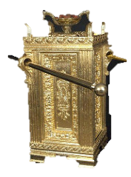
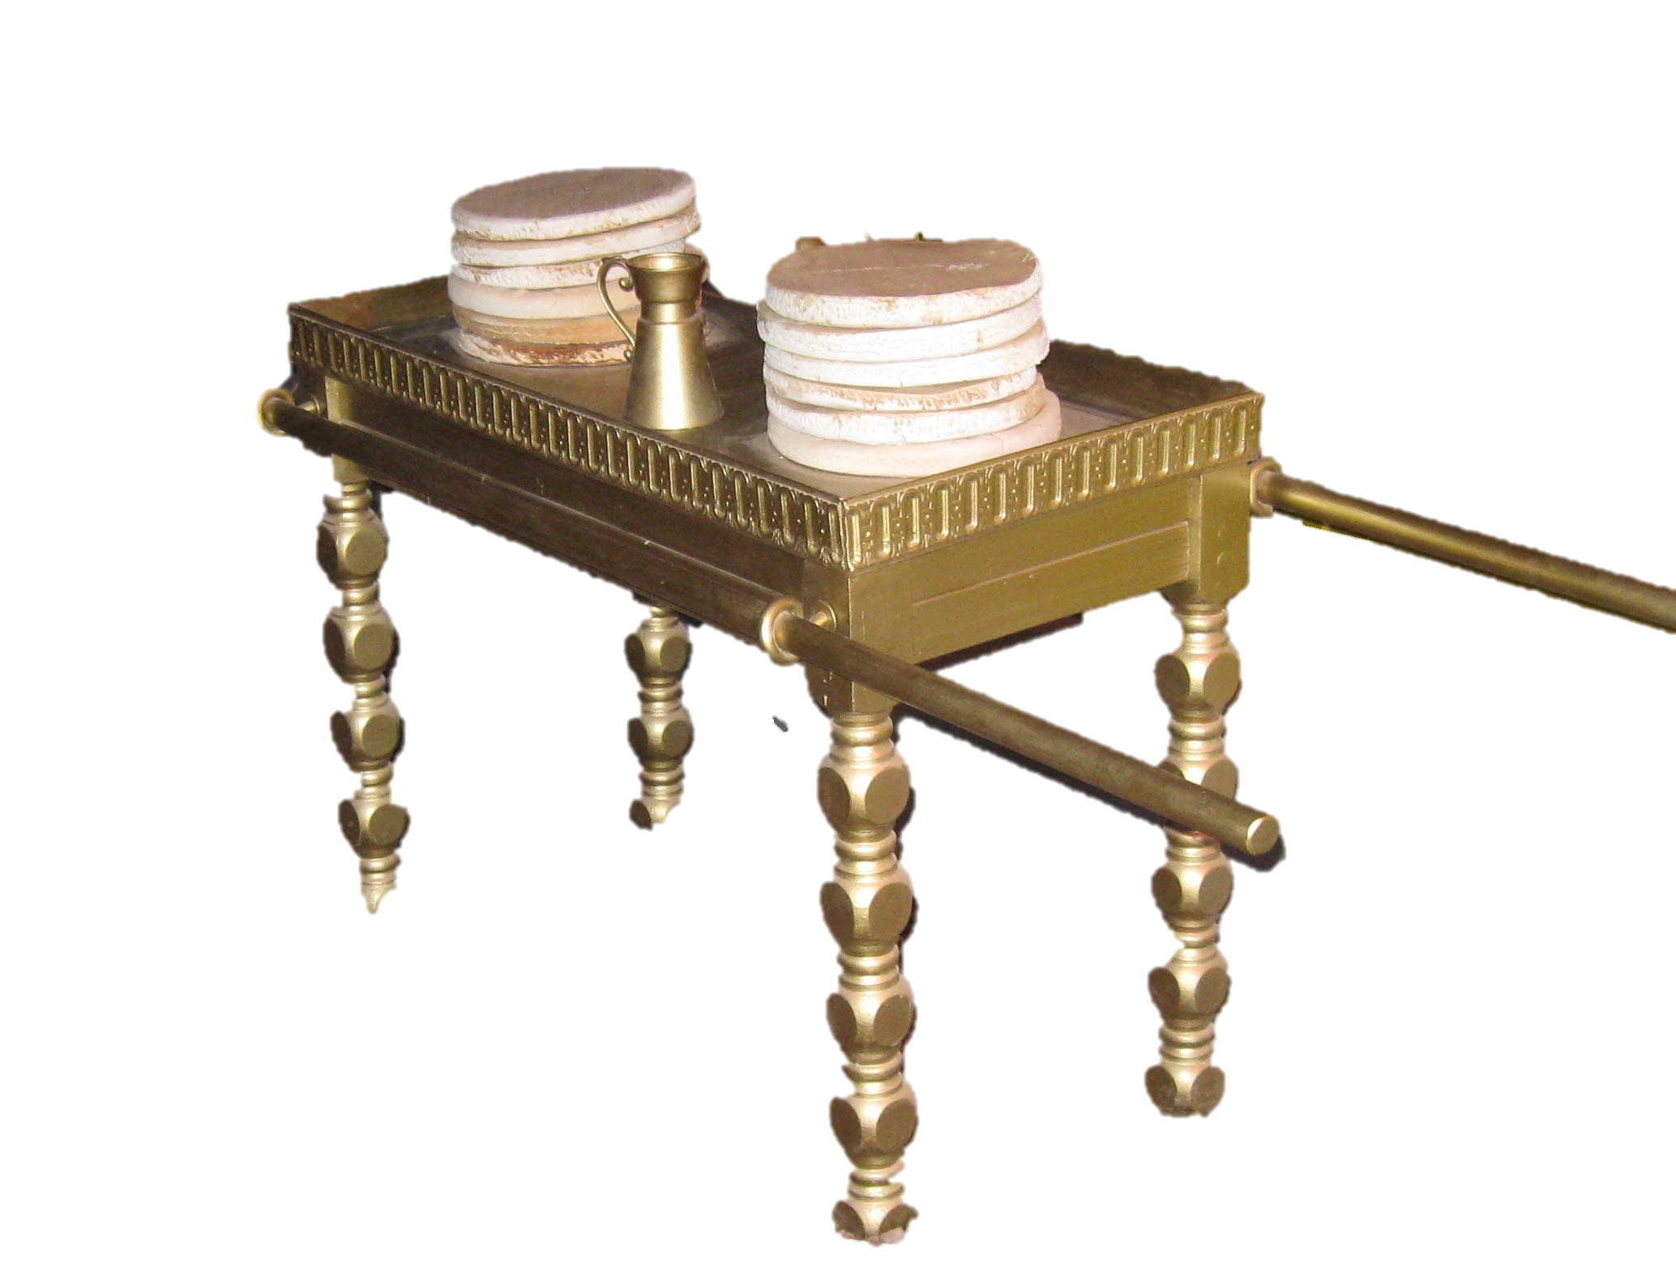

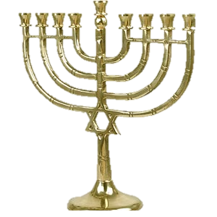
8:7-9:10
Ark of the Covenant
W
S
N
E
Golden Altar
Table of Showbread
Menorah

Slide 26
8:7-9:10
Inside the Ark of the Covenant:
manna (Ex. 16:33) = Bread of Life
Aaron’s rod (Num. 17:7) = Resurrection
tablets of the
covenant (Ex. 25:16) = the Law

Slide 27
8:7-9:10

Slide 28
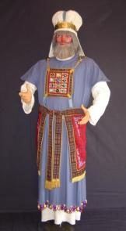
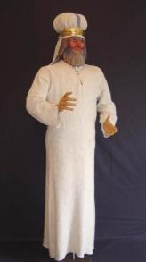
8:7-9:10
The High Priest’s daily attire
The High Priest on the Day of Atonement

Slide 29
8:7-9:10

Slide 30
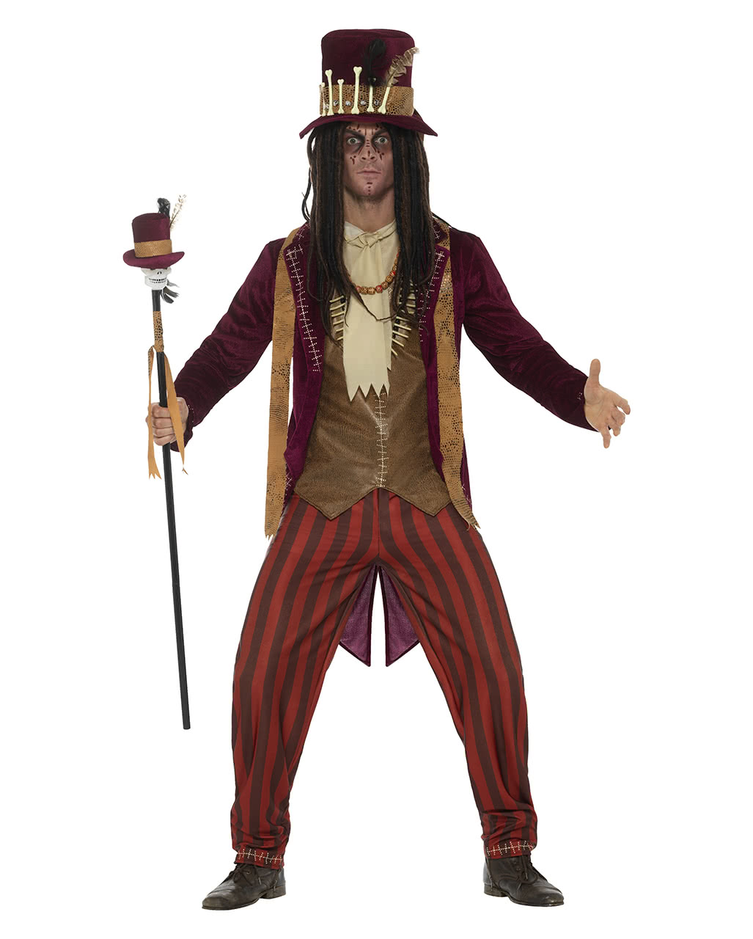
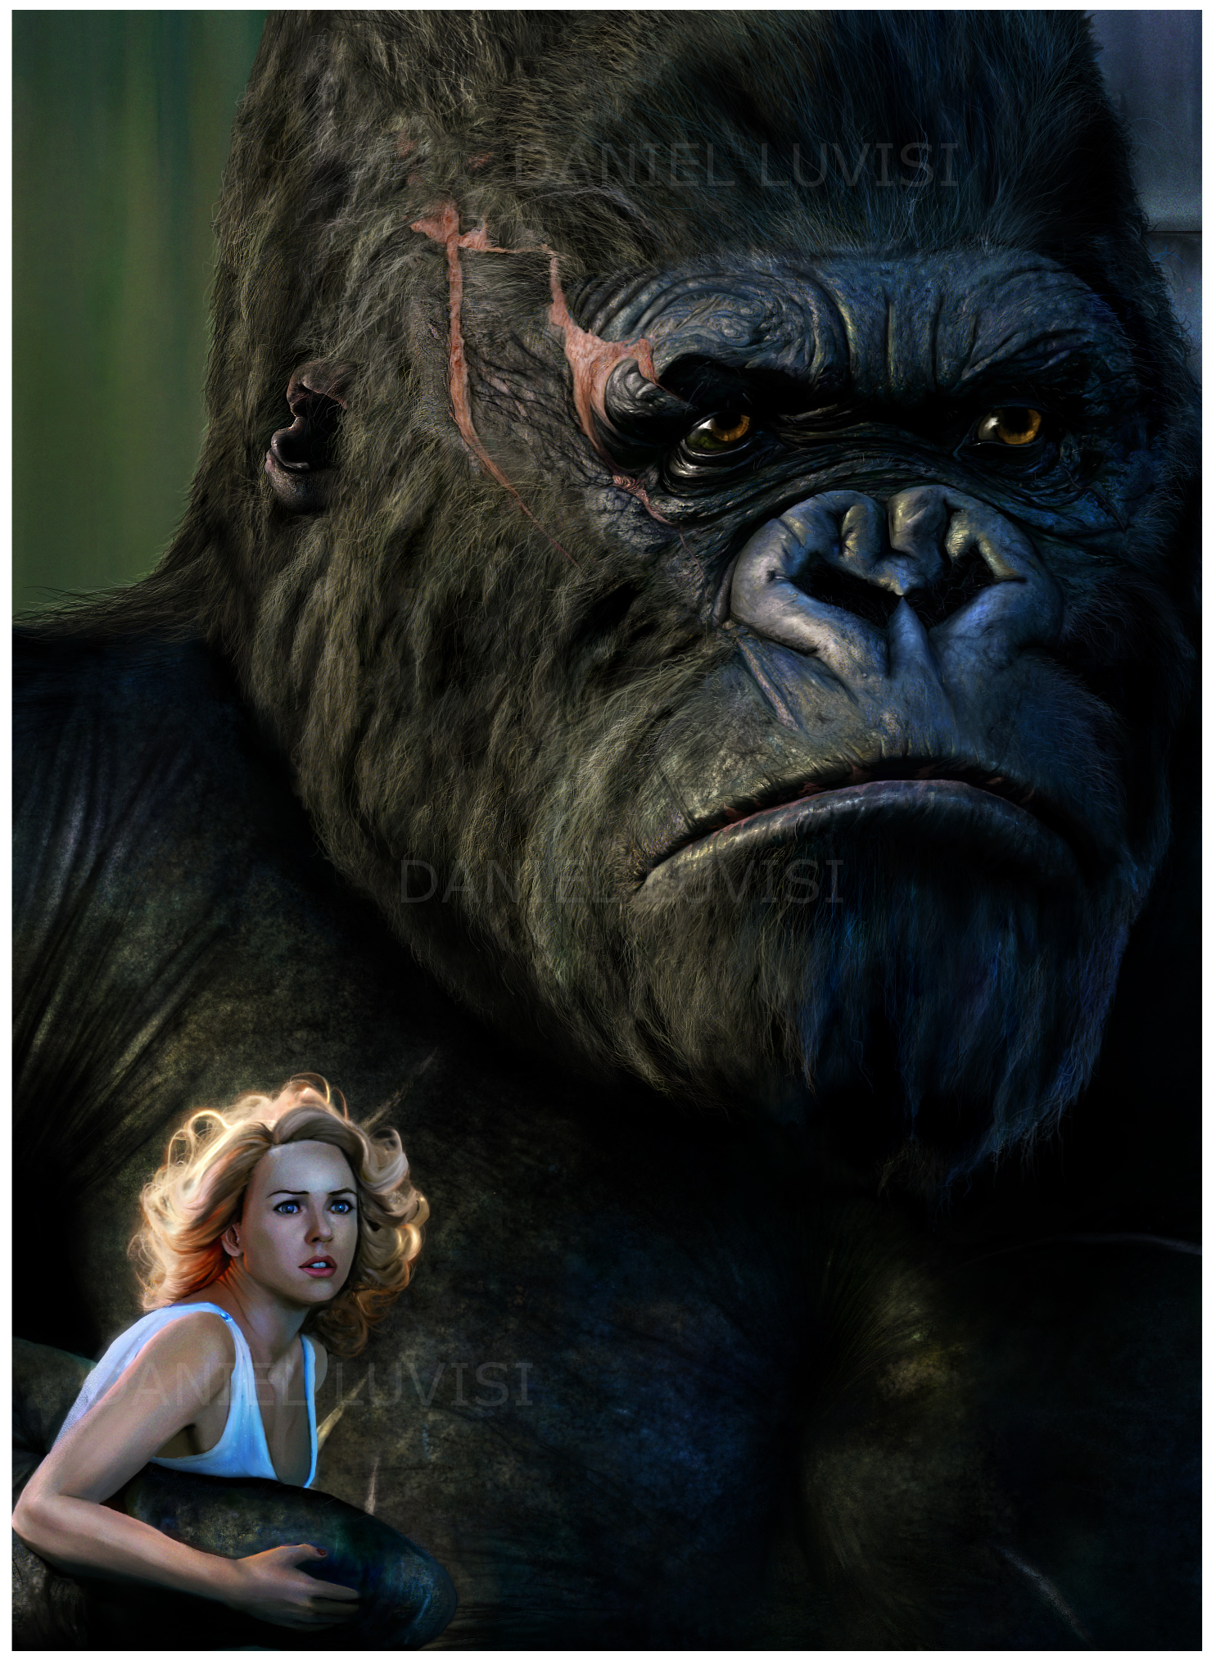
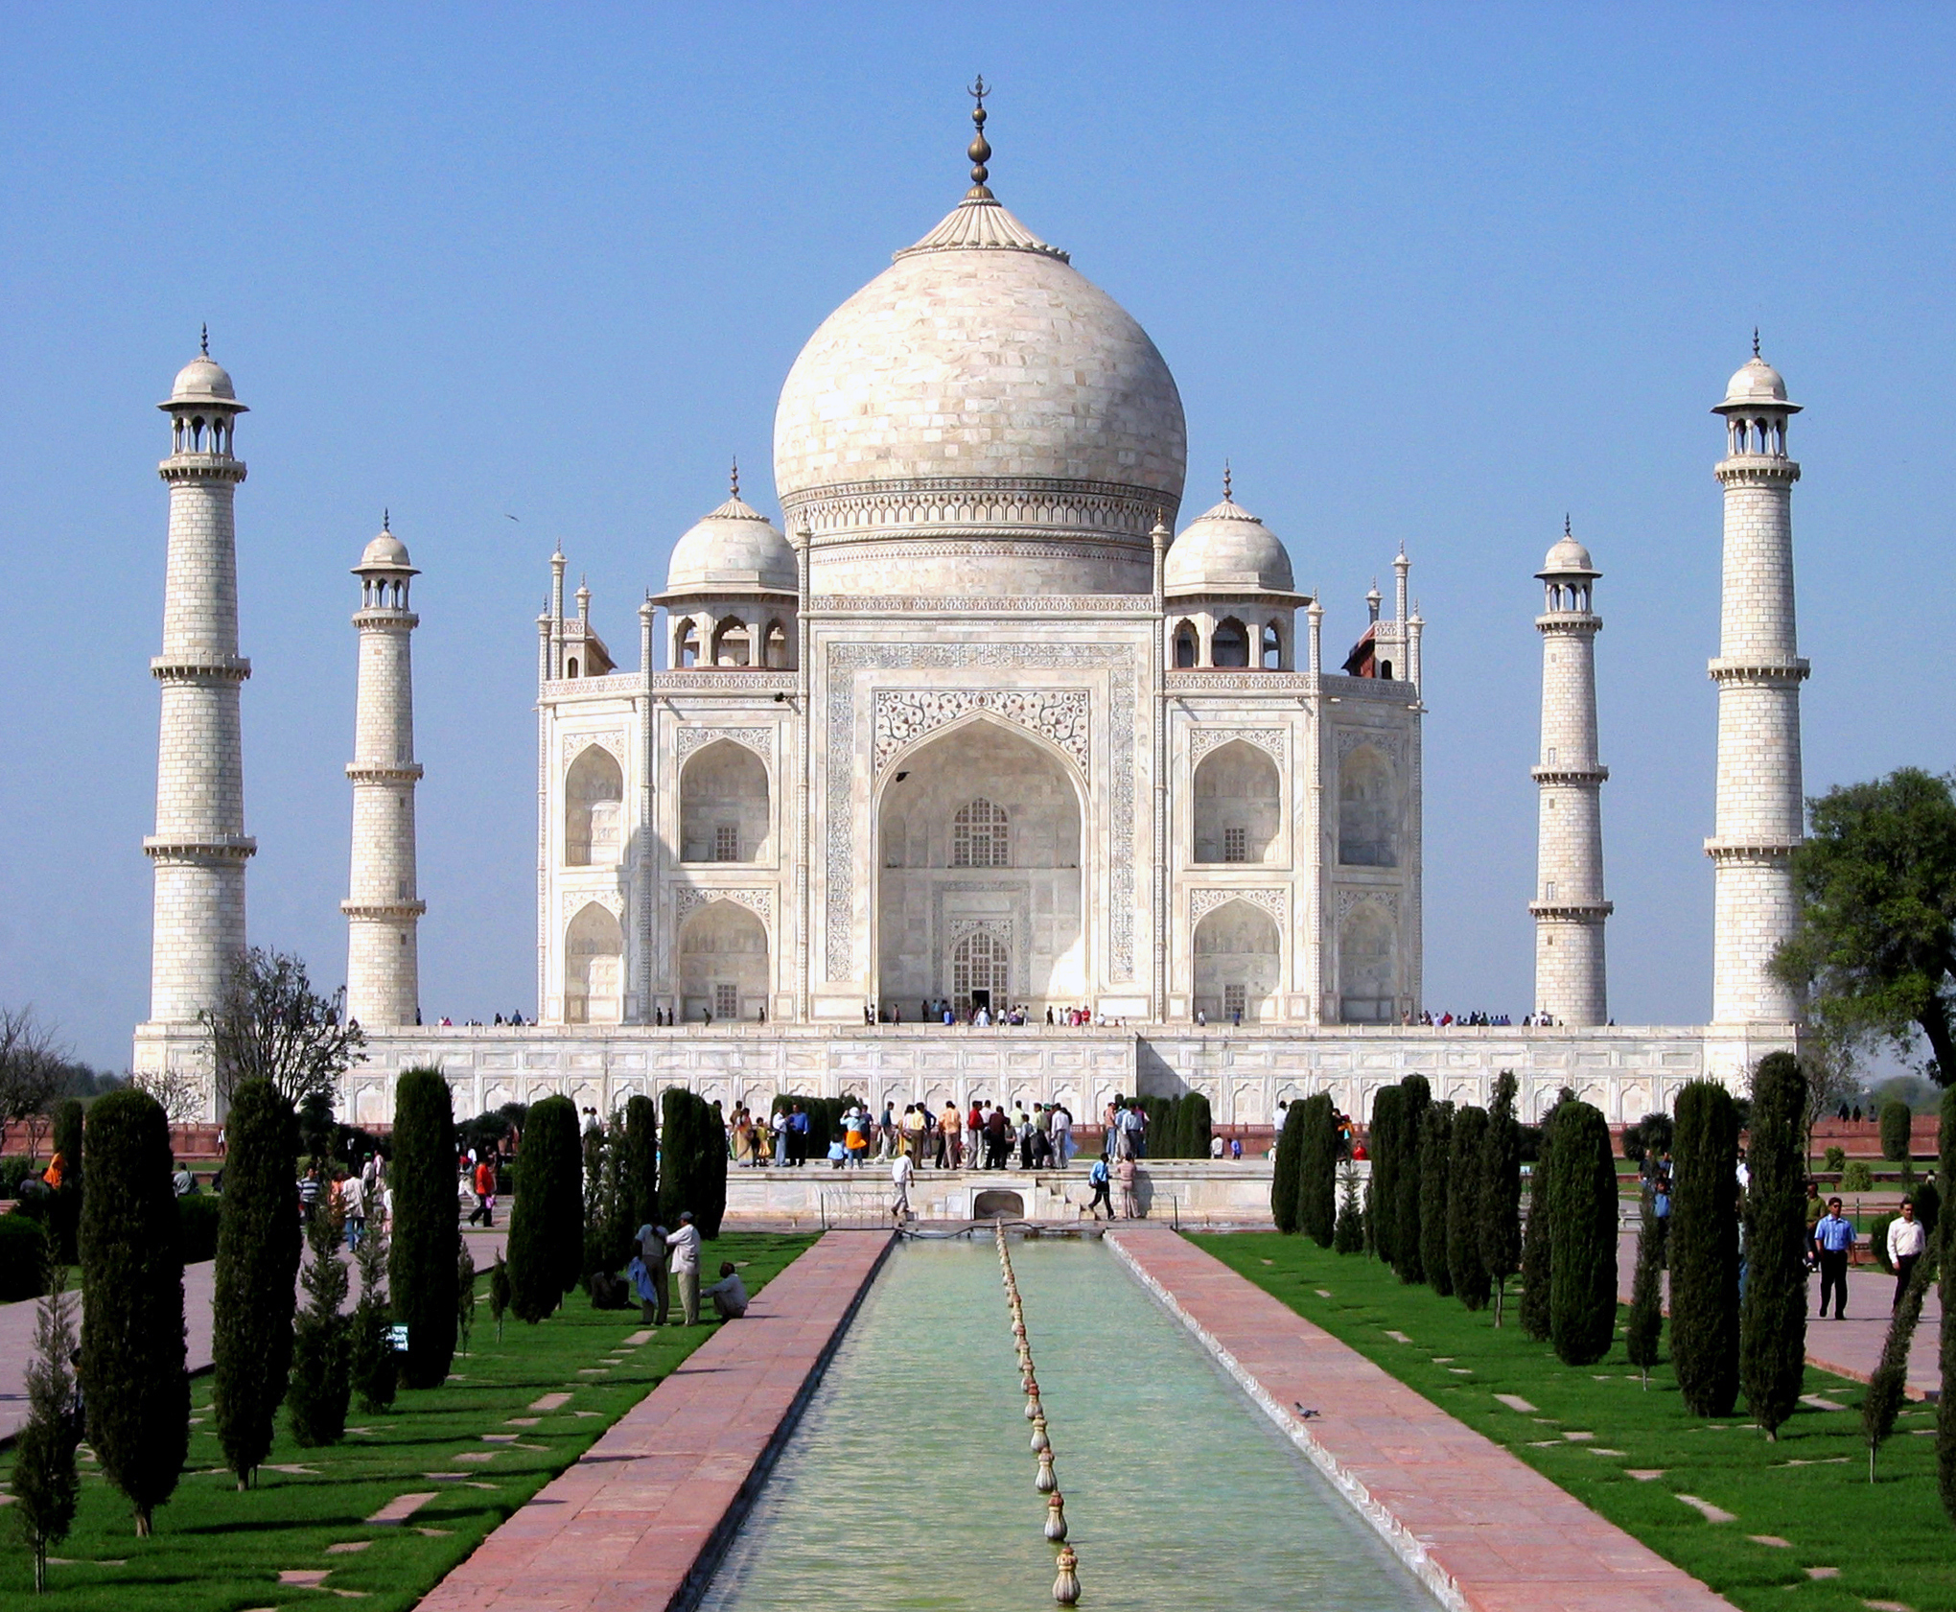
8:7-9:10
The priesthood required 3 things:
1) A priest
~ Jesus, of the order of Melchizedek
2) A place
~ the Mercy Seat in heaven
3) A present
~ His own sacrificial life

Slide 31
8:7-9:10

Slide 32


8:7-9:10

Slide 33
8:7-9:10

Slide 34
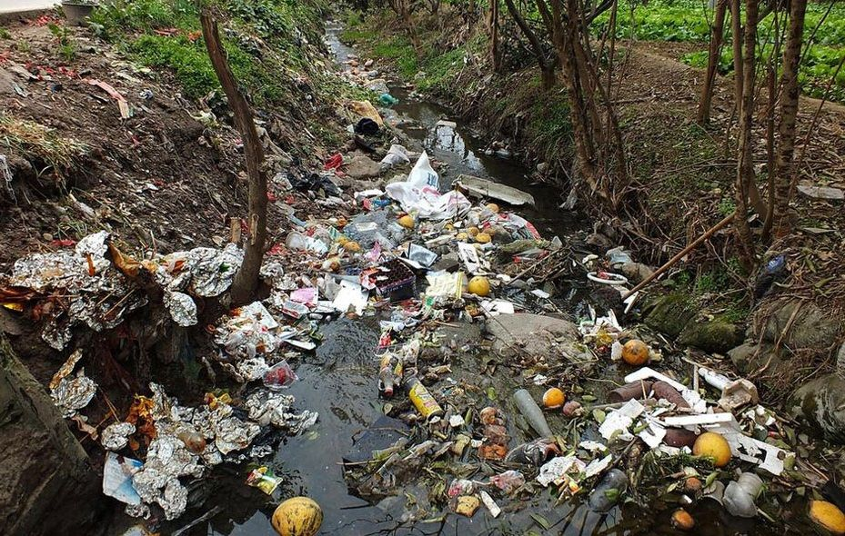
8:7-9:10

Slide 35
8:7-9:10

