Slide 1
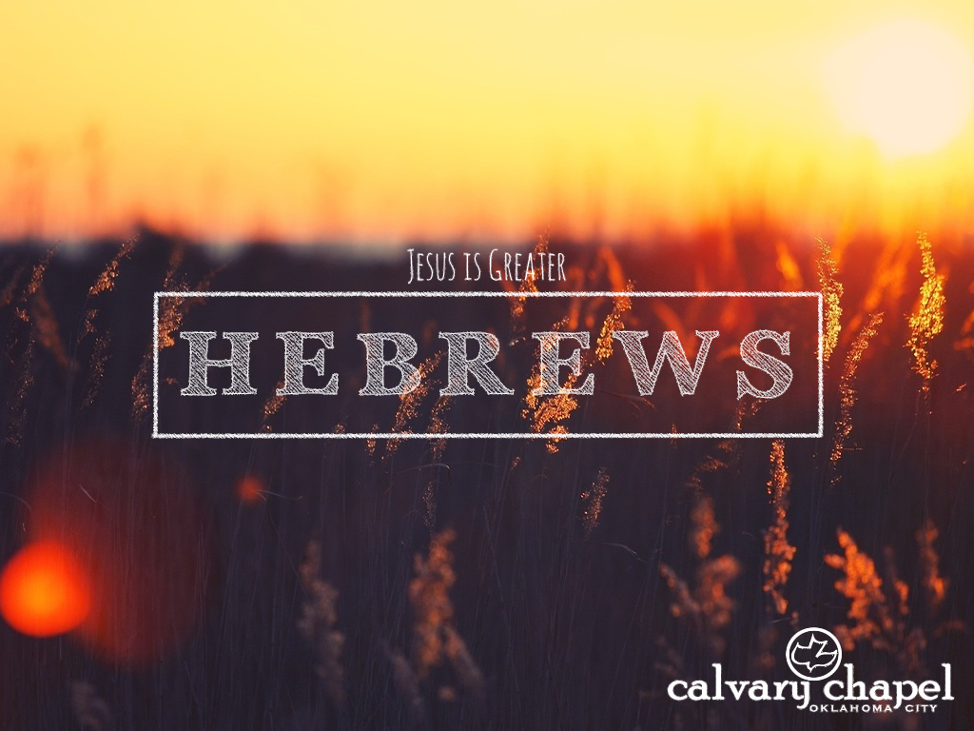
7:11-8:6

Slide 2
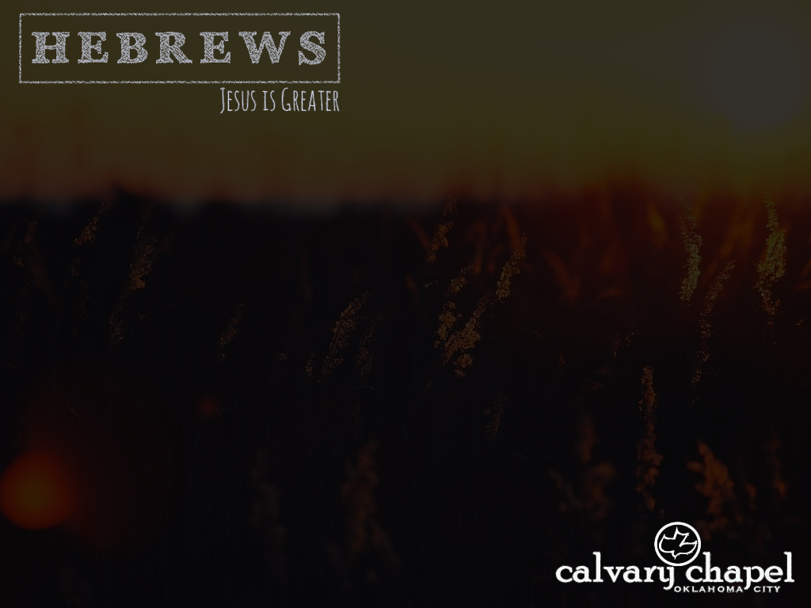
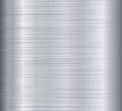



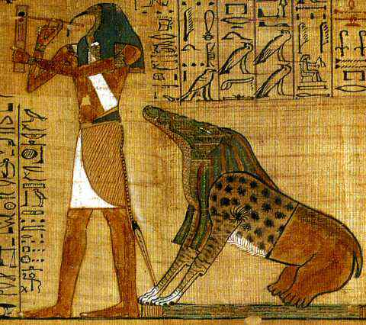

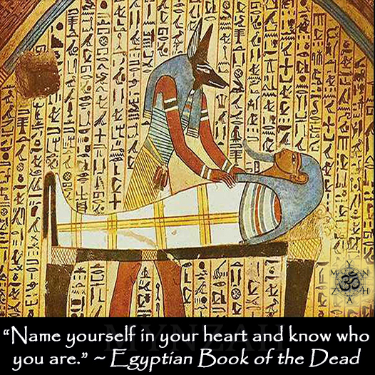

7:11-8:6
Ammit, crocodile head
leopard shoulders
rhino backside

Slide 3
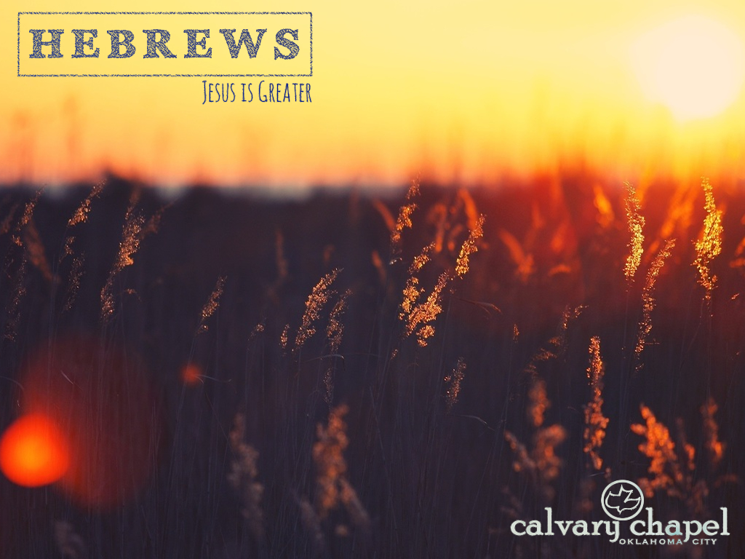
7:11-8:6

Slide 4
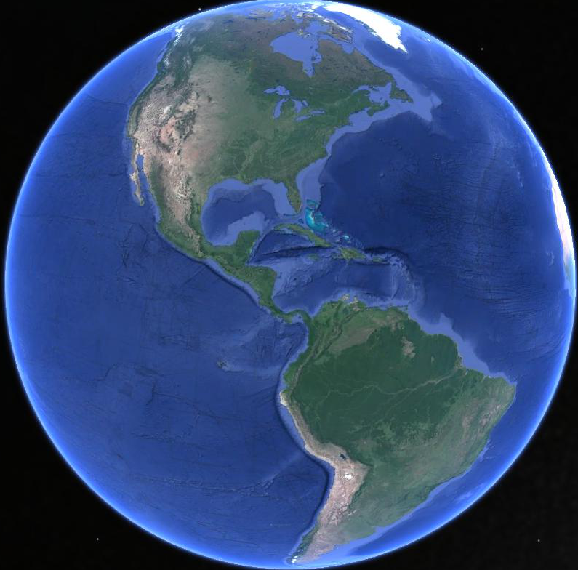
7:11-8:6
Heaven
Barna poll
55%
Being good will earn
a place in heaven
All experience the
same outcome after death
44%
38%
All religions teach
the same lesson

Slide 5
7:11-8:6

Slide 6
7:11-8:6
Hebrews 7:11–8:6 ~ ¹¹ Therefore, if perfection were through the Levitical priesthood (for under it the people received the law), what further need was there that another priest should rise according to the order of Melchizedek, and not be called according to the order of Aaron? ¹² For the priesthood being changed, of necessity there is also a change of the law. ¹³ For He of whom these things are spoken belongs to another tribe, from which no man has officiated at the altar.
¹⁴ For it is evident that our Lord arose from Judah, of which tribe Moses spoke nothing concerning

Slide 7
7:11-8:6
Hebrews 7:11–8:6 ~ priesthood. ¹⁵ And it is yet far more evident if, in the likeness of Melchizedek, there arises another priest ¹⁶ who has come, not according to the law of a fleshly commandment, but according to the power of an endless life. ¹⁷ For He testifies:
“You are a priest forever
According to the order of Melchizedek.”
¹⁸ For on the one hand there is an annulling of the former commandment because of its weakness and unprofitableness, ¹⁹ for the law made nothing perfect; on the other hand, there is the bringing in

Slide 8
7:11-8:6
Hebrews 7:11–8:6 ~ of a better hope, through which we draw near to God.
²⁰ And inasmuch as He was not made priest without an oath ²¹ (for they have become priests without an oath, but He with an oath by Him who said to Him:
“The Lord has sworn
And will not relent,
‘You are a priest forever
According to the order of Melchizedek’”),
²² by so much more Jesus has become a surety of a better covenant.

Slide 9
7:11-8:6
Hebrews 7:11–8:6 ~ ²³ Also there were many priests, because they were prevented by death from continuing. ²⁴ But He, because He continues forever, has an unchangeable priesthood. ²⁵ Therefore He is also able to save to the uttermost those who come to God through Him, since He always lives to make intercession for them.
²⁶ For such a High Priest was fitting for us, who is holy, harmless, undefiled, separate from sinners, and has become higher than the heavens; ²⁷ who does not need daily, as those high priests, to offer up sacrifices, first for His own sins and then for the people’s,

Slide 10
7:11-8:6
Hebrews 7:11–8:6 ~ for this He did once for all when He offered up Himself. ²⁸ For the law appoints as high priests men who have weakness, but the word of the oath, which came after the law, appoints the Son who has been perfected forever.
^{8:1} Now this is the main point of the things we are saying: We have such a High Priest, who is seated at the right hand of the throne of the Majesty in the heavens, ² a Minister of the sanctuary and of the true tabernacle which the Lord erected, and not man. ³ For every high priest is appointed to offer both gifts and

Slide 11
7:11-8:6
Hebrews 7:11–8:6 ~ sacrifices. Therefore it is necessary that this One also have something to offer. ⁴ For if He were on earth, He would not be a priest, since there are priests who offer the gifts according to the law; ⁵ who serve the copy and shadow of the heavenly things, as Moses was divinely instructed when he was about to make the tabernacle. For He said, “See that you make all things according to the pattern shown you on the mountain.” ⁶ But now He has obtained a more excellent ministry, inasmuch as He is also Mediator of a better covenant, which was established on better promises.

Slide 12
7:11-8:6

Slide 13

7:11-8:6
Q. “How do you get to heaven?”
A. “A person dies … then goes to heaven”
A. “In this world? Nobody’s going to heaven”
A. “I don’t know … I’ve never really thought about it”
A. “I would like to think it’s because they’re a decent human being”
A. “Not the way I’m getting’ there, that’s for sure (snickers)”

Slide 14
7:11-8:6
Q. “How do you get to heaven?”
A. “That’s a tough one … I don’t know. Hopefully doing the right thing?”
A. “Actually you don’t get there ‘cause you’re already there … every day you’ve got day and you’ve got night … so you’re in heaven and in hell all the time … so how are you gonna go where you already are?”

Slide 15
7:11-8:6
Q. “How do you get to heaven?”
A. “Heaven’s inside us already, so I don’t think you get to heaven … it’s just something that you recognize that’s inside yourself and inside other people”
A. “To heaven? Not the good old way … the purgatory … these days, it’s by good deeds”
A. “I don’t know that there really is one”

Slide 16
7:11-8:6
Q. “How do you get to heaven?”
A. “To be a good person … like I’m a Christian. You could be a good Jew; you could be a good person of Islamic faith … doesn’t matter”
A. “Through the front door”
Q. “Who opens that front door?”
A. “Whoever’s guarding heaven’s gate at the time you arrive … If they let you in – you’re in … if they don’t – you try another day”

Slide 17
7:11-8:6
Q. “How do you get to heaven?”
A. “Uh … asking Jesus Christ in their heart”

Slide 18
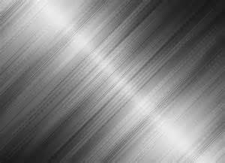


7:11-8:6
grace
2pt.
1pt.
Earth
Heaven
3pt.
salvation-o-meter

Slide 19
7:11-8:6

Slide 20
7:11-8:6
perfection ~ teleiōsis – completion in the sense of arriving at a desired goal

Slide 21
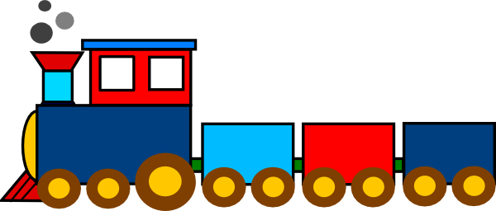
7:11-8:6
Heaven
Priests

Slide 22
7:11-8:6

Slide 23
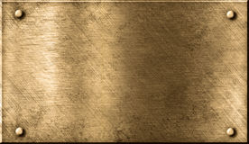
7:11-8:6
Aaron anointed 1446 BC
Fall of Jerusalem AD 70
1 every 18 years
1000 BC
500 BC
BC/AC
83 High Priests*
* source ~ Josephus

Slide 24
7:11-8:6

Slide 25
7:11-8:6
John 5:31-32 ~ ³¹ “If I bear witness of Myself, My witness is not true. ³² There is another who bears witness of Me, and I know that the witness which He witnesses of Me is true.

Slide 26
7:11-8:6

Slide 27
7:11-8:6
The annulling of the Law did
make us free to serve God
not make us free to sin

Slide 28
7:11-8:6

Slide 29
7:11-8:6
Heaven
Law

Slide 30
7:11-8:6

Slide 31
7:11-8:6
surety ~ literally, to go to bail
Usually translated guarantee or guarantor
covenant ~ diathēkē – 16x in Hebrews (33x in NT)

Slide 32
7:11-8:6
Job 9:32-33 ~ ³² For He is not a man, as I am,
That I may answer Him,
And that we should go to court together.
³³ Nor is there any mediator between us,
Who may lay his hand on us both.
Latin word for: bridge ~ ponem
bridge builder ~ pontifex
greatest bridge builder ~ pontifex maximus

Slide 33
7:11-8:6
Jesus is the Pontifex Maximus
1 Tim. 2:5 ~ For there is one God and one Mediator between God and men, the Man Christ Jesus,

Slide 34
7:11-8:6

Slide 35
7:11-8:6
unchangeable (v. 24) ~ inviolable
Phillips ~ But Christ … possesses a priesthood that needs no successor.
uttermost ~ pantelēs
pan ~ all
telos ~ completely
the uttermost
Not from
But to

Slide 36
7:11-8:6

Slide 37
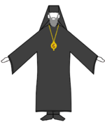
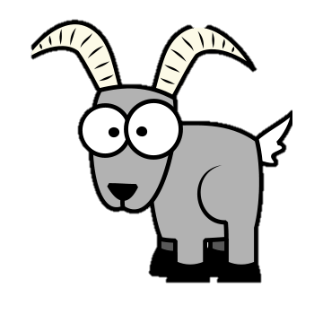
7:11-8:6
Yom Kippur ~ Day of Atonement
1st goat ~ forgiven
2nd goat ~ forgotten
Jer. 31:34 ~ For I will forgive their iniquity, and their sin I will remember no more.

Slide 38
7:11-8:6

Slide 39
7:11-8:6
Heaven
Jesus

Slide 40
7:11-8:6

Slide 41
7:11-8:6
Hebrews 1-13
2
4
6
8
10
12
3 ½ chapters

Slide 42
7:11-8:6

Slide 43
7:11-8:6
Minister ~ leitourgos – originally a public servant
Came to mean one who performs a sacred function
Origen of the word liturgy

Slide 44
7:11-8:6

Slide 45
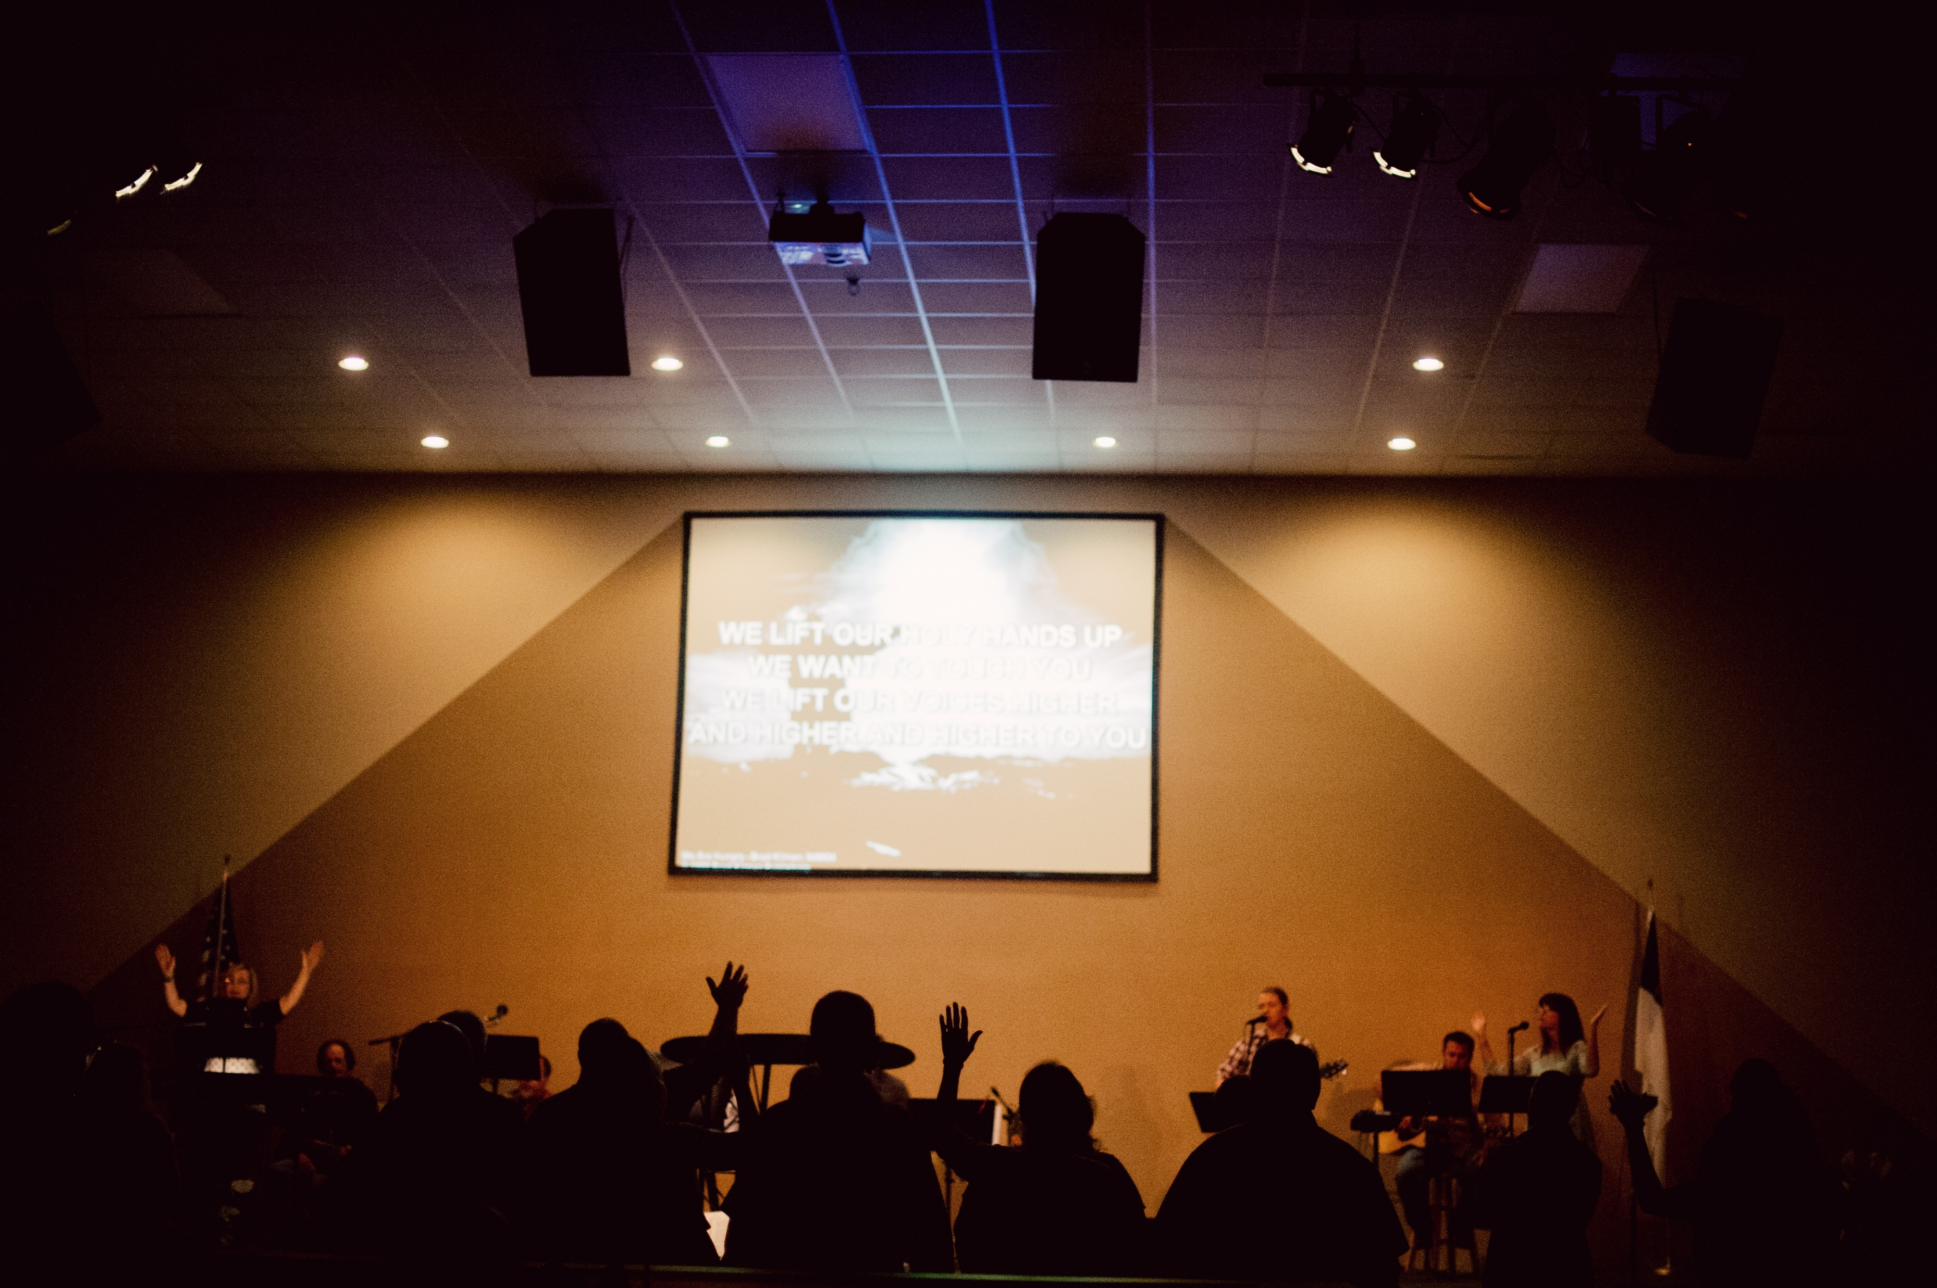
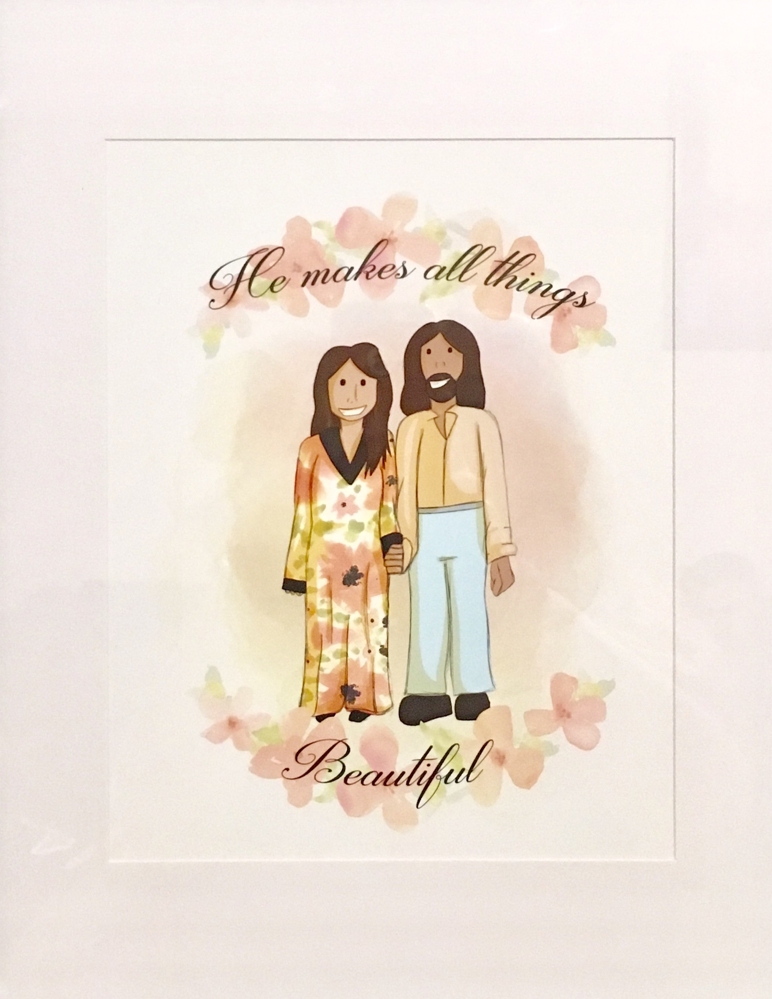
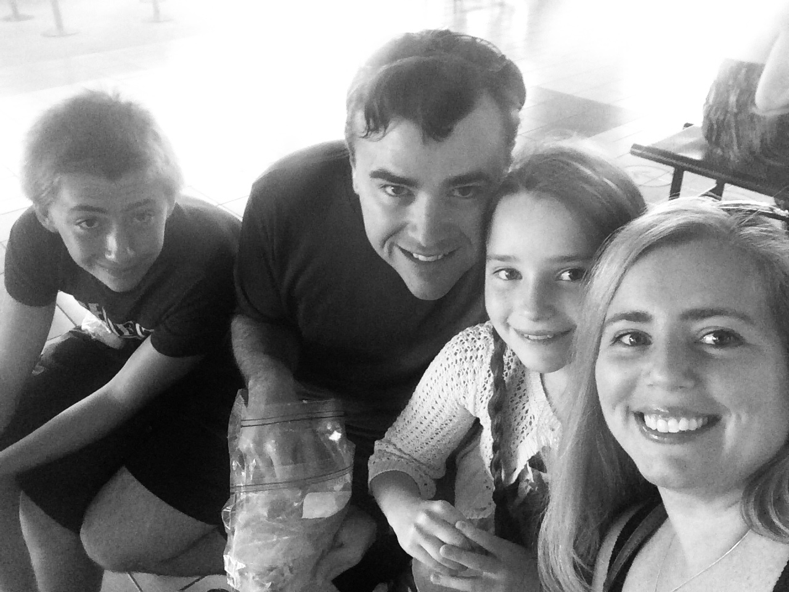
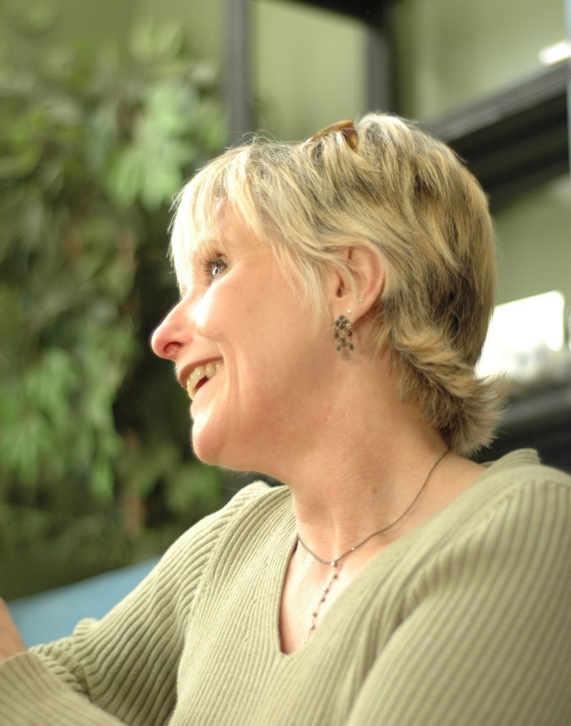
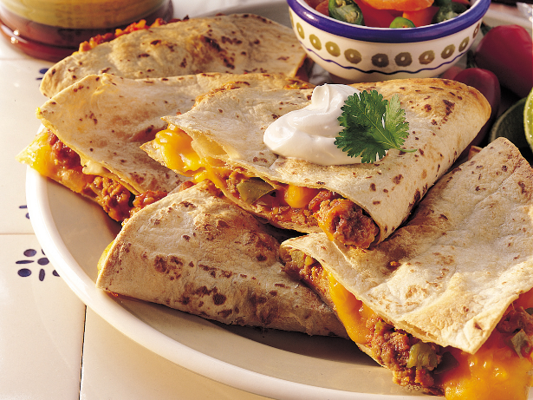
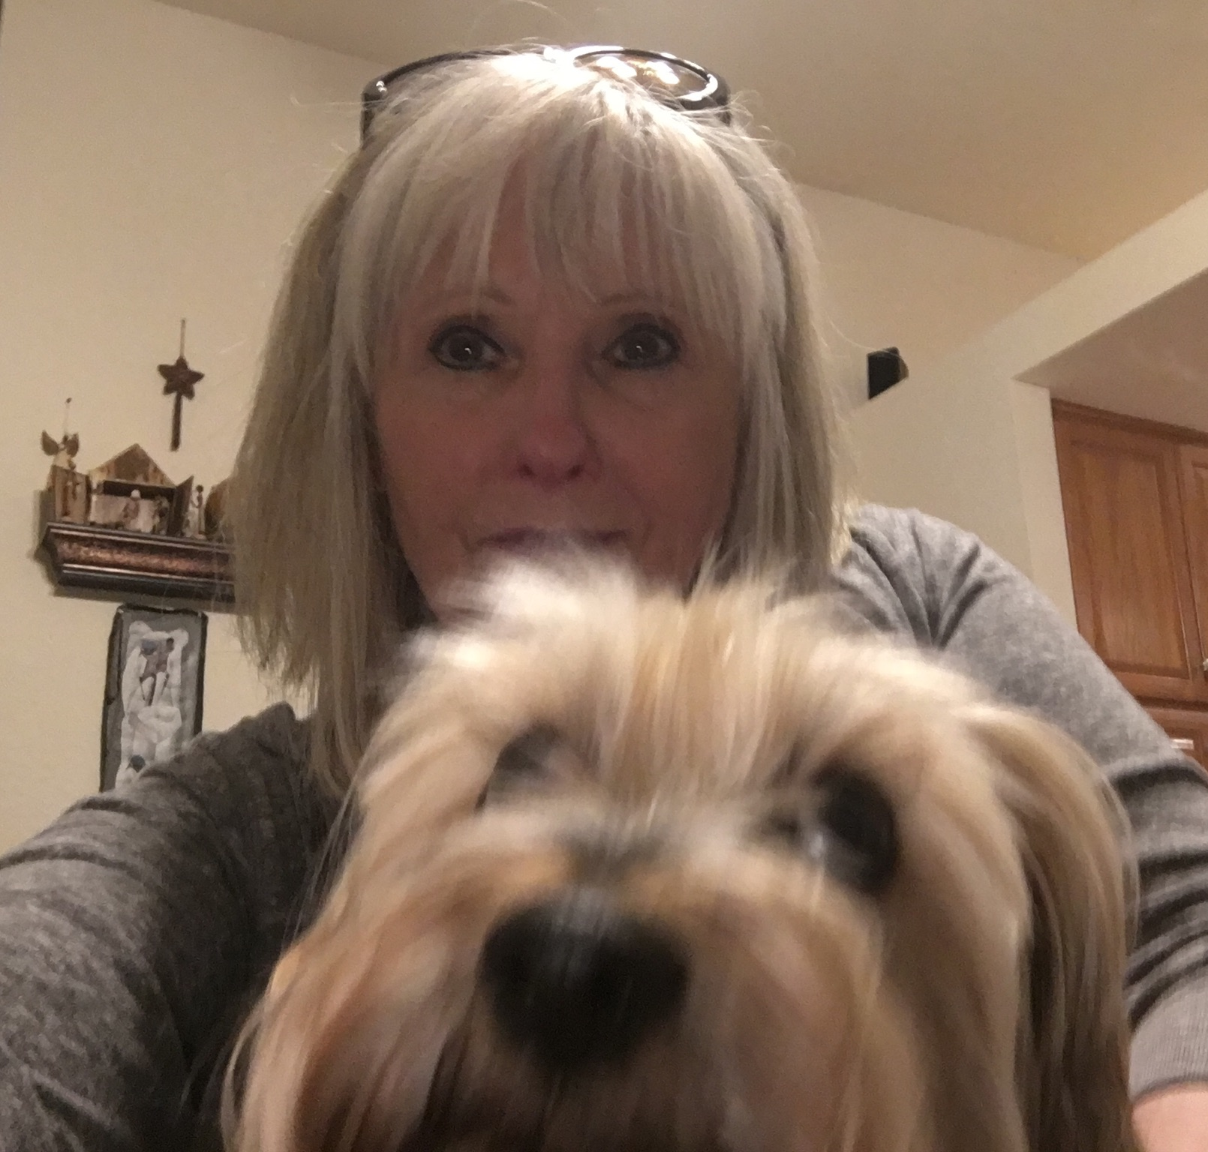
7:11-8:6
Col. 2:17 ~ a shadow of things to come, but the substance is of Christ.

Slide 46
7:11-8:6
Why is He silent when a word,
Would slay His accusers all?
Why does He meekly bear their taunts,
When angels wait His call?
“He was made sin,” my sin He bore
Upon that cursed tree,
And sin hath no defense to make,
His silence was for me!

Slide 47
7:11-8:6

