Slide 1
6:9-7:10

Slide 2
6:9-7:10
Jacob
Judah
Levi
Kohath
Tabernacle/Temple Stewards
David
Amram
Aaron
David’s “greater” Son, Jesus

Slide 3
6:9-7:10

Slide 4
6:9-7:10
Toot ‘n’ tell or go to hell

Slide 5
6:9-7:10

Slide 6
6:9-7:10
Hebrews 6:9–7:10 ~ ⁹ But, beloved, we are confident of better things concerning you, yes, things that accompany salvation, though we speak in this manner. ¹⁰ For God is not unjust to forget your work and labor of love which you have shown toward His name, in that you have ministered to the saints, and do minister. ¹¹ And we desire that each one of you show the same diligence to the full assurance of hope until the end, ¹² that you do not become sluggish, but imitate those who through faith and patience inherit the promises. ¹³ For when God made a promise to Abraham,

Slide 7
6:9-7:10
Hebrews 6:9–7:10 ~ because He could swear by no one greater, He swore by Himself, ¹⁴ saying, “Surely blessing I will bless you, and multiplying I will multiply you.” ¹⁵ And so, after he had patiently endured, he obtained the promise. ¹⁶ For men indeed swear by the greater, and an oath for confirmation is for them an end of all dispute. ¹⁷ Thus God, determining to show more abundantly to the heirs of promise the immutability of His counsel, confirmed it by an oath, ¹⁸ that by two immutable things, in which it is impossible for God to lie, we might have strong consolation,

Slide 8
6:9-7:10
Hebrews 6:9–7:10 ~ who have fled for refuge to lay hold of the hope set before us.
¹⁹ This hope we have as an anchor of the soul, both sure and steadfast, and which enters the Presence behind the veil, ²⁰ where the forerunner has entered for us, even Jesus, having become High Priest forever according to the order of Melchizedek.
^{7:1} ~ For this Melchizedek, king of Salem, priest of the Most High God, who met Abraham returning from the slaughter of the kings and blessed him, ² to whom also Abraham gave a tenth part of all,

Slide 9
6:9-7:10
Hebrews 6:9–7:10 ~ first being translated “king of righteousness,” and then also king of Salem, meaning “king of peace,” ³ without father, without mother, without genealogy, having neither beginning of days nor end of life, but made like the Son of God, remains a priest continually.
⁴ Now consider how great this man was, to whom even the patriarch Abraham gave a tenth of the spoils. ⁵ And indeed those who are of the sons of Levi, who receive the priesthood, have a commandment to receive tithes from the people according to the law, that is,

Slide 10
6:9-7:10
Hebrews 6:9–7:10 ~ from their brethren, though they have come from the loins of Abraham; ⁶ but he whose genealogy is not derived from them received tithes from Abraham and blessed him who had the promises. ⁷ Now beyond all contradiction the lesser is blessed by the better. ⁸ Here mortal men receive tithes, but there he receives them, of whom it is witnessed that he lives. ⁹ Even Levi, who receives tithes, paid tithes through Abraham, so to speak, ¹⁰ for he was still in the loins of his father when Melchizedek met him.

Slide 11
6:9-7:10

Slide 12
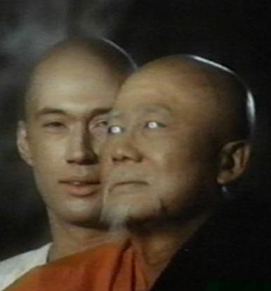
6:9-7:10
Chinese proverb ~ “You do not drown by falling in the water, you drown by staying there.”
Master Po
(Keye Luke, Kung Fu)

Slide 13
6:9-7:10

Slide 14
6:9-7:10
Heb. 5:11 ~ … of whom (Melchizedek) we have much to say, and hard to explain, since you have become
dull of hearing.
sluggish

Slide 15
6:9-7:10

Slide 16
6:9-7:10
Abraham born 2166 BC
Ishmael
born 2080 BC
Abraham (175 y/o)
dies 1991 BC
25 years
2150 BC
2100 BC
2050 BC
2000 BC
(Dates approximate)
Abraham given promise 2091 BC
Isaac born 2066 BC (Abraham 100 y/o)

Slide 17
6:9-7:10

Slide 18
6:9-7:10
Abraham meets Melchizedek
David prophesies of Jesus’ priesthood
Author shows prophecy fulfilled
2000 BC
1500 BC
1000 BC
500 BC
Gen. 4:18-24 Ps. 110:4 Heb. 5:5-11

Slide 19
6:9-7:10
Gen. 14:18 ~ Then Melchizedek king of Salem brought out bread and wine; he was the priest of God Most High.
Melchizedek ~ King of Righteousness
melek – king; tsedeq – righteousness
Salem ~ peace (shalom)
Uru-salim (City of Salem) in the tel Amarna letters

Slide 20
6:9-7:10
Chazalic Period
300 BC
BC/AD
AD 300
AD 600
Chazalim ~ acronym for “Our Sages, may their memory be blessed”
They believed Melchizedek was a nickname for Shem – Noah’s son

Slide 21
6:9-7:10
Theophany? ~ a pre-incarnate appearance of the Son
Often shown as
the Angel of the Lord
definite article
Malak
of the
Yahweh

Slide 22
6:9-7:10
Theophany? ~ a pre-incarnate appearance of the Son
Exodus 3:2 ~ And the Angel of the Lord appeared to him in a flame of fire from the midst of a bush. So he looked, and behold, the bush was burning with fire, but the bush was not consumed.
Exodus 3:4 ~ So when the Lord saw that he turned aside to look, God called to him from the midst of the bush and said, “Moses, Moses!”
And he said, “Here I am.”

Slide 23
6:9-7:10
Theophany? ~ a pre-incarnate appearance of the Son
Judges 6:11 ~ Now the Angel of the Lord came and sat under the terebinth tree which was in Ophrah, which belonged to Joash the Abiezrite, while his son Gideon threshed wheat in the winepress, in order to hide it from the Midianites.
Judges 6:14 ~ Then the Lord turned to him and said, “Go in this might of yours, and you shall save Israel from the hand of the Midianites. Have I not sent you?”

Slide 24
6:9-7:10
Theophany? ~ a pre-incarnate appearance of the Son
Abraham’s “Visitor” (Gen. 18), the burning bush (Ex. 3), the Captain of the Lord’s Army (Josh. 5), etc.

Slide 25
6:9-7:10
Theophany? ~ a pre-incarnate appearance of the Son
without father = apatōr
without mother = amētōr
without genealogy (or lineage) = agenealogētos
Phillips ~ He had no father or mother and no family tree.

Slide 26
6:9-7:10
Theophany? ~ a pre-incarnate appearance of the Son
Ezra 2:62 ~ These sought their listing among those who were registered by genealogy, but they were not found; therefore they were excluded from the priesthood as defiled.
He was “like” the Son of God
made like ~ aphomoioō – to make like, to assimilate closely

Slide 27
6:9-7:10

Slide 28
6:9-7:10
Priest

Slide 29
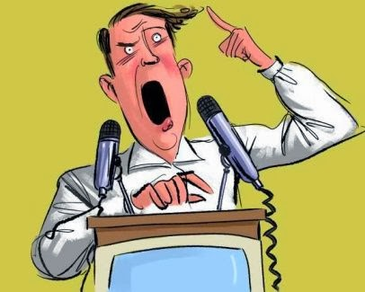
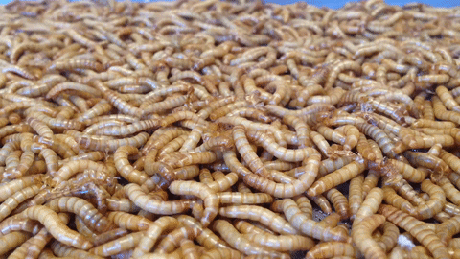
6:9-7:10

Slide 30
6:9-7:10
Jesus Christ
Priest

Slide 31
6:9-7:10

Slide 32
6:9-7:10
1 Peter 2:9-10 ~ ⁹ But you are a chosen generation, a royal priesthood, a holy nation, His own special people, that you may proclaim the praises of Him who called you out of darkness into His marvelous light; ¹⁰ who once were not a people but are now the people of God, who had not obtained mercy but now have obtained mercy.

Slide 33
6:9-7:10

