Slide 1

4:11-5:11

Slide 2




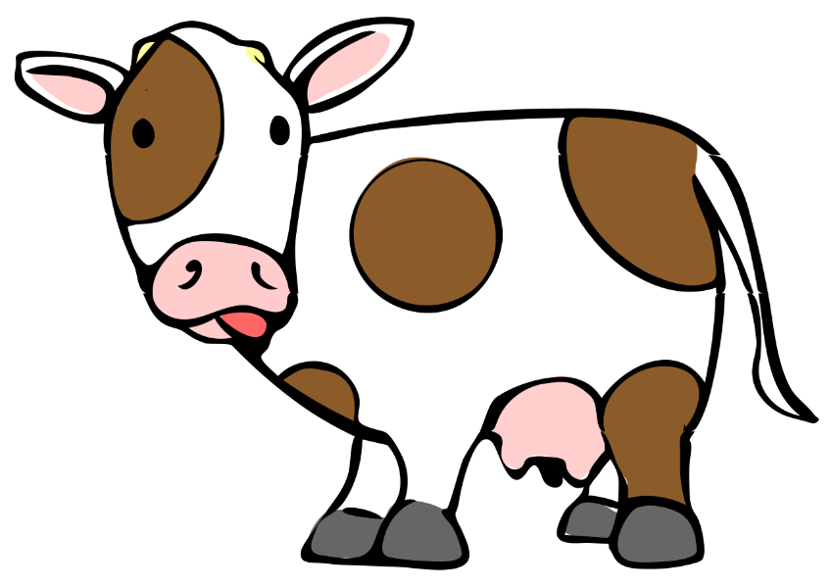
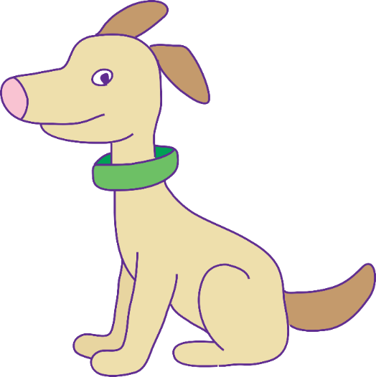

4:11-5:11
10
20
30
40
50
60
70
80

Slide 3

4:11-5:11

Slide 4
4:11-5:11
Hebrews 4:11–5:11 ~ ¹¹ Let us therefore be diligent to enter that rest, lest anyone fall according to the same example of disobedience. ¹² For the word of God is living and powerful, and sharper than any two-edged sword, piercing even to the division of soul and spirit, and of joints and marrow, and is a discerner of the thoughts and intents of the heart. ¹³ And there is no creature hidden from His sight, but all things are naked and open to the eyes of Him to whom we must give account.

Slide 5
4:11-5:11
Hebrews 4:11–5:11 ~ ¹⁴ Seeing then that we have a great High Priest who has passed through the heavens, Jesus the Son of God, let us hold fast our confession. ¹⁵ For we do not have a High Priest who cannot sympathize with our weaknesses, but was in all points tempted as we are, yet without sin. ¹⁶ Let us therefore come boldly to the throne of grace, that we may obtain mercy and find grace to help in time of need.
5:¹ For every high priest taken from among men is appointed for men in things pertaining to God, that he may offer both gifts and sacrifices for sins.

Slide 6
4:11-5:11
Hebrews 4:11–5:11 ~ ² He can have compassion on those who are ignorant and going astray, since he himself is also subject to weakness. ³ Because of this he is required as for the people, so also for himself, to offer sacrifices for sins. ⁴ And no man takes this honor to himself, but he who is called by God, just as Aaron was.
⁵ So also Christ did not glorify Himself to become High Priest, but it was He who said to Him:
“You are My Son,
Today I have begotten You.”

Slide 7
4:11-5:11
Hebrews 4:11–5:11 ~ ⁶ As He also says in another place:
“You are a priest forever
According to the order of Melchizedek”;
⁷ who, in the days of His flesh, when He had offered up prayers and supplications, with vehement cries and tears to Him who was able to save Him from death, and was heard because of His godly fear, ⁸ though He was a Son, yet He learned obedience by the things which He suffered. ⁹ And having been perfected, He became the author of eternal salvation to all who obey Him,

Slide 8
4:11-5:11
Hebrews 4:11–5:11 ~ ¹⁰ called by God as High Priest “according to the order of Melchizedek,” ¹¹ of whom we have much to say, and hard to explain, since you have become dull of hearing.

Slide 9
4:11-5:11

Slide 10
4:11-5:11
One Day – Wayne Watson
One day Jesus will call my name
As days go by I hope I don’t stay the same
I wanna get so close to Him
That it’s no big change
On that day when Jesus calls my name

Slide 11
4:11-5:11

Slide 12
4:11-5:11
diligent ~ KJV, labor – spoudazō

Slide 13
4:11-5:11

Slide 14


4:11-5:11
Word of God
judgment
grace

Slide 15
4:11-5:11
A. W. Tozer ~ “The love of Christ both wound and heals, it fascinates and frightens, it kills and makes alive, it draws and repulses. There can be nothing more terrible or wonderful than to be stricken with love for Christ so deeply that the whole being so out in a pained adoration of His Person, an adoration that disturbs and discontents while it purges and satisfies and relaxes the deep inner heart.”

Slide 16
4:11-5:11

Slide 17
4:11-5:11
overwhelmed …
If I ever feel
alone …
in despair …
Heb. 13:5b ~ For He Himself has said, “I will never leave you nor forsake you.”
John 14: 3 ~ “And if I go and prepare a place for you, I will come again and receive you to Myself; that where I am, there you may be also.”
John 16:33 ~ “These things I have spoken to you, that in Me you may have peace. In the world you will have tribulation; but be of good cheer, I have overcome the world.”

Slide 18
4:11-5:11

Slide 19
4:11-5:11
time of need ~ eukairos
eu ~ good, chairos ~ time
G. Campbell Morgan ~ “in the nick of time”
William Temple (1881-1944) ~ “The life of faith does not earn eternal life – it is eternal life. And Christ is its vehicle.”

Slide 20
4:11-5:11
1 Cor. 2:9-12 ~ ⁹ But as it is written:
“Eye has not seen, nor ear heard,
Nor have entered into the heart of man
The things which God has prepared for those who love Him.”
¹⁰ But God has revealed them to us through His Spirit. For the Spirit searches all things, yes, the deep things of God. ¹¹ For what man knows the things of a man except the spirit of the man which is in him?

Slide 21
4:11-5:11
1 Cor. 2:9-12 ~ Even so no one knows the things of God except the Spirit of God. ¹² Now we have received, not the spirit of the world, but the Spirit who is from God, that we might know the things that have been freely given to us by God.

Slide 22
4:11-5:11
boldly ~ literally, in the midst of every possible assurance
may ~ subjunctive mood (sometimes it indicates a “mood of possibility”)
“Let’s go obtain mercy”
“Maybe we will obtain mercy … maybe we won’t”
Merrihew Standard Version ~ Therefore (in light of Christ’s victory as our High Priest), let us go before throne of grace with complete confidence of our acceptance and let us receive the mercy and grace He offers at exact time we need it.

Slide 23
4:11-5:11
Sherry Standard Version ~ Let us boldly go before the throne of grace
… and promptly fall upon our face.

Slide 24
4:11-5:11

Slide 25
4:11-5:11
It takes more than
It takes a calling
being a good man to be a priest
education or money to be a priest
being in authority to be a priest

Slide 26
4:11-5:11
Warren Wiersbe ~ “You would think that one sinner would have compassion for another sinner, but this is not always the case. Sin makes a person selfish. Sin can blind us to the hurts of others. Sin can harden our hearts and make us judgmental instead of sympathetic. When King David was confronted with a story of a rich man’s sin, he had no sympathy for him, even though David himself was a worse sinner (2 Sam. 12).

Slide 27
4:11-5:11
Warren Wiersbe ~ “No, it is the spiritually minded person with a clean heart who sympathizes with a sinner and seeks to help him (see Gal. 6:1). Because we are so sinful, we have a hard time helping other sinners; but because Jesus is perfect, He is able to meet our needs after we sin.”

Slide 28
4:11-5:11

Slide 29
4:11-5:11
Acts. 13:30-33 ~ ³⁰ But God raised Him from the dead. ³¹ He was seen for many days by those who came up with Him from Galilee to Jerusalem, who are His witnesses to the people. ³² And we declare to you glad tidings— that promise which was made to the fathers. ³³ God has fulfilled this for us their children, in that He has raised up Jesus. As it is also written in the second Psalm:
“You are My Son,
Today I have begotten You.”

Slide 30
4:11-5:11
His High Priesthood was the result of His victory:
He suffered like no one has suffered
He was in all points tempted
He died like no one has died
He went from complete connection with to complete separation from the Father
He was raised like no one has been raised
He was the Firstfruits from the dead

Slide 31
4:11-5:11

Slide 32
4:11-5:11
Gen. 14:18 ~ Then Melchizedek king of Salem brought out bread and wine; he was the priest of God Most High.
king of “peace”
Melchizedek ~ melek – king; tsedeq – righteousness
King of Righteousness

Slide 33
4:11-5:11

Slide 34
4:11-5:11
What did He pray?
Was this prayer answered?
Matt. 26:39 ~ Oh, Father, if it is possible, let this cup pass from Me;
nevertheless, not as I will but as You will.

Slide 35
4:11-5:11

