Slide 1
3:14-4:10

Slide 2
3:14-3:10
Hebrews 3 ~ unbelief
Lack of rest
Hebrews 4 ~ disobedience
A. W. Tozer (Knowledge of the Holy) ~ “Unbelief is actually perverted faith, for it puts its trust, not in the living God but in dying men. The unbeliever denies the self-sufficiency of God and usurps attributes that are not his. This dual sin dishonors God and ultimately destroys the soul of man.”

Slide 3
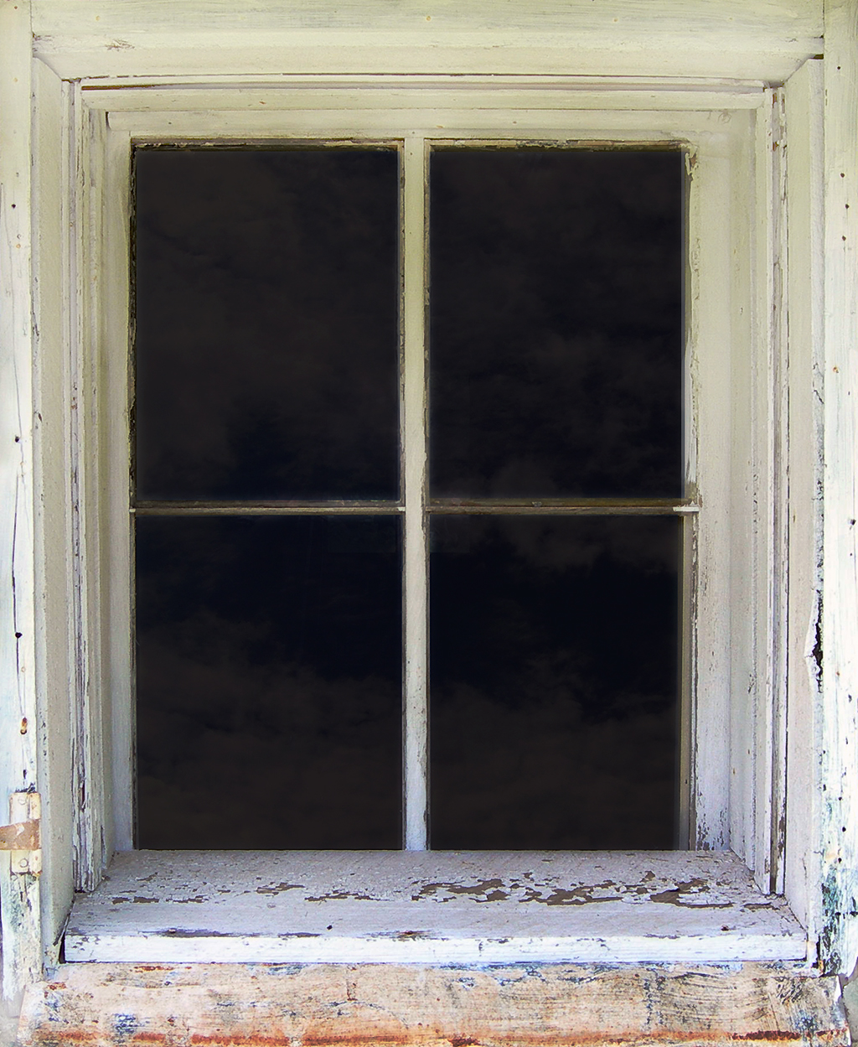
3:14-3:10
“When you come in to spank me, can you bring me a drink of water?”
“I’m thirsty. Can you bring me a drink of water?”
“I told you ‘NO.’ If you ask again, I’m gonna have to spank you!”
“I’m thirsty. Can I have a drink of water?”
“No. You had your chance. Lights out.”
“WHAT?”
“WHAT??!!”
“Da-ad”
“What?”
“Daa-aad?”
“Daaaa-aaaad?”

Slide 4
3:14-4:10

Slide 5
3:14-3:10
Heb. 3:14–4:10 ~ ¹⁴ For we have become partakers of Christ if we hold the beginning of our confidence steadfast to the end, ¹⁵ while it is said:
“Today, if you will hear His voice,
Do not harden your hearts as in the rebellion.”
¹⁶ For who, having heard, rebelled? Indeed, was it not all who came out of Egypt, led by Moses? ¹⁷ Now with whom was He angry forty years? Was it not with those who sinned, whose corpses fell in the wilderness? ¹⁸ And to whom did He swear that they would not enter His rest, but to those who did not obey?

Slide 6
3:14-3:10
Heb. 3:14–4:10 ~ ¹⁹ So we see that they could not enter in because of unbelief.
4:¹ Therefore, since a promise remains of entering His rest, let us fear lest any of you seem to have come short of it. ² For indeed the gospel was preached to us as well as to them; but the word which they heard did not profit them, not being mixed with faith in those who heard it. ³ For we who have believed do enter that rest, as He has said:
“So I swore in My wrath,
‘They shall not enter My rest,’ ”

Slide 7
3:14-3:10
Heb. 3:14–4:10 ~ although the works were finished from the foundation of the world. ⁴ For He has spoken in a certain place of the seventh day in this way: “And God rested on the seventh day from all His works”; ⁵ and again in this place: “They shall not enter My rest.”
⁶ Since therefore it remains that some must enter it, and those to whom it was first preached did not enter because of disobedience, ⁷ again He designates a certain day, saying in David, “Today,” after such a long time, as it has been said:

Slide 8
3:14-3:10
Heb. 3:14–4:10 ~ “Today, if you will hear His voice,
Do not harden your hearts.”
⁸ For if Joshua had given them rest, then He would not afterward have spoken of another day. ⁹ There remains therefore a rest for the people of God. ¹⁰ For he who has entered His rest has himself also ceased from his works as God did from His.

Slide 9
3:14-4:10

Slide 10
3:14-3:10
Five Warnings Passages in Hebrews:
1. Heb. 2:1-4
~ do not drift
2. Heb. 3:7-4:10
~ do not depart
3. Heb. 5:11-6:20
4. Heb. 10:26-39
5. Heb. 12:14-29

Slide 11
3:14-3:10
Hebrews 3:12 ~ Beware, brethren, lest there be in any of you an evil heart of unbelief in departing from the living God;
departing ~ aphistēmi – to go away from a place

Slide 12
3:14-4:10

Slide 13
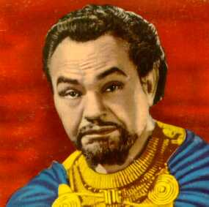
3:14-3:10
who ~ KJV, some
Edward G. Robinson as Dathan
in “The Ten Commandments”

Slide 14
3:14-4:10

Slide 15
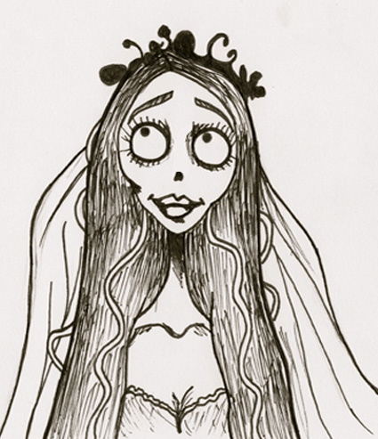
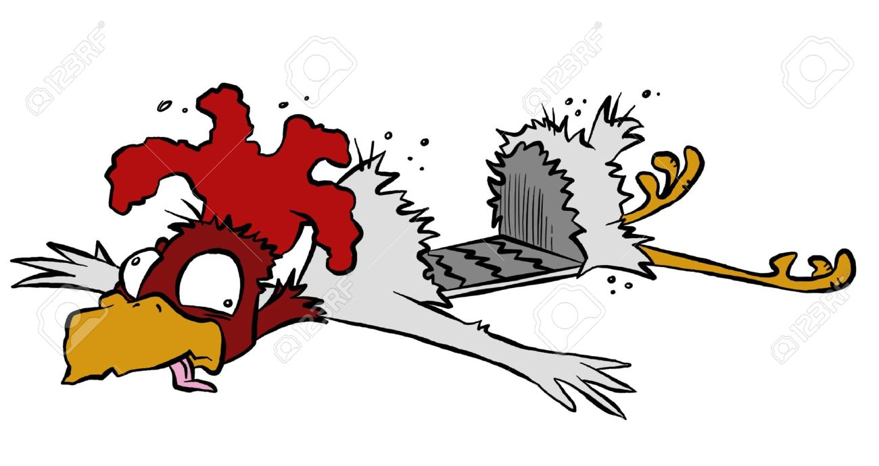
3:14-3:10
corpses ~ KJV, carcasses
Carcass
Corpse

Slide 16
3:14-4:10

Slide 17
3:14-3:10
(v. 16) who … rebelled
(v. 18) whom … would not enter His rest
(v. 17) whom … corpses fell
(v. 18) whom … would not enter His rest
(v. 17) whom … corpses fell

Slide 18
3:14-4:10

Slide 19
3:14-3:10
2 Cor. 12:10 ~ Therefore I take pleasure in infirmities, in reproaches, in needs, in persecutions, in distresses, for Christ’s sake. For when I am weak, then I am strong.

Slide 20
3:14-4:10

Slide 21
3:14-3:10
Rom. 5:1 ~ Therefore, having been justified by faith, we have peace with God through our Lord Jesus Christ …
Col. 3:15 ~ And let the peace of God rule in your hearts, to which also you were called in one body; and be thankful.
rule ~ to be an umpire
Phil. 3:14 ~ I press toward the goal for the prize of the upward call of God in Christ Jesus.

Slide 22
3:14-4:10

Slide 23
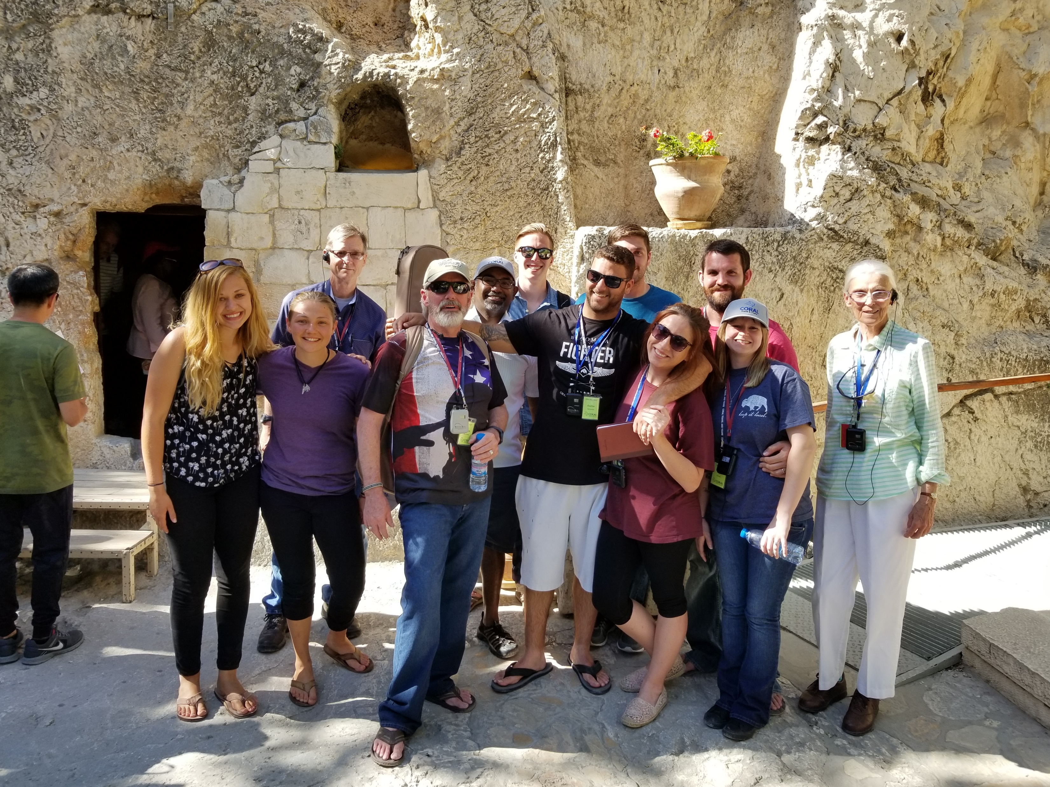
3:14-3:10
Garden Tomb

Slide 24
3:14-4:10

Slide 25
3:14-3:10
Exodus 17
Today
Today
Hebrews
4000
3000
2000
1000
BC - AD
1000
2000
Today
God rested on the 7th day
David
Today
Today
Me

Slide 26
3:14-4:10

Slide 27
3:14-3:10
Joshua ~ Iēsous – Jesus (KJV, some versions)
Rest ~ sabbatismos – a Sabbath observance (only here in New Testament)

Slide 28
3:14-4:10

Slide 29
3:14-3:10
Rom. 14:5-6a ~ ⁵ One person esteems one day above another; another esteems every day alike. Let each be fully convinced in his own mind. ^{6a} He who observes the day, observes it to the Lord; and he who does not observe the day, to the Lord he does not observe it.

Slide 30
3:14-4:10

Slide 31
3:14-3:10
3 hindrances to rest:
1) Presumption
2) Panic
3) Pride

Slide 32
3:14-4:10

