Slide 1
2:10-:3-13

Slide 2
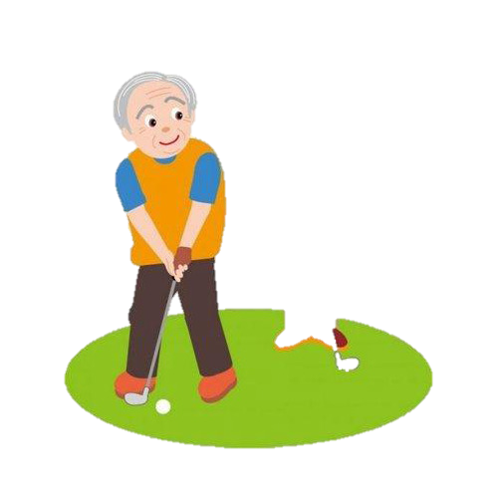
2:10-3:13
Me too.
Let’s get a coke.
No, it’s Thursday.
Windy today, isn’t it?

Slide 3
2:10-3:13
Hebrews 2:10–3:13 ~ ¹⁰ For it was fitting for Him, for whom are all things and by whom are all things, in bringing many sons to glory, to make the captain of their salvation perfect through sufferings. ¹¹ For both He who sanctifies and those who are being sanctified are all of one, for which reason He is not ashamed to call them brethren, ¹² saying:
“I will declare Your name to My brethren;
In the midst of the assembly I will sing praise to You.”
¹³ And again:
“I will put My trust in Him.”
And again:

Slide 4
2:10-3:13
Hebrews 2:10–3:13 ~ “Here am I and the children whom God has given Me.”
¹⁴ Inasmuch then as the children have partaken of flesh and blood, He Himself likewise shared in the same, that through death He might destroy him who had the power of death, that is, the devil, ¹⁵ and release those who through fear of death were all their lifetime subject to bondage. ¹⁶ For indeed He does not give aid to angels, but He does give aid to the seed of Abraham. ¹⁷ Therefore, in all things He had to be made like His brethren, that He might be a merciful and faithful High Priest in
Things pertaining to God,

Slide 5
2:10-3:13
Hebrews 2:10–3:13 ~ to make propitiation for the sins of the people. ¹⁸ For in that He Himself has suffered, being tempted, He is able to aid those who are tempted.
3:1-13 ~ ¹ Therefore, holy brethren, partakers of the heavenly calling, consider the Apostle and High Priest of our confession, Christ Jesus, ² who was faithful to Him who appointed Him, as Moses also was faithful in all His house. ³ For this One has been counted worthy of more glory than Moses, inasmuch as He who built the house has more honor than the house. ⁴ For every
house is built by someone, but He who built all
things is God.

Slide 6
2:10-3:13
Hebrews 2:10–3:13 ~ ⁵ And Moses indeed was faithful in all His house as a servant, for a testimony of those things which would be spoken afterward, ⁶ but Christ as a Son over His own house, whose house we are if we hold fast the confidence and the rejoicing of the hope firm to the end.
⁷ Therefore, as the Holy Spirit says:
“Today, if you will hear His voice,
⁸ Do not harden your hearts as in the rebellion,
In the day of trial in the wilderness,
⁹ Where your fathers tested Me, tried Me,
And saw My works forty years.

Slide 7
2:10-3:13
Hebrews 2:10–3:13 ~ ¹⁰ Therefore I was angry with that generation,
And said, ‘They always go astray in their heart,
And they have not known My ways.’
¹¹ So I swore in My wrath,
‘They shall not enter My rest.’”
¹² Beware, brethren, lest there be in any of you an evil heart of unbelief in departing from the living God; ¹³ but exhort one another daily, while it is called “Today,” lest any of you be hardened through the deceitfulness of sin.

Slide 8
2:10-3:13

Slide 9
2:10-3:13
“He who has an ear, let him hear what the Spirit says to the churches.” (2:7, 2:11, 2:17, 2:29, 3:6, 3:13 and 3:22)

Slide 10
2:10-3:13
You know what the
Now stay tuned for the rest of the story.
news is …
good news is …
Paul Harvey 1918-2009

Slide 11
2:10-3:13
“I’m Ready for the Rest of You”

Slide 12
2:10-3:13

Slide 13
2:10-3:13
peace God
of
But not the
with
(Phil. 4:7)
They have
(Rom. 5:1)

Slide 14
2:10-3:13

Slide 15
2:10-3:13
Captain ~ archēgos – pioneer, trail-blazer
archē ~ chief, prime (first in rank) leader
agō ~ to bring or to drive

Slide 16
2:10-3:13

Slide 17
2:10-3:13
Chapter 1 ~ Jesus’ superiority as the Son of Man
Chapter 2 ~ Jesus’ superiority as the Son of God
Chapter 3 ~ Jesus’ superiority over Moses

Slide 18
2:10-3:13

Slide 19
2:10-3:13
Consider ~ katanoeō – to observe fully
Apostle ~ apostolos – to be sent on a mission

Slide 20
2:10-3:13

Slide 21
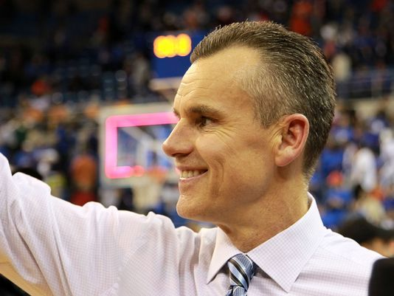
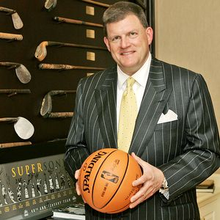
2:10-3:13
Billy Donovan
Coach
Nick Collison
Player
Clay Bennett
Owner

Slide 22
2:10-3:13

Slide 23
2:10-3:13
Psalms 95:6-7a ~ ⁶ Oh come, let us worship and bow down;
Let us kneel before the Lord our Maker.
^{7a} For He is our God,
And we are the people of His pasture,
And the sheep of His hand.

Slide 24
2:10-3:13

Slide 25
2:10-3:13
God ~ “Believe Me”

Slide 26
2:10-3:13

Slide 27
2:10-3:13
Ex. 17:7 ~ So he called the name of the place Massah and Meribah, because of the contention of the children of Israel, and because they tempted the Lord, saying, “Is the Lord among us or not?”
Massah (testing) and Meribah (strife, contention)

Slide 28
2:10-3:13

Slide 29
2:10-3:13
Harden ~ sklērunō – arterial sclerosis
Only shows in time of stress

Slide 30
2:10-3:13
Ex. 31:15-17 ~ ¹⁵ Work shall be done for six days, but the seventh is the Sabbath of rest, holy to the Lord. Whoever does any work on the Sabbath day, he shall surely be put to death. ¹⁶ Therefore the children of Israel shall keep the Sabbath, to observe the Sabbath throughout their generations as a perpetual covenant. ¹⁷ It is a sign between Me and the children of Israel forever; for in six days the Lord made the heavens and the earth, and on the seventh day He rested and was refreshed.

Slide 31
2:10-3:13

Slide 32
2:10-3:13
Departing ~ apostēnai
apo ~ away from; histēmi ~ to stand

Slide 33
2:10-3:13
Five Warnings Passages in Hebrews:
1. Heb. 2:1-4
~ do not drift
2. Heb. 3:7-4:1
~ do not depart
3. Heb. 5:11-6:20
4. Heb. 10:26-39
5. Heb. 12:14-29

Slide 34
2:10-3:13

Slide 35
2:10-3:13
Eph. 4:14-15 ~ ¹⁴ that we should no longer be children … ¹⁵ speaking the truth in love, may grow up in all things into Him who is the head — Christ,
Prov. 25:11-12 ~ ¹¹ A word fitly spoken is like apples of gold
In settings of silver.
¹² Like an earring of gold and an ornament of fine gold
Is a wise rebuker to an obedient ear.

Slide 36
2:10-3:13
Amy Carmichael ~ “If I can hurt another by speaking faithfully without much preparation of spirit, and without hurting myself far more than I hurt that other, then I know nothing of Calvary love.”
Prov. 18:1 ~ A man who isolates
himself seeks his own desire and rages against all sound judgment.

Slide 37
2:10-3:13

